Slide 1
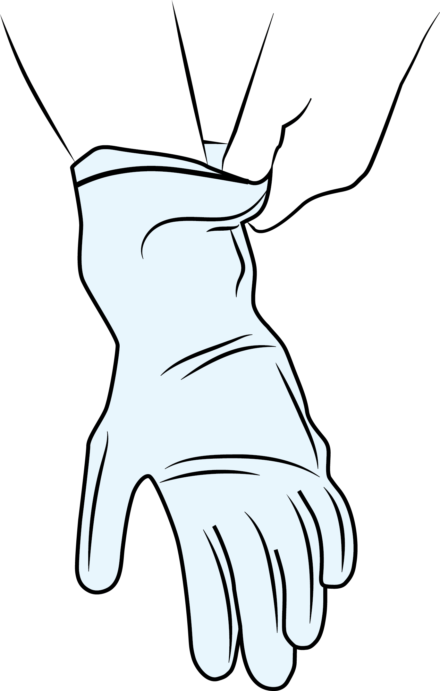

Gloves off:
Staff may not be wearing gloves when…
1
Taking your blood
2
Cleaning
the clinical
areas
3
Taking your blood pressure
4
Giving you injections -
antibiotics & vaccinations
5
Handing out your medication
6
Examining your general skin (not genitals)
7
Being your chaperone
8
8
Using a phone or computer
9
Staff will wash their hands between tasks which has been shown to be more hygienic
Gloves are the most common SINGLE USE PLASTIC items in healthcare.
Help us protect patients & the planet.
Notes:
HIV and Sexual Health OPD – patient facing

Slide 2
Gloves off:
You don’t have to wear gloves when…
1
2
Cleaning
the clinical
areas
3
Taking pulse & blood pressure
4
Drawing up antibiotics or giving injections
5
Handing out medication
Taking blood
6
Examining general skin (not genitals)
7
8
Using a phone or computer
9
Being a chaperone
8
Regular hand washing between tasks has been shown to be more hygienic
Gloves are the most common SINGLE USE PLASTIC items in healthcare.
Help us protect patients & the planet.
Notes:
HIV outpatients – staff facing

Slide 3
Gloves off:
You don’t have to wear gloves when…
1
2
Cleaning
clinical
areas
3
Reading microscopy
4
Drawing up antibiotics or giving injections
5
Handling clinic samples e.g. urine
Taking blood
6
General skin examination
(not genitals)
7
Regular hand washing between tasks has been shown to be more hygienic
Chaperoning
8
Using a phone or computer
9
Gloves are the most common SINGLE USE PLASTIC items in healthcare.
Help us protect patients & the planet.
Notes:
Sexual Health outpatients for staff

Slide 4
Gloves off:
Staff may not be wearing gloves when…
1
Taking your blood
2
Cleaning
the clinical
areas
3
Taking your blood pressure
4
Drawing up
IV meds & giving IM injections
5
Handing out your medication
Examining your general skin (not genitals)
8
6
7
Being
your chaperone
8
Staff will wash their hands between tasks which has been shown to be more hygienic
Using phones or computers
Testing your urine
9
10
Touching you
Gloves are the most common SINGLE USE PLASTIC items in healthcare.
Help us protect patients & the planet.
Notes:
Clinical Research – patient facing

Slide 5
Gloves off:
You don’t have to wear gloves when…
1
Taking blood
2
Checking blood pressure & temperature
3
Dispensing medications
4
Drawing up
IV meds & giving IM injections
5
Using a phone or computer
7
Chaperoning
7
Handing out hot drinks & meal trays
8
Bathing &
dressing
inpatients
Instead, regularly wash your hands between tasks
6
Pushing a chair, trolley or bed & mobilising a patient
Gloves are the most common SINGLE USE PLASTIC items in healthcare.
Help us protect patients & the planet.
Notes:
Inpatients staff facing (including taking blood)

Slide 6
Gloves off:
You don’t have to wear gloves when…
1
Taking blood
2
Handing out & collecting meal trays
3
Dispensing medications
4
Drawing up
IV meds & giving IM injections
5
Using a phone or computer
6
Making & handing out drinks
8
Bathing and
dressing
inpatients
9
Eye or ear care
Instead, regularly wash your hands between tasks
7
Chaperoning
7
Pushing a chair, trolley or bed & mobilising a patient
10
Touching a patient
Gloves are the most common SINGLE USE PLASTIC items in healthcare.
Help us protect patients & the planet.
Notes:
Inpatients staff facing with ALL icons including taking blood

