Slide 1
REMOVE THIS SLIDE BEFORE USE
These slides may be used as part of a training package for non-registered health professionals to dispense PrEP via PSD to patients who are already established on PrEP.
Please ensure that this training pathway has been approved within your local area before using it.
We recommend adding slides to reflect how to log and document on your specific EPR system, and the follow up process specific to your clinical area

Slide 2
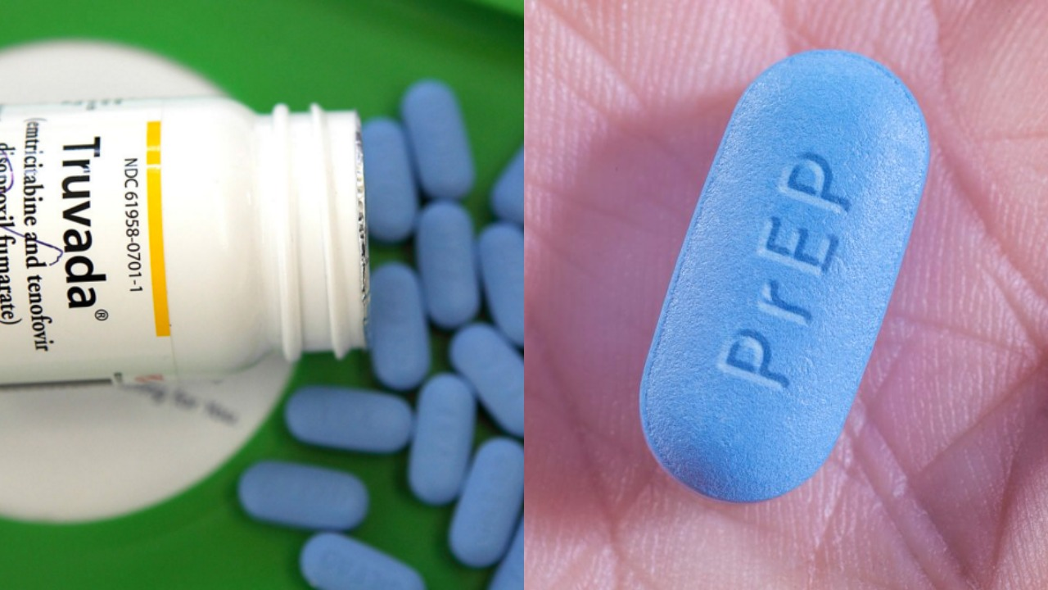
------------
Pre-Exposure Prophylaxis for HIV (PrEP)
Training for Clinic Support Workers

Slide 3
PrEP is a preventative medication taken to prevent HIV infection in people who may be at risk of contracting the infection.
The main PrEP medication used in the NHS is Emtricitabine and Tenofovir disproxil fumerate (Truvada)
Also available but less widely used is Tenofovir alafenamide/emtricitabine (Descovy)
Used correctly, PrEP is 99% effective at preventing HIV

Slide 4
Who is PrEP recommended for?

Slide 5



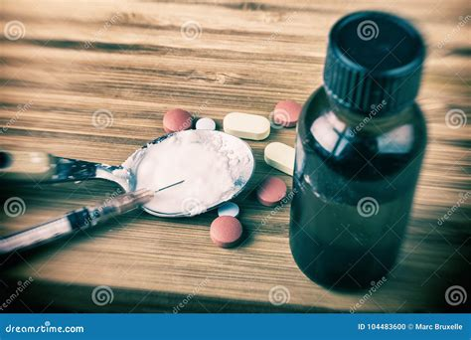

- GBMSM and Trans Women.
- HIV Negative people having sex with PLWHIV who are not undetectable
Recommended:
MSM and trans women who report condomless anal sex in the previous 6 months and on-going condomless anal sex.
HIV-negative individuals having condomless sex with partners who are living with HIV and not yet undetectable
Population level indicators
Sexual behaviours/networks
Population level indicators
Drug use
Sexual Autonomy

Slide 6
- GBMSM and Trans Women.
- HIV Negative people having sex with PLWHIV who are not undetectable
Consider:
People travelling to high prevalence countries likely to have unprotected sex.
Partners of people from high prevalence countries where an ongoing risk exists
Population level indicators
Sexual behaviours/networks
Drug use
Sexual Autonomy

Slide 7
- GBMSM and Trans Women.
- HIV Negative people having sex with PLWHIV who are not undetectable
Consider:
-People engaging in group sex.
-People in polyamorous relationships
-People in non-monogamous relationships
-People with a partner also having MSM sex
Population level indicators
Sexual behaviours/networks
Drug use
Sexual Autonomy

Slide 8
- GBMSM and Trans Women.
- HIV Negative people having sex with PLWHIV who are not undetectable
Consider:
-People engaging in chemsex (drug use in a sexual context)
Population level indicators
Sexual behaviours/networks
Not recommended:
-People injecting drugs with no sexual contact
Drug use
Sexual Autonomy

Slide 9
- GBMSM and Trans Women.
- HIV Negative people having sex with PLWHIV who are not undetectable
Consider:
- People engaged in commercial or transactional sex work
People in abusive relationships
People with concerns about their partner’s fidelity (if having sex with people from high prevalence groups)
Population level indicators
Sexual behaviours/networks
Drug use
Sexual Autonomy

Slide 10
What is PrEP?
How do you take PrEP?

Slide 11
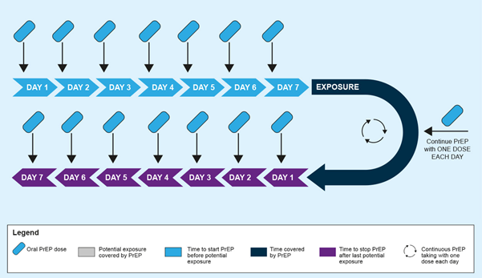
Daily Dosing
Daily Dosing Time to effectiveness:
For Anal Sex – 24 hours (if single tablet taken)
For Vaginal Sex – 7 days (7 tablets)
Stopping Daily Dosing
For Anal Sex – 48 hours (2 tablets after sex)
For Vaginal Sex – 7 days (7 tablets)
Missed doses
For Anal Sex – 3 in 7 days
For Vaginal Sex – >48 hour gap

Slide 12
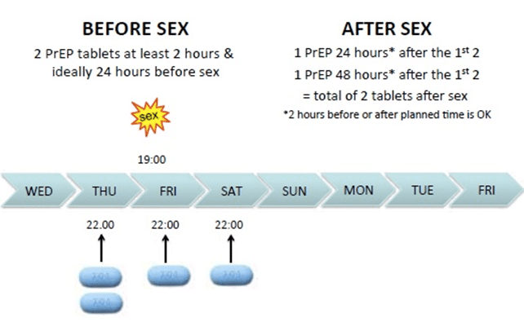
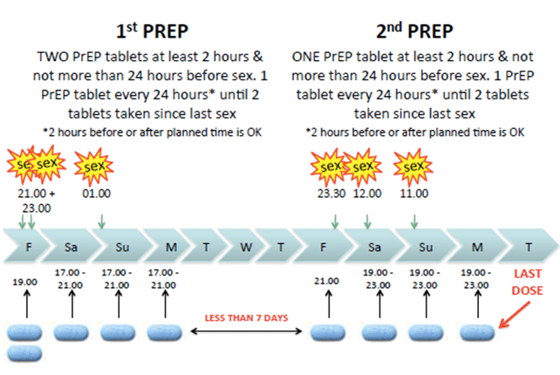
Event based dosing

Slide 13
Event based dosing
Event based dosing only suitable for MSM:
PrEP takes up to 2 hours to reach a protective concentration in the anal tissue.
It takes up to 7 days to reach a protective concentration in the vaginal tissue (So EBD not suitable for vaginal or frontal sex)

Slide 14
Month 0/12
Month 3
Month 6
Month 9
Full screen
Renal Function Checks
Hepatitis C
Check adherence
Give 6 months PrEP
Sexual health screen (either in person or home screening)
Full Screen
Check adherence
Renal Checks if >40 or renal risks
Medical hx ?changes
Give 6 months PrEP
Hep C (if chems/fisting/group sex)
Medical hx ? changes
Sexual health screen (either in person or home screening)
PrEP
Cycle
Renal Risks include:
Kidney disease
Hypertension
Diabetes
EGFR <90 at baseline

Slide 15
Inclusion Criteria for continuation of PrEP by Clinic Support Workers
Has attended clinic or completed home test within last 3-4 months
All results within acceptable range
No untreated STIs
Asymptomatic
Ongoing sexual risk
Good adherence to PrEP
Attending for PrEP management only (asymptomatic, no outstanding treatment or support needs)
No drug interactions
No new diagnoses/medical problems

Slide 16
Exclusion Criteria: continuing PrEP
With Clinic Support Worker
Consent not given (or no capacity).
Under 18
Unable to adhere
Not attended for testing in last 6 months
Allergy or hypersensitivity to PrEP treatment
No longer meeting inclusion criteria for risk
Viral infection symptoms on day of attending (fever, rash, feeling flu-like)
Have been diagnosed with HIV
EGFR <60ml/min
Creatinine >100
Pregnant or breastfeeding
Change to medical history
Taking medicines that interact (Check new medications)
Any patient excluded should be referred to a senior member of staff

Slide 17
Patient attends requesting to continue PrEP
Do they meet criteria for PrEP by PSD?
Yes
No
Yes
Refer to senior Clinician
No
Adherent to PrEP? (No missed doses on EBP)
Asymptomatic?
Most recent results negative
Same medical/ Medication History?
Yes
Yes
Full Sexual Health Screen
Creatinine and UPCR if indicated (every 6 months if over 40 or renal risk, every year if under 40 and no renal risk
A doctor or NMP reviews the patient's records and completes a PSD in the patient notes if in agreement with the assessment
Complete and label prescribed supply of PrEP: Ensure patient details and date prescribed is clearly documented
Explain relevant information including reminding how to take, when to seek advice, and what to do if misses a dose. Arrange follow up as appropriate. Document on EPR

Slide 18
Before seeing patient:
Check results (if any positive untreated ref to HA)
Check last renal tests (if any abnormal ref to senior)
Check if vaccines due (if so refer to nurse)
Check when last prescription given and how much
When seeing patient:
Check medical history
Check drug history (including over the counter/recreational/supplements)
Check adherence
Sexual history
Management of patient:
Full SHS
Prescription for 6 months PrEP
Renal tests if needed
Book 3/12 check up if not having home screening kit

Slide 19
Diagnosed with HIV
Unstable adherence and risk (sex not protected with PrEP)
eGFR below 60mL/min/1.73 m2
Intolerable side effects
Does not meet inclusion criteria
Don’t give

Slide 20
Diagnosed with HIV
Unstable adherence and risk (sex not protected with PrEP)
eGFR below 60mL/min/1.73 m2
Intolerable side effects
Does not meet inclusion criteria
Don’t give
New medications
New medical diagnosis
Renal risks identified (Hypertension, diabetes)
Bone risks identified (Osteoporosis, osteopenia)
Pregnant or breastfeeding
Rise in creatinine/fall in eGFR above <60mL/min/1.73 m2
Untreated STI
Side effects
Check with Senior

Slide 21
Diagnosed with HIV
Unstable adherence and risk (sex not protected with PrEP)
eGFR below 60mL/min/1.73 m2
Intolerable side effects
Does not meet inclusion criteria
Don’t give
New medications
New medical diagnosis
Renal risks identified (Hypertension, diabetes)
Bone risks identified (Osteoporosis, osteopenia)
Pregnant or breastfeeding
Rise in creatinine/fall in eGFR above <60mL/min/1.73 m2
Untreated STI
Side effects
Check with senior
Attending regularly
No changes to health/medication history
No concerns from patient
OK to give

