Slide 1
Management of Mycoplasma genitalium (Mgen)
BASHH National Clinical Audit 2022

Slide 2
Background and aim
Introduction of NAAT test for Mgen
BASHH Mgen guideline December 2018: objectives included to assist “in making the case for funding” for testing
Audit aim:
To assess adherence to this guideline and current use of Mgen testing
Originally planned for early 2021 – postponed due to pandemic

Slide 3
Methods
Survey of local arrangements for Mgen management, to be completed once for every level 3 STI service
Case-note review of the last 40 adults (16 or over) at each service with a positive Mgen NAAT between 1 July 2021 and 30 June 2022, or all if fewer than 40
Data collection: September-November 2022
NB: services with no access to Mgen testing, or no positive tests, could not participate in the case-note review

Slide 4
Clinic survey
140 responses

Slide 5
Access to Mgen NAAT and resistance testing
 | Number of services | % of services
Able to test for Mgen whenever deemed clinically indicated | 118 | 84.3
Some access to Mgen testing but cannot test in all circumstances where clinically indicated | 18 | 12.9
Do not have access to Mgen testing (eg would need to refer elsewhere) | 4 | 2.9
Of 136 services with at least some access to Mgen NAAT:
66 (48.5%) accessed this via a local laboratory, 63 (46.3%) via a national/regional laboratory, and 7 (5.1%) selected “other”
112 (82.4%) reported access to testing for macrolide-resistance mediating mutations, 16 (11.8%) reported no access, and 8 (5.9%) were unsure

Slide 6
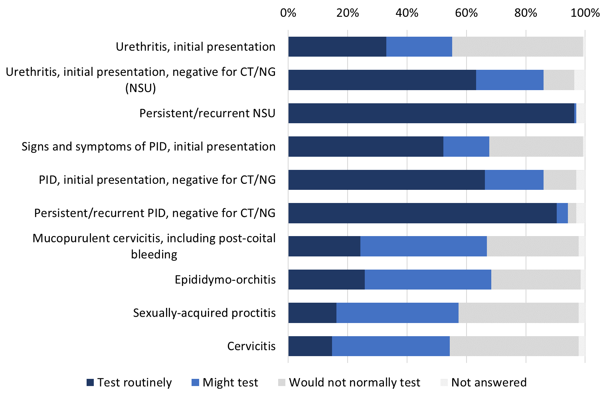
Use of Mgen test, among services with access

Slide 7
Management of sexual partners of confirmed Mgen, among services with access to test
 | Number | %
Test for Mgen | 68 | 50.0
Test for Mgen plus empirical treatment while awaiting results | 52 | 38.2
It varies | 15 | 11.0
Not answered | 1 | 0.7

Slide 8
Management at 4 services with no access to Mgen NAAT testing
Suspected Mgen:
All four services would treat empirically
Partner of confirmed Mgen:
Two services would refer elsewhere for management
Two services would treat empirically

Slide 9
Empirical treatment for Mgen
56 services said they use empirical treatment in some cases (including while awaiting test results for partners):
53 (94.6%) use doxycycline 100 mg bd for seven days followed by azithromycin 1 g orally then 500 mg orally od for two days
1 (1.8%) use moxifloxacin 400 mg orally once daily for ten days
1 (1.8%) said they use the same treatment as for the index case
1 (1.8%) did not answer

Slide 10
Case-note review
2885 individuals from 149 services

Slide 11
Characteristics of audited individuals
Current gender | Number | %
Male (including 8 trans) | 1699 | 58.9
Heterosexual | 1387 | 48.1
Gay/MSM | 260 | 9.0
Bisexual | 46 | 1.6
Not stated/not answered | 6 | 0.2
Female (including 9 trans) | 1156 | 40.1
Non-binary or other | 2 | 0.1
Not stated | 1 | 0.0
Not answered | 27 | 0.9
Total | 2885 | 100.0
Age | Number | %
16-19 | 207 | 7.2
20-24 | 873 | 30.3
25-29 | 774 | 26.8
30-34 | 458 | 15.9
35 or older | 560 | 19.4
Not recorded/not answered | 13 | 0.5
Total | 2990 | 100.0

Slide 12
Characteristics, continued
Ethnic group | Number | %
White | 1862 | 64.5
A British | 1632 | 56.6
B Irish | 16 | 0.6
C Any other White background | 214 | 7.4
Mixed/Multiple | 182 | 6.3
D White and Black Caribbean | 76 | 2.6
E White and Black African | 41 | 1.4
F White and Asian | 17 | 0.6
G Any other mixed background | 48 | 1.7
Asian/Asian British | 99 | 3.4
H Indian | 23 | 0.8
J Pakistani | 33 | 1.1
K Bangladeshi | 8 | 0.3
L Any other Asian background | 35 | 1.2
Black/Black British | 419 | 14.5
M Caribbean | 167 | 5.8
N Black or Black British African | 195 | 6.8
P Any other Black background | 57 | 2.0
R Chinese | 13 | 0.5
S Any other ethnic group | 72 | 2.5
Z Not stated | 236 | 8.2
Not answered | 2 | 0.1
Total | 2990 | 100.0

Slide 13
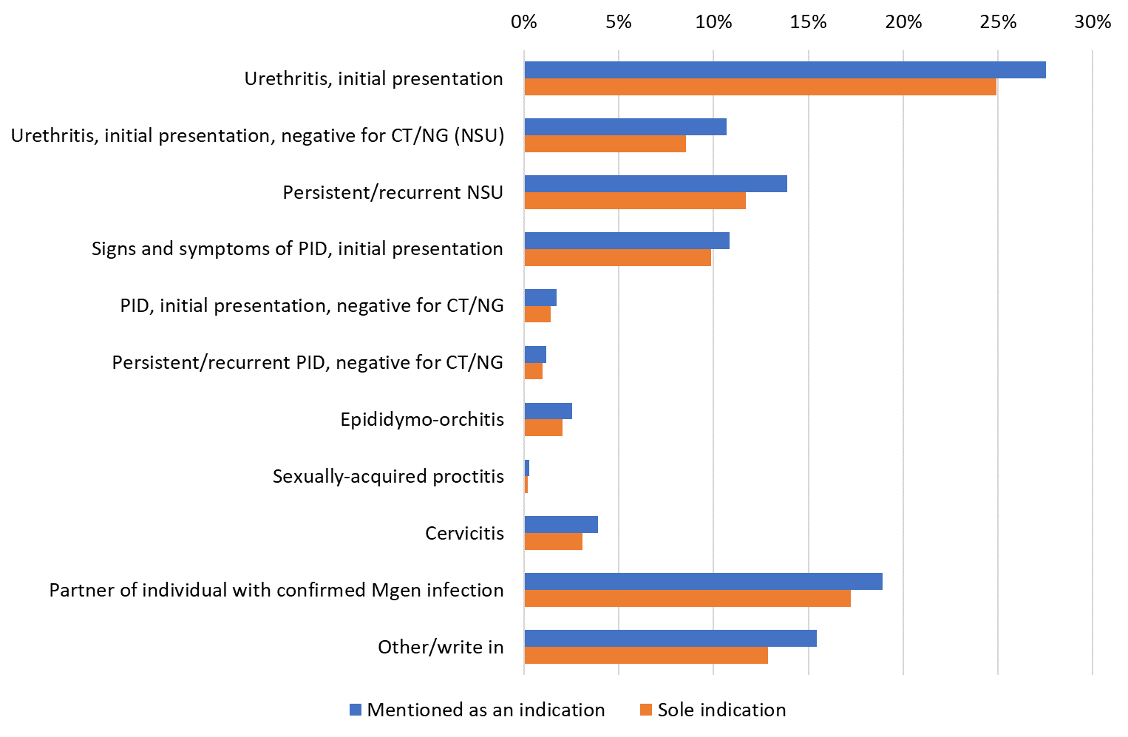
Indications for first use of Mgen test during relevant episode of care among audited individuals

Slide 14
Resistance testing
Guideline recommends that, where possible, all Mgen-positive specimens should be tested for macrolide resistance-mediating mutations
 | Number (%) of audited individuals | Among whom, number (%) with detected resistance mutations
Done at time of initial diagnosis | 1580 (54.8) | 759 (48.0)
Done after initial diagnosis | 192 (6.7) | 115 (59.9)
Total for whom resistance test done | 1772 (61.4) | 874 (49.3)
Resistance test not available | 168 (5.8) | NA
Not done | 880 (30.5) | NA
Not reported/not answered | 65 (2.3) | NA

Slide 15
Treatment of Mgen
Treatment given | Number (%) of audited individuals
Doxycycline 100 mg bd for seven days followed by azithromycin 1 g orally then 500 mg orally od for two days | 1913 (66.3)
Moxifloxacin 400 mg orally once daily for ten days | 838 (29.0)
Moxiﬂoxacin 400 mg orally once daily for 14 days | 238 (8.2)
No treatment | 66 (2.3)
More than one regimen could be selected
Reason if treatment given other than or in addition to doxycycline/azithromycin | Number (%) of audited individuals
Previous treatment with azithromycin failed | 124 (4.3)
Suspected macrolide resistance | 121 (4.2)
Macrolide resistance confirmed by testing | 634 (22.0)
Complicated Mgen infection | 93 (3.2)
Other concurrent infection(s) in addition to Mgen | 30 (1.0)
More than one reason could be selected

Slide 16
Test of cure
Auditable outcome in guideline: TOC at least ﬁve weeks (and no sooner than three weeks) after start of treatment
 | Number (%) of audited individuals
TOC done | 1625 (56.3)
Not done because of pandemic-related service restrictions | 16 (0.6)
Not done for other reasons | 969 (33.6)
Not recorded | 255 (8.8)
Not answered | 20 (0.7)

Slide 17
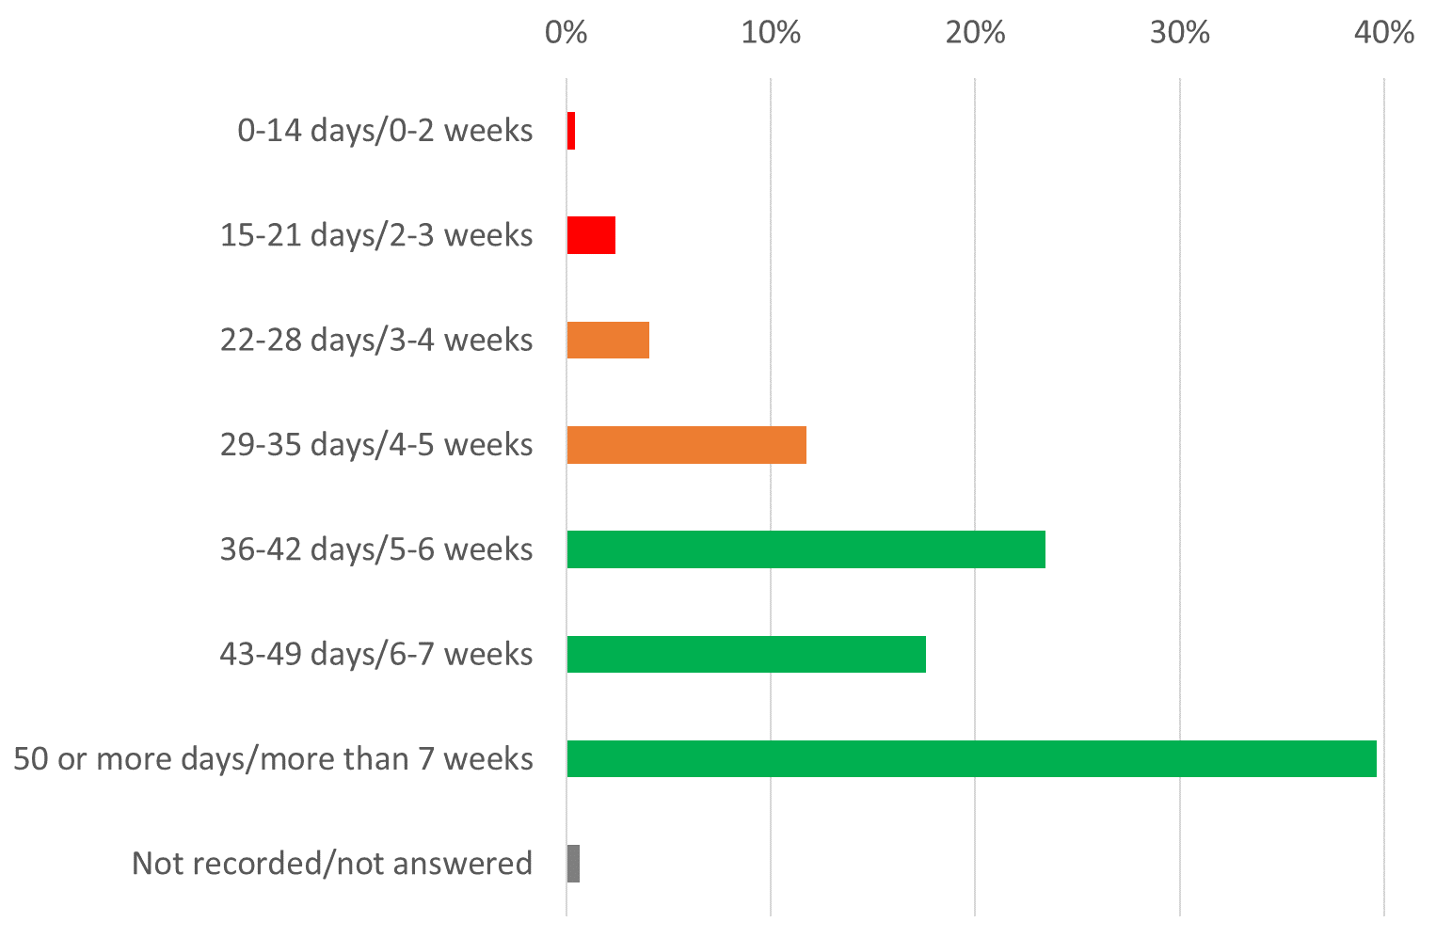
Timing of first TOC after start of treatment, among individuals for whom this was reported as done

Slide 18
Outcome of TOC
Time from start of treatment | Mgen detected, number (%) | Equivocal, number (%) | Mgen not detected – treatment successful, number (%) | Not recorded/ not answered, number (%)
0-3 weeks (N=46) | 14 (30.4) | 0 (0.0) | 31 (67.4) | 1 (2.2)
3-5 weeks (N=257) | 62 (24.1) | 0 (0.0) | 190 (73.9) | 5 (1.9)
Over 5 weeks (N=1311) | 266 (20.3) | 8 (0.6) | 1020 (77.8) | 17 (1.3)
Not reported (N=11) | 3 (27.3) | 0 (0.0) | 6 (54.5) | 2 (18.2)
All TOC (N=1625) | 345 (21.2) | 8 (0.5) | 1247 (76.7) | 25 (1.5)
66 (19.1%) cases with Mgen detected at TOC were attributed to re-infection
307 (89.0%) cases with Mgen detected at TOC received further treatment

Slide 19
Reporting of treatment failure
Auditable outcome in guideline: Confirmed treatment failure by positive TOC should be reported to PHE (now UKHSA)
Of 147 individuals with Mgen detected at TOC more than 5 weeks after start of treatment, and not attributed to re-infection or non-adherence, from services in England:
6 (4.1%) were reported to PHE/UKHSA
83 (56.5%) were not
58 (39.5%) respondent was unsure or did not answer

Slide 20
Partner notification
Auditable outcome in guideline: PN should be performed and documented according to the BASHH statement (performance standard 97%)
 | Number (%) of audited individuals
PN was discussed | 2608 (90.4)
Not discussed | 96 (3.3)
Not recorded | 147 (5.1)
Not answered | 34 (1.2)

Slide 21
Provision of written information
Auditable outcome in guideline: Individuals should be provided with written information about their diagnosis and management (performance standard 97%)
 | Number (%) of audited individuals
Done | 1075 (37.3)
Not done | 667 (23.1)
Not recorded | 1113 (38.6)
Not answered | 30 (1.0)

Slide 22
SHHAPT coding
Auditable outcome in guideline: New Mgen cases should have SHHAPT code C16 submitted to GUMCAD (performance standard 97%).
 | Number (%) of audited individuals from services in England (N=2758)
Done | 2565 (93.0)
Not required because not a new diagnosis – previously submitted | 4 (0.1)
Not done | 141 (5.1)
Not recorded | 32 (1.2)
Not answered | 16 (0.6)
This may represent a best-case scenario as some services might have used SHHAPT code C16 as the basis for identifying individuals for inclusion in the audit

Slide 23
Conclusions
Summary of findings

Slide 24
Access to and use of Mgen testing
Guideline recommends: Test for Mgen in all males with NGU, in all individuals with signs and symptoms of PID, and current sexual partners of persons infected with Mgen
84.3% of services reported being able to access Mgen testing whenever clinically indicated
However among services with access to testing, only 63.2% and 52.2% routinely test for NSU and for signs and symptoms of PID respectively

Slide 25
Other auditable outcomes and recommendations in guideline
Resistance testing was done for 61.4% of individuals (54.8% at time of diagnosis)
49.3% of resistance tests showed macrolide-resistance mediating mutations
Treatment appeared broadly consistent with guideline
TOC was done for 56.3% of individuals, usually more than 5 weeks from start of treatment
2.8% of first TOC were done earlier than 3 weeks, contrary to guideline
Failure of treatment was rarely reported to UKHSA

Slide 26
Other auditable outcomes and recommendations in guideline, continued
PN was discussed for 90.4% of individuals: 97% standard not met
Provision of written information was done for 37.3% of individuals, not done for 23.1% and not recorded for 38.6%: 97% standard not met
SHHAPT code C16 was submitted to GUMCAD for 93.0% of individuals in England (not required for 0.1%): 97% standard not met

Slide 27
Acknowledgements
Thank you to everyone who participated in the audit
National Audit Group: V Apea (chair), A Blume, H Bradshaw, E Buitendam, H Curtis (co-ordinator), S Davies, L Goodall, E McCarty, R Metcalfe, K Michie, R Omer, N Pal, K Phyu, D Raha, M Ramogi, J Saunders, C Slater, A Sullivan, M Symonds, S Thomas, K Verma, R Viney, H Wallace, S Warren, H Wiggins

