Slide 1

HIV Partner Notification (PN)
2018 audit against 2015 standards
Presented by Vanessa Apea
Written by Lauren Bull and Hilary Curtis
on Behalf of the Bashh National Audit Group
Joint BHIVA/BASHH Spring Conference
April 2018

Slide 2
Background: 2013 audit
2013 joint BASHH/BHIVA audit of HIV PN¹:
2964 index cases diagnosed during 2011
PN highly effective for diagnosing HIV:
  20.9% prevalence among tested contacts
  1 new diagnosis per 10 index cases
But, wide variation, inconsistent definitions, lack of clarity
Uncertainty re how to report contacts whose status already known
1. Rayment M et al. Sex Transm Infect 2016;0:1–6. doi:10.1136/sextrans-2015-052532

Slide 3
Background: Standards
HIV Partner Notification for Adults: Definitions, Outcomes and Standards (NAT, BASHH, SSHA, BHIVA 2015) defines contacts as:
Status known: known positive, known negative (test 4w+ post last exposure), or deceased
Status unknown contactable: means of contact available, or able to be “found” via past service attendance
Status unknown uncontactable: no means of contact

Slide 4
Outcomes flow chart
Index cases
Denominator for outcome 1
All contacts
Status unknown, uncontactable (no action possible)
Status known (no action necessary)
Status unknown, contactable
+
Denominator for outcome 2
Positive
Tested, verified by HCW
Tested, reported by index case
Notified, unknown if tested
Not
notified
Negative
Deceased
PN outcome successful

Slide 5
Standards: Outcome 1
Contacts tested per index case, at 3 months:
Definition:
  Numerator: Status known contacts + status unknown contactable contacts who are tested
  Divided by denominator: Number of index cases
Standard:
  Verified by HCW: 0.6
  Index reported or verified by HCW: 0.8

Slide 6
Standards: Outcome 2
Proportion of contactable contacts who are tested, at 3 months:
Definition:
  Numerator: Status known contacts + status unknown contactable contacts who are tested
  Divided by denominator: Status known contacts + status unknown contactable contacts
Standard:
  Verified by HCW: 65%
  Index reported or verified by HCW: 85%

Slide 7
Standards: Outcomes 3 & 4
Outcome 3: Index cases with a documented PN plan within 4 weeks of diagnosis:
Standard: 97%
Outcome 4: Index cases with documented PN discussion at diagnosis to identify risk contact within previous 72 hours and refer partners potentially eligible for PEP:
Standard: 97%

Slide 8
2018 BASHH audit
Survey about clinic’s role in HIV PN
Case-note review of last 40 adult (16+) index cases diagnosed with HIV during 2016 or 2017 at each clinic, or all if <40
All BHIVA HIV services invited to participate as well as those regularly participating in BASHH audits

Slide 9
Site survey

Slide 10
Site characteristics
Total responses | 149 (100%)
Provide ongoing HIV treatment/care Provide HIV testing but not ongoing treatment/care | 123 (82.6%) 26 (17.4%)
Provide HIV PN HIV PN provided elsewhere Other arrangement | 131 (87.9%) 8 (5.4%) 10 (6.7%)
HIV PN included in contract/formal agreement: Yes, this clinic, in service spec Yes, another service | 114 (76.5%) 9 (6.0%)
HIV PN provided in accordance with 2015 Standards: Yes, this clinic Yes, another service | 114 (76.5%) 11 (7.4%)

Slide 11
Case-note review
Adults (16+) diagnosed with HIV during 2016 or 2017

Slide 12
Demographics
 |  | Number (%)
Total |  | 2755 (100)
Male |  | 2139 (77.6)
 | MSM | 1474 (53.5)
 | Heterosexual | 517 (18.8)
 | IDU | 22 (0.8)
 | Other | 42 (1.5)
 | Not known/not answered | 84 (3.0)
Female |  | 598 (21.7)
 | Heterosexual | 564 (20.5)
 | IDU | 8 (0.3)
 | Other | 7 (0.3)
 | Not known/not answered | 19 (0.7)
Trans or non-binary |  | 13 (0.5)
 | MSM | 6 (0.2)
 | Heterosexual | 5 (0.2)
 | Other | 2 (0.1)
Not stated |  | 5 (0.2)
 | MSM | 5 (0.2)
 |  | Number (%)
Total |  | 2755 (100)
Ethnicity White |  | 1800 (65.3)
Black African |  | 401 (14.6)
Other |  | 482 (17.5)
Not stated |  | 72 (2.6)
Age 16-29 |  | 746 (27.1)
30-49 |  | 1405 (51.0)
>50 |  | 557 (20.2)
Not stated |  | 47 (1.7)

Slide 13
Prior HIV testing history
 | All index cases | M MSM | M het | F het
Previous negative test for HIV: At any time During 2015-17 | 53.9% 28.7% | 68.8% 43.1% | 32.3% 10.8% | 39.5% 12.1%
Likely recent infection, within 6 months | 20.9% | 29.8% | 11.6% | 10.1%

Slide 14
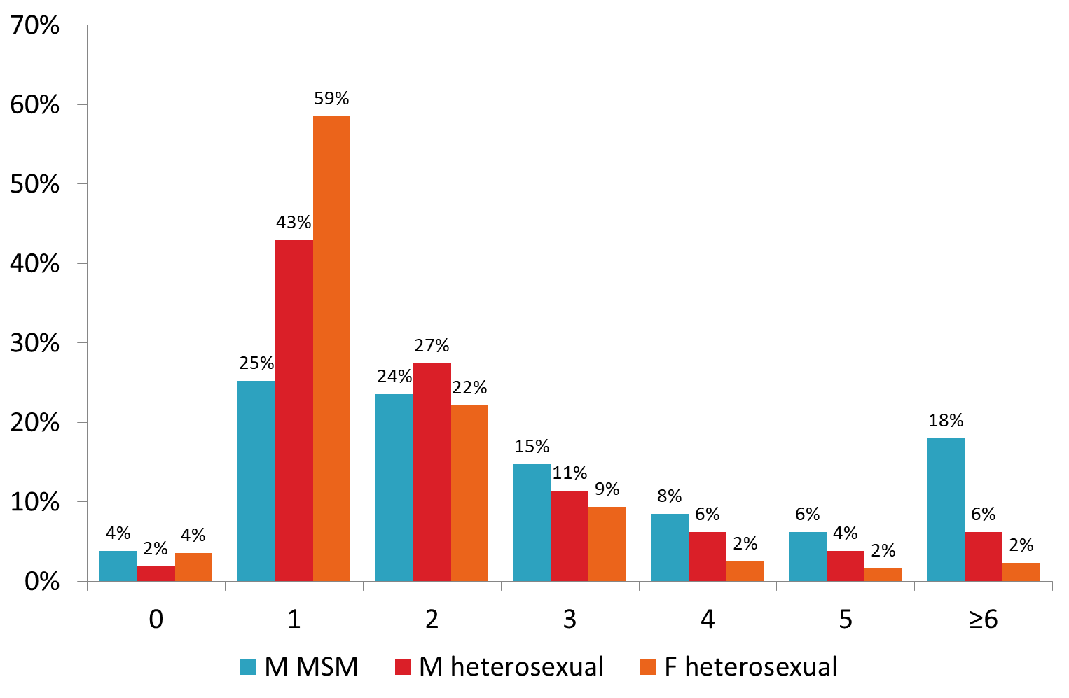
Total contacts per index case

Slide 15
Outcome 1
Number of contacts tested per index case
Relevant contacts per index case | All index cases | M MSM | M het | F het
Status known | 0.67 | 0.72 | 0.58 | 0.62
Status unknown contactable | 0.74 | 0.93 | 0.55 | 0.50
Status unknown contactable, HCW verified tested | 0.23 | 0.25 | 0.22 | 0.18
Status unknown contactable, index reported tested | 0.13 | 0.17 | 0.09 | 0.08
Tested*: HCW verified (standard 0.6) | 0.9 | 0.98 | 0.80 | 0.80
Tested*: index reported or HCW verified (standard 0.8) | 1.03 | 1.15 | 0.89 | 0.88
*Tested = status known + tested status unknown contactable

Slide 16
Outcome 2
Proportion of contactable partners who have been tested
 | All index cases | M MSM | M het | F het
Proportion of contactable contacts tested*: HCW verified (standard 65%) | 63.6% | 59.0% | 70.9% | 71.1%
Proportion of contactable contacts tested*: index reported or HCW verified (standard 85%) | 72.8% | 69.2% | 79.1% | 78.2%
*Tested, ie numerator = status known + tested status unknown contactable Denominator = status known + status unknown contactable

Slide 17
Outcome 3:
PN plan documented within 4 weeks (standard 97%)
 | All index cases | M MSM | M het | F het
With PN plan | 80.4% | 81.4% | 79.9% | 79.3%
With PN plan and/or *PN resolved | 93.5% | 93.6% | 94.2% | 93.6%
*PN resolved: ie total contacts ≥1, indicating PN initiated AND all status unknown contactable contacts tested (verified or reported) so no further action needed.

Slide 18
Outcome 4:
PN discussion at diagnosis re: PEP eligibility of contacts (standard 97%)
 | All index cases | M MSM | M het | F het
Overall | 69.3% | 69.9% | 72.1% | 67.2%

Slide 19
Characteristics of status known contacts
Status known contacts per index case | All index cases | M MSM | M het | F het
Total status known | 0.67 | 0.72 | 0.58 | 0.62
Tested HIV positive before index case diagnosis | 0.31 | 0.33 | 0.28 | 0.28
Tested HIV negative >4w after last possible exposure but before index case diagnosis | 0.34 | 0.38 | 0.26 | 0.28
Deceased | 0.03 | 0.01 | 0.03 | 0.06

Slide 20
“Added value” of PN
 | All index cases | M MSM | M het | F het
Total status unknown contactable contacts | 2046 (100%) | 1376 (100%) | 285 (100%) | 284 (100%)
Tested, verified by HCW Tested, reported by index Total tested Tested per index case: | 30.7% 17.5% 48.3% 0.36 | 27.2% 18.2% 45.3% 0.42 | 40.4% 16.8% 57.2% 0.32 | 35.6% 15.7% 51.4% 0.26
Notified but not known to have been tested | 31.6% | 34.4% | 24.2% | 27.8%
Notified or tested | 79.9% | 79.8% | 81.4% | 79.2%

Slide 21
Results of testing
 | All index cases | M MSM | M het | F het
Total status unknown contactable contacts who were tested (verified or reported) | 988 (100%) | 624 (100%) | 163 (100%) | 146 (100%)
Tested positive Tested negative Tested, but result not reported | 18.2% 63.0% 18.8% | 14.9% 63.8% 21.3% | 22.7% 62.0% 15.3% | 28.8% 57.5% 13.7%
New positive tests per index case | 0.066 | 0.063 | 0.071 | 0.076
Number of new positive cases per index is quite low however one or more positive or deceased contacts were already known or identified via PN for:
29.0% of all index cases
28.9% of M MSM
28.8% of M heterosexuals
33.5% of F heterosexuals

Slide 22
Summary of outcomes
2755 Index cases
Denominator for outcome 1
All contacts:
??
Status unknown, uncontactable (no action possible): ?7382
Status known (no action necessary): 1848)
Status unknown, contactable: 2046
+
Denominator for outcome 2
Positive: 845
Tested, verified by HCW:
629
Tested, reported by index case:
359
Notified, unknown if tested:
647
Not
notified:
411
Negative: 933
Deceased:
70
PN outcome successful

Slide 23
Comparison of 2013 and 2018 audits
 | Standard | 2013 | 2018
Status known contacts per index case Status unknown contactable contacts per index case |  | ~0.18 ~0.88 | 0.67 0.74
Outcome 1: Contacts tested per index case Verified Reported or verified | 0.6 0.8 | 0.45 0.64 | 0.90 1.03
Outcome 2: Proportion of contactable contacts tested Verified Reported or verified | 65% 85% | ~53% ~75% | 63.6% 72.8%
Seropositivity among newly tested contacts |  | 20.9% | 18.2%
Index cases per new diagnosis among contacts |  | 10 | 15.3
NB Outcome 2 depends on the number of status unknown contactable contacts, which was not well defined in the 2013 audit.

Slide 24
Summary of outcomes (standards)
Outcome 1: contacts tested per index case;
HCW verified (0.6): 0.90 met
Verified or reported (0.8): 1.03 met
Outcome 2: proportion of contactable contacts tested:
HCW verified (65%): 63.6% not met (met for M/F heterosexuals)
Verified or reported (85%): 72.8% not met

Slide 25
Summary of outcomes (standards)
Outcome 3: PN plan in notes (97%): 80.4% or 93.5% when modified not met
Outcome 4: PN at diagnosis re PEP (97%): 69.3% not met

Slide 26
Conclusions
Performance against outcome 1 improved significantly between the 2013 and 2018 audits
This may be largely due to better recording and/or ascertainment of status known contacts
Standards were not met for other outcomes
Most index cases did not have a positive or deceased contact identified

Slide 27
Conclusions, continued
Impact of PN in making new HIV diagnoses declined between 2013 and 2018 audits, but remained high:
2013: one contact newly tested positive per 10 index cases
2018: one contact newly tested positive per 15 index cases
This probably reflects wider improvement in testing/treatment, hence lower prevalence of undiagnosed HIV

Slide 28
Recommendations
Services should continue to pursue PN as an effective way of diagnosing HIV
BASHH/BHIVA/SHHA/NAT should:
Revise and update HIV PN standards to clarify definitions further
Consider developing a pro-forma/template for consistent recording

Slide 29
Suggested modified outcomes
Outcome 3: Index cases with a documented PN plan within 4 weeks of diagnosis or PN fully resolved by this time point:
Standard: 97%
Outcome 4: Index cases with documented PN discussion at diagnosis to identify risk contact within previous 72 hours and refer partners potentially eligible for PEP or documented evidence of no need:
Standard: 97%

Slide 30
Acknowledgements
Thanks to all clinical services which provided data
BASHH NAG: L Anderson, V Apea, S Basavaraj, S Brady, E Buitendam, L Bull, C Cunningham, L Cunningham, S Davies, S Estreich, L Goodall, A Hughes, E McCarty, H McClean, V McNamara, A Menon-Johansson, N Pal, M Pammi, H Price, C Saxon, J Saunders, S Scofield, A Sullivan (chair), M Symonds, S Tayal, H Wallace, H Ward, H Wiggins, A Williams.
Co-ordinator: H Curtis.

