Slide 1
CONFIDENTIALITY AND GP DISCLOSURE IN GUM CLINICS
Qiang Lu
University of Southampton
Supervisors: Dr Emily Clarke, Dr Raj Patel

Slide 2
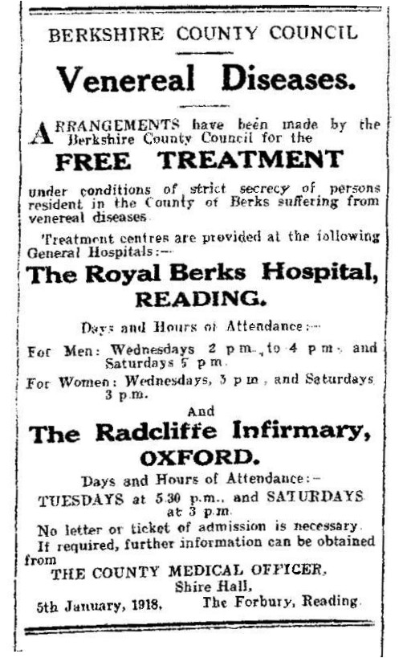
Background
Confidentiality has been the bedrock of sexual health services.
The duty of enforcement of confidentiality originates from the Public Health (Venereal Diseases) Regulations 1916.
Patient information is not shared except for the purpose of treatment of STIs, or for the purpose of prevention.

Slide 3
Background
No routine communication with GPs in GUM clinics. Patients are asked for permission for GP disclosure.
A large minority of GU patients decline GP disclosure.
The Department of Health has proposed to devolve more sexual health services to primary care settings.

Slide 4
Aims
To explore the reasons why some patients attending GUM clinic choose to decline permission for the clinic to contact their GP if required.
Other key research questions are as follows:
How much do patients understand about the additional confidentiality protections in GUM clinics?
What are patients’ views on GP disclosure against expressed wishes, in order to treat an STI, when a patient is unable to be contacted by other means?

Slide 5
Methodology
10 semi-structured face-to-face interview were conducted with patients attending RSH GUM clinic for GU care.
Approved by NRES

Slide 6
Results
-Patients’ reasons for declining GP disclosure.

Slide 7
Demographics of interviewed participants
Of the 10 participants in this qualitative study, eight were White, one Asian and one of African descent.
The ages of the participants ranged from 20 to 57 years (mean 34.9).
We were unable to recruit any sex workers.

Slide 8
1. Perceived potential negative implications of recording STI results on GP medical records.
“I heard that insurance can be affected if you have a bad condition or what so ever… I don’t know, I guess it is just precautions.”
“…it’s more about the information going on my medical file as a whole, which could then by accessed by lawyers, or insurance companies.”

Slide 9
2. Anticipated negative feelings of discomfort/embarrassment/shame/being judged
“Sometimes you get doctors that know your family, obviously they would never say anything, but I would be uncomfortable with them knowing.”
“I just think I would be concerned that the receptionists , when she sort of check my details or putting up tests on there, would think “oh, look at that.”

Slide 10
3. Irrelevant to GP care
“There is no point going to GP, they are not sexual health specialist doctor. What are they going to do? They can’t do anything and will just refer you back to sexual health clinic, so what’s the point.”
“None of their business.”

Slide 11
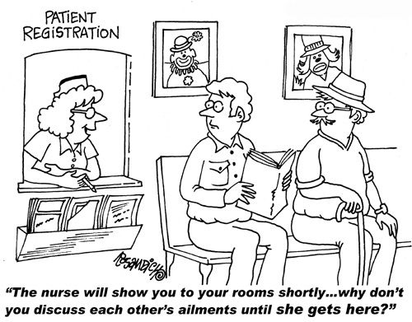
4.Breach of confidentiality by administrative staff.
“…when you go to see your GP, the receptionist will ask you why did you come to see your GP today, but I don’t want them to know. …What do you want me to tell her in front of everybody standing in the queue?”

Slide 12
Limited understanding of the confidentiality policy in GUM clinics
“Because it just seems like if you put your GP down, the information is just going to go straight to them.”
“…I used to think, before I joined NHS, that this would been shared with my GP.”
“..what would have made me more secure about sharing my details is a website, or something provided by the NHS, of exactly where my information is stored.”

Slide 13
Discussions
Patient education on information sharing and confidentiality protections.
GP practices should provide relevant confidentiality training to all members of staff.
However, some patient concerns are difficult to deal with due to the stigma around sexual health.
Reception area is a particularly troublesome source of confidentiality breach - consider the use of electronic check-in services to better protect patient privacy.

Slide 14
Limitations
Study was carried out only in two GUM clinics. Representative of the rest of the UK?
Small sample size for the interview phase. Data saturation?

Slide 15
References
Alder MW, French P, McNab A, Smith C, Wellsteed S. The national strategy for sexual health and HIV: implications for genitourinary medicine. Sex Transm Infect. 2002; 78: 83-86.
Beauchamp TL, Childress J. Principles of biomedical ethics, 6th ed. New York: Oxford University Press; 2009.
Higgins GL. The History of Confidentiality in Medicine. Canadian Family Physician. 1989; 35:921-914.
British Medical Association. Confidentiality and disclosure of health information toolkit. http://bma.org.uk/practical-support-at-work/ethics/confidentiality-tool-kit (accessed 15 December 2015).
Hope T, Savulescu J, Hendrick J. Medical Ethics and Law: The Core Curriculum, 2nd ed. Edinburgh: Churchill Livingstone; 2008.

Slide 16
Acknowledgements
Dr Emily Clarke, Dr Raj Patel
Staff working in Royal South Hants’ Hospital and St. Mary’s Hospital
Patients who took part in the study

