Slide 1




User Perspectives on an Online Sexual Health Service
Harriet Pittaway

Slide 2

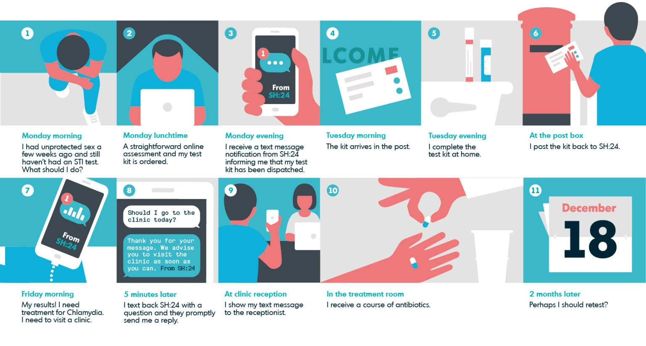

Slide 3
GetTested Trial
Inclusion Criteria
Aged 16-30 years
Resident in Lambeth or Southwark
At least one sexual partner in last 12 months
Willing to take an STI test
Access to the internet
Enrolment
(via www.gettested.org.uk)
Exclusion Criteria
Can not read English
Unable to give informed consent (e.g. people with severe learning difficulties)
Baseline data
(via www.gettested.org.uk)
Randomisation
(via www.gettested.org.uk)
Intervention
Receive SMS with invitation to get an STI test via SH:24 online service
Allocation
Control
Receive SMS with invitation to get an STI test in a local sexual health clinic
Follow Up
Follow up questionnaire sent to all participants at 6 weeks
Service use, STI tests and STI treatment objectively verified with relevant service
Free text responses ‘In your opinion, how could we improve the experience of getting a test from a sexual health service?’
Qualitative thematic analysis of 1337 participant experiences of either sexual health service.
Analysis
Notes:
.

Slide 4
Analysis
Interaction with Service
Method
Results
Professionalism
Sufficiency & Proficiency
Privacy & Confidentiality
Ergonomics of Service
Test ‘hardware’
Accessibility
Autonomy
Efficiency & Ease
Comfort with Service
Stigma

Slide 5





‘felt very safe’
‘treated with respect’
‘I was left for 5 hours waiting for PEP due to admin staff error’
‘Clearer websites’
‘Further education’
‘Burrell street clinic is open 7 days, which is why I first visited’
‘Patient details (including orientation) overheard at main desk - awkward!’

Slide 6





‘It really encouraged me to take a test when I may otherwise have not’
‘I got a bit nervous about doing all those kind of things myself’
‘perhaps more ‘human touch’’
‘Doing it at home is more comfortable if one were scared to go into a clinic’
‘it was when I got the actual instructions that I realized how difficult it would be’

Slide 7

As clinicians…

Slide 8

Conclusions
+

