Slide 1
Acceptability of DARE as anal cancer screening in HIV positive MSM
Tamara Lewis
Final Year Medical Student
University of Southampton

Slide 2

Background
Anal cancer common in HIV positive MSM (137 in 100,000)
Tumours tend to be larger and more advanced at diagnosis
EACS recommend DARE with a screening interval of 1-3 years.
Benefit of such a strategy is still unknown

Slide 3

Study Aims
Investigate the acceptability and outcomes of introducing DARE
4 research questions:
  Perception of anal cancer risk
  Awareness of DARE
  Acceptability of DARE
  Patient experience of DARE

Slide 4

Methods
Two-part questionnaire – based on previous study
Part 1 (Pre-DARE): Assessed attitudes towards DARE
Part 2 (Post-DARE): Assessed experience of DARE

Slide 5
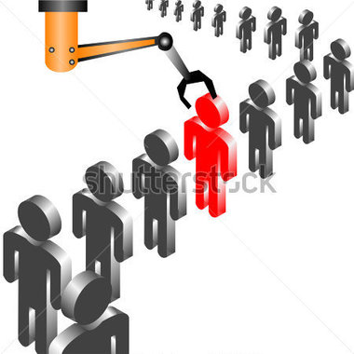
Recruitment
Inclusion Criteria
HIV positive MSM aged 35 and over.
Access to Patients
328 registered on database
Invited on the day of clinic appointment
68 (21%) had appointment over recruitment period

Slide 6
Participation
68 eligible patients during recruitment period
44 patients invited into study
30 patients accepted
14 patients declined
24 patients not invited into study
29 patients proceeded to DARE
1 patient declined DARE

Slide 7
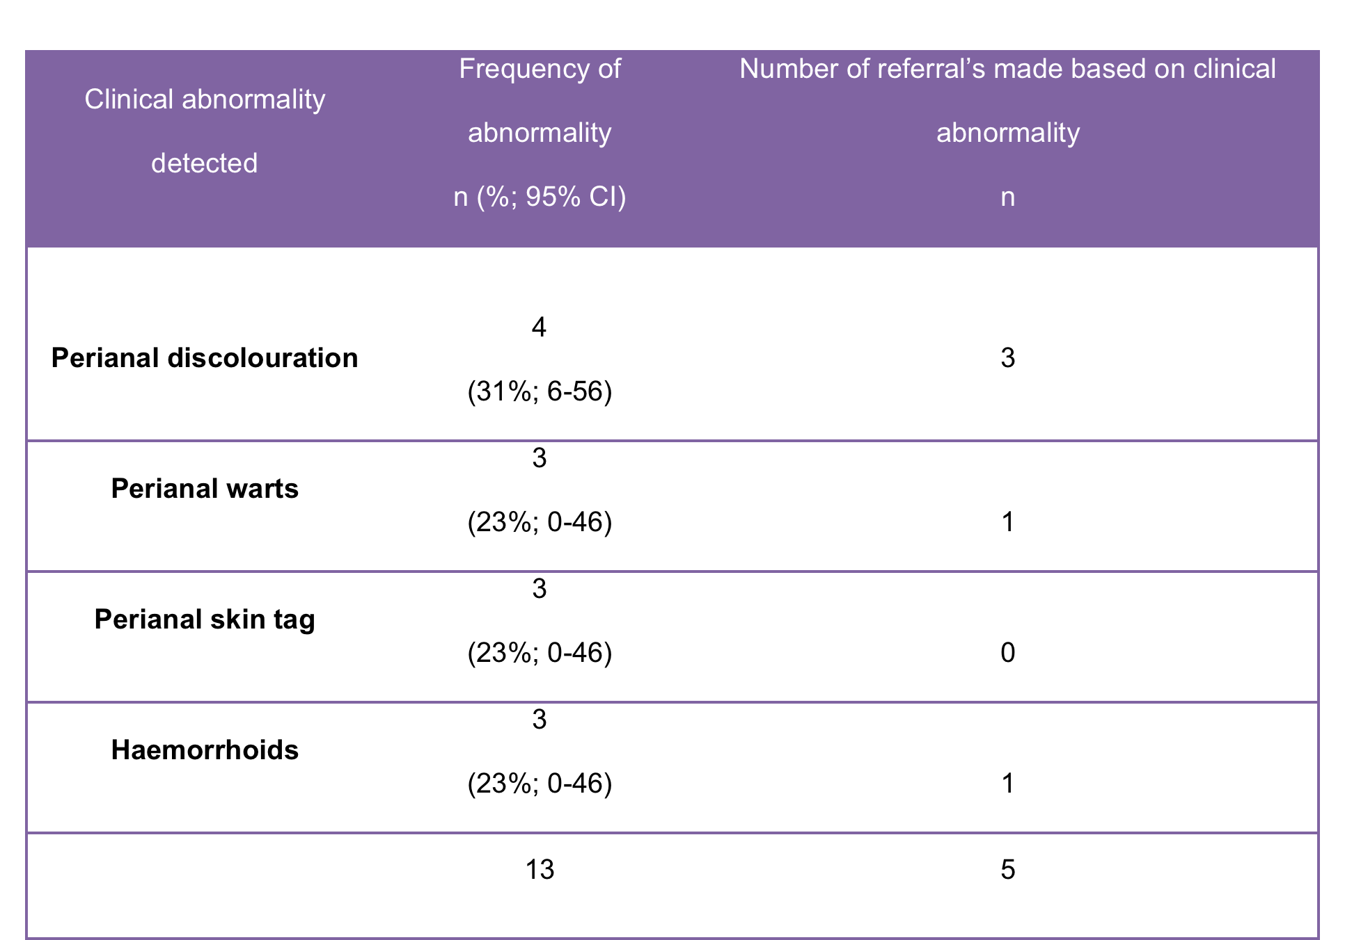
Results – DARE Outcomes
13 clinical abnormalities detected (45%)
5 required a referral (17%)
3 on suspicion of AIN (10%)

Slide 8

Results
Perception of anal cancer risk
80% - aware of their increased risk of developing anal cancer
Awareness of DARE
43% - knew about DARE
Acceptability of DARE
100% - DARE is acceptable
10% would like more information about it first

Slide 9
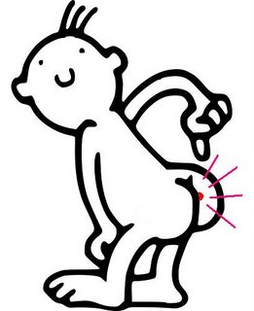
Results – Patient Experience
Significant discomfort – 1
Significant pain – 0
Emotional upset – 0
Really nervous, tense or embarrassed - < 10%
Not feeling clean – 69%
Losing control of bowels – 17%

Slide 10

How can we improve acceptability and experience?
Pre-warning patients to expect DARE during their next consultation
Leaflets about DARE available in the clinic
Re-assuring patients prior to each examination

Slide 11
Summary
Annual DARE is an acceptable addition to routine care of HIV positive MSM
DARE has the ability to pick up clinical abnormalities
Implementation should be seriously considered
HIV positive MSM are 50 times more likely to develop anal cancer highlighting an urgent health priority for this patient group

Slide 12
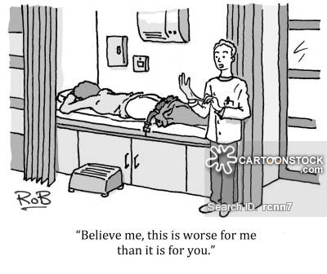
Acknowledgments
Dr Sangeetha Sundaram
Dr Raj Patel
Dr Sam Samraj
GUM Clinic Staff
Patients

Slide 13

Any Questions?

