Slide 1
Triage review: Should they stay, or should they go?
Dr Susanna Currie
ST4 Genitourinary Medicine
Central Manchester University Hospitals NHS Foundation Trust

Slide 2
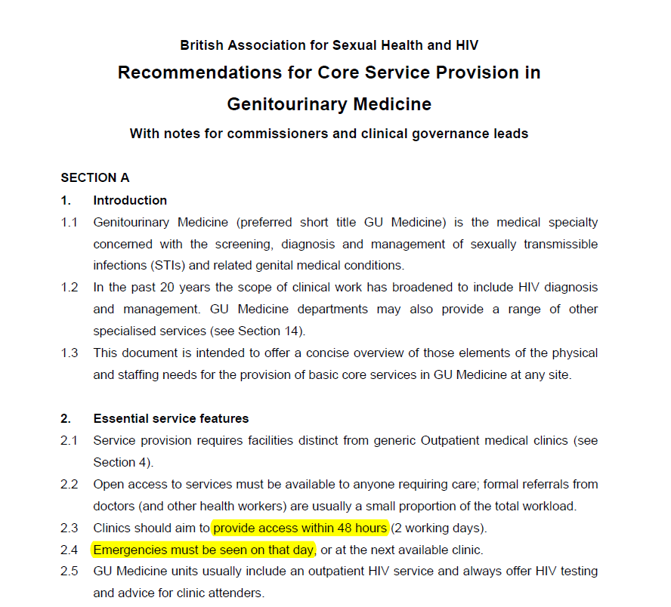
Background
BASHH Guidance:
48 hour access for all
On the day review for emergencies
Manchester Centre for Sexual Health:
Triage forms since 2010

Slide 3
Aim
Review the diagnoses of patients who fill in triage forms
And in turn, determine whether triage is effective

Slide 4
Method
A retrospective review of all triage forms completed between 5/1/15 – 24/3/15 and the diagnoses of those patients

Slide 5
Results
January – March 2015
?
patients leave
698
fill in triage forms
488
turned away
224
never returned
264
returned
210
accepted

Slide 6
Results - diagnoses
 | n = | % accepted | % initially turned away
PEPSE | 7 | 100 | 0
UTI | 4 | 100 | 0
Herpes | 37 | 78 | 22
PID/Epididymo-orchitis | 26 | 65 | 35
Contact of infection | 22 | 64 | 36
Gonorrhoea | 19 | 58 | 42
STI diagnosed elsewhere | 12 | 58 | 42
Non-specific GU infection | 37 | 54 | 46
Chlamydia | 33 | 51 | 49
HIV | 2 | 50 | 50
Primary syphilis | 2 | 50 | 50
Hepatitis B | 2 | 50 | 50
Candidiasis or BV | 64 | 42 | 58
Molluscum or Warts | 65 | 15 | 85
Late syphilis | 2 | 0 | 100

Slide 7
Results - diagnoses
 | n = | % accepted | % initially turned away
PEPSE | 7 | 100 | 0
UTI | 4 | 100 | 0
Herpes | 37 | 78 | 22
PID/Epididymo-orchitis | 26 | 65 | 35
Contact of infection | 22 | 64 | 36
Gonorrhoea | 19 | 58 | 42
STI diagnosed elsewhere | 12 | 58 | 42
Non-specific GU infection | 37 | 54 | 46
Chlamydia | 33 | 51 | 49
HIV | 2 | 50 | 50
Primary syphilis | 2 | 50 | 50
Hepatitis B | 2 | 50 | 50
Candidiasis or BV | 64 | 42 | 58
Molluscum or Warts | 65 | 15 | 85
Late syphilis | 2 | 0 | 100

Slide 8
Results - diagnoses
 | n = | % accepted | % initially turned away
PEPSE | 7 | 100 | 0
UTI | 4 | 100 | 0
Herpes | 37 | 78 | 22
PID/Epididymo-orchitis | 26 | 65 | 35
Contact of infection | 22 | 64 | 36
Gonorrhoea | 19 | 58 | 42
STI diagnosed elsewhere | 12 | 58 | 42
Non-specific GU infection | 37 | 54 | 46
Chlamydia | 33 | 51 | 49
HIV | 2 | 50 | 50
Primary syphilis | 2 | 50 | 50
Hepatitis B | 2 | 50 | 50
Candidiasis or BV | 64 | 42 | 58
Molluscum or Warts | 65 | 15 | 85
Late syphilis | 2 | 0 | 100

Slide 9
Results - diagnoses
 | n = | % accepted | % initially turned away
PEPSE | 7 | 100 | 0
UTI | 4 | 100 | 0
Herpes | 37 | 78 | 22
PID/Epididymo-orchitis | 26 | 65 | 35
Contact of infection | 22 | 64 | 36
Gonorrhoea | 19 | 58 | 42
STI diagnosed elsewhere | 12 | 58 | 42
Non-specific GU infection | 37 | 54 | 46
Chlamydia | 33 | 51 | 49
HIV | 2 | 50 | 50
Primary syphilis | 2 | 50 | 50
Hepatitis B | 2 | 50 | 50
Candidiasis or BV | 64 | 42 | 58
Molluscum or Warts | 65 | 15 | 85
Late syphilis | 2 | 0 | 100

Slide 10
Results - diagnoses
 | n = | % accepted | % initially turned away
PEPSE | 7 | 100 | 0
UTI | 4 | 100 | 0
Herpes | 37 | 78 | 22
PID/Epididymo-orchitis | 26 | 65 | 35
Contact of infection | 22 | 64 | 36
Gonorrhoea | 19 | 58 | 42
STI diagnosed elsewhere | 12 | 58 | 42
Non-specific GU infection | 37 | 54 | 46
Chlamydia | 33 | 51 | 49
HIV | 2 | 50 | 50
Primary syphilis | 2 | 50 | 50
Hepatitis B | 2 | 50 | 50
Candidiasis or BV | 64 | 42 | 58
Molluscum or Warts | 65 | 15 | 85
Late syphilis | 2 | 0 | 100

Slide 11
Results - diagnoses
 | n = | % accepted | % initially turned away
PEPSE | 7 | 100 | 0
UTI | 4 | 100 | 0
Herpes | 37 | 78 | 22
PID/Epididymo-orchitis | 26 | 65 | 35
Contact of infection | 22 | 64 | 36
Gonorrhoea | 19 | 58 | 42
STI diagnosed elsewhere | 12 | 58 | 42
Non-specific GU infection | 37 | 54 | 46
Chlamydia | 33 | 51 | 49
HIV | 2 | 50 | 50
Primary syphilis | 2 | 50 | 50
Hepatitis B | 2 | 50 | 50
Candidiasis or BV | 64 | 42 | 58
Molluscum or Warts | 65 | 15 | 85
Late syphilis | 2 | 0 | 100

Slide 12
Results - diagnoses
 | n = | % accepted | % initially turned away
PEPSE | 7 | 100 | 0
UTI | 4 | 100 | 0
Herpes | 37 | 78 | 22
PID/Epididymo-orchitis | 26 | 65 | 35
Contact of infection | 22 | 64 | 36
Gonorrhoea | 19 | 58 | 42
STI diagnosed elsewhere | 12 | 58 | 42
Non-specific GU infection | 37 | 54 | 46
Chlamydia | 33 | 51 | 49
HIV | 2 | 50 | 50
Primary syphilis | 2 | 50 | 50
Hepatitis B | 2 | 50 | 50
Candidiasis or BV | 64 | 42 | 58
Molluscum or Warts | 65 | 15 | 85
Late syphilis | 2 | 0 | 100

Slide 13
Results - diagnoses
 | n = | % accepted | % initially turned away
PEPSE | 7 | 100 | 0
UTI | 4 | 100 | 0
Herpes | 37 | 78 | 22
PID/Epididymo-orchitis | 26 | 65 | 35
Contact of infection | 22 | 64 | 36
Gonorrhoea | 19 | 58 | 42
STI diagnosed elsewhere | 12 | 58 | 42
Non-specific GU infection | 37 | 54 | 46
Chlamydia | 33 | 51 | 49
HIV | 2 | 50 | 50
Primary syphilis | 2 | 50 | 50
Hepatitis B | 2 | 50 | 50
Candidiasis or BV | 64 | 42 | 58
Molluscum or Warts | 65 | 15 | 85
Late syphilis | 2 | 0 | 100

Slide 14
Percentage accepted & rejected

Slide 15
Percentage accepted & rejected

Slide 16
Limitations
January – March 2015
When clinic is full
?
patients leave
698
fill in triage forms
488
turned away
224
never return
264
returned
210
accepted

Slide 17
Conclusions
Triage is effective for some conditions
Acute needs such as PEPSE
Common, non-acute conditions such as warts and candidiasis
Triage is less effective for patients with chlamydia & gonorrhoea
BASHH concerns are justified

Slide 18
Possible strategies
Asymptomatic screen for all patients
Nearly 10% of those who returned had CT or GC
Saving clinic visits
Would this capture those who leave before triage?
Closer links between clinics in a region with central booking systems

Slide 19
References
Recommendations for core service provision in genitourinary medicine. British Association for Sexual Health & HIV, 2005. www.bashh.org

