Slide 1
Self-taken extragenital samples compared with clinician-taken extragenital samples for the diagnosis of gonorrhoea and chlamydia in women and MSM
Janet Wilson¹, Harriet Wallace¹, Michelle Loftus-Keeling¹,
Helen Ward², Claire Hulme³, Mark Wilcox⁴
¹ Leeds Centre for Sexual Health, Leeds Teaching Hospitals NHS Trust, UK,
²Department of Infectious Disease Epidemiology, Imperial College, London, UK,
³Academic Unit of Health Economics, University of Leeds, UK
⁴Department of Clinical Microbiology, Leeds Teaching Hospitals NHS Trust, UK,

Slide 2
Background
In MSM the majority of gonorrhoea (NG) and chlamydia (CT) infections are extra-genital so rectal and pharyngeal swabs are essential
Recent studies in women indicate a high prevalence of rectal CT - rectal sampling suggested in those disclosing AI
Self-taken samples are preferred by most patients, are more cost-effective and can be performed outside health care facilities
Increasing use of self-taken extra-genital swabs for NG and CT by sexual health services

Slide 3
Background
Yet published evidence poor – only five studies
Only one study (where self-taken samples taken first) was adequately powered for rectal NG and CT*
No study adequately powered for pharyngeal NG and CT
Only one study in women assessing rectal samples
No well constructed RCT of self-taken versus clinician-taken extra-genital samples in MSM or women
*Sensitivities lower than expected 71-84%
Authors suggest specimen collection or processing
needed to be improved

Slide 4
SYSTEMATIC
(Swab-yourself trial with economic monitoring and testing for infections collectively)
Objective: Compare sensitivity and specificity of individually analysed self-taken swabs from rectum and pharynx with individually analysed clinician-taken swabs
Study population:
Women and MSM aged 16 and over attending Leeds Sexual Health
Exclusion criteria:
Antibiotics in the preceding 28 days
Rectal symptoms (discharge, pain or bleeding, as these would necessitate an examination with clinician-taken swabs via a proctoscope)
Unable or unwilling to perform self-taken swabs or have clinician performed swabs
Power calculation:
Recruitment target 1500 women and 850 MSM to achieve 50 cases of each infection at each site

Slide 5
Methods - Randomisation
Each participant had:
clinician-taken rectal and pharyngeal processed separately
self-taken rectal, pharyngeal and VVS or FCU processed separately
Order of self/clinician randomised using computer generated simple randomisation

Slide 6
Methods - Microbiology analysis
All samples analysed by Aptima Combo 2 (AC2)
AC2 positive samples retested by Aptima GC or CT
Laboratory staff blinded to samples being self or clinician-taken
Patient infected status - at least two confirmed positive samples from any of the sites including the pooled sample, or a positive culture for NG
Site infected status - at least one confirmed positive sample if PIS positive

Slide 7
1191 women and 387 MSM recruited Jan 2015 to June 2016 by 5 clinicians
Results
MSM
Mean age 34 years (18-77) Median 30 years
Sexual history:
354 (91.5%) had ever given AI
351 (90.7%) had ever received AI
383 (99.0%) had ever given OI
385 (99.5%) had ever received OI
Women
Mean age 25 years (16-71) Median 23 years
Sexual history:
1190 (99.9%) had ever had VI
548 (46%) had ever had AI
1142 (95.9%) had ever given OI

Slide 8
Results - gonorrhoea
MSM
Patient Infected Status: 39
Overall prevalence: 10.1%
Site Infected Status:
Urethral 2.8% (11)
Rectum 6.7% (26)
Pharynx 6.2% (24)
28 MSM (71.8% of NG cases) were urethra negative:
11 (28.2%) were pharyngeal only positive
9 (23.1%) were rectal only positive
8 (20.5%) were rectal and pharyngeal positive
Women
Patient Infected Status: 60
Overall prevalence: 5.0%
Site Infected Status:
Urogenital 4.6% (55)
Rectum 3.9% (46)
Pharynx 2.9% (35)
5 women (8.3% of NG cases) were urogenital negative:
5 were pharyngeal only positive
0 were rectal only positive

Slide 9
Results - gonorrhoea
Self taken versus clinician-taken
No difference between self versus clinician-taken

Slide 10
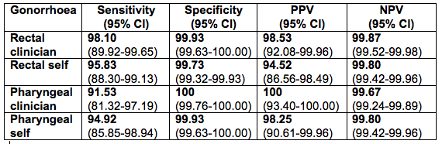
Results - gonorrhoea
Sensitivity, specificity, PPV and NPV
No difference in sensitivities of self versus clinician samples

Slide 11
Results - chlamydia
MSM
Patient Infected Status: 31
Overall prevalence: 8.0%
Site Infected Status:
Urethra 1.8% (7)
Rectum 6.7% (26)
Pharynx 1.0% (4)
24 MSM (67.7% of CT cases) were urethra negative:
21 (67.7%) sole rectal infections
2 (6.5%) sole pharyngeal infections
1 (3.2%) rectal and pharyngeal infections
Women
Patient Infected Status: 227
Overall prevalence: 19.1%
Site Infected Status:
VVS 16.5% (197)
Rectum 17.6% (209)
Pharynx 4.7% (56)
30 women (13.2% of CT cases) were VVS negative:
17 (7.5%) sole rectal infections
8 (3.5%) sole pharyngeal infections
5 (2.2%) rectal and pharyngeal infections

Slide 12
Results - chlamydia
Self taken versus clinician-taken
No difference between self versus clinician-taken

Slide 13
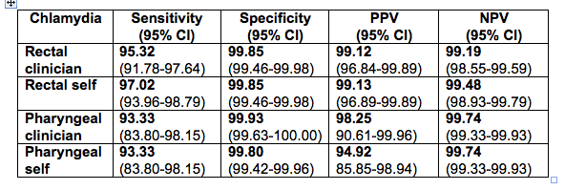
Results - chlamydia
Sensitivity, specificity, PPV and NPV
No difference in sensitivities of self versus clinician samples

Slide 14
Conclusions
First adequately powered RCT to demonstrate self-taken samples are equivalent to clinician-taken samples for the diagnosis of extra-genital NG and CT in MSM and women
Good concordance between self and clinician-taken samples with high sensitivity and specificity
Identified high levels of extra-genital infections in women as well as MSM
In women 8.3% of NG and 13.2% of CT would be missed by just genital sampling
In women the rectum was the most prevalent site for CT

Slide 15
Acknowledgements
NHS National Institutes Health Research, Research for Patient Benefit Programme
This presentation presents independent research funded by the National Institute for Health Research (NIHR) under its Research for Patient Benefit (RfPB) Programme (Grant Reference Number PB-PG-0212-27041). The views expressed are those of the authors and not necessarily those of the NHS, the NIHR or the Department of Health.
Hologic for providing the extra swabs for the pooled samples and the sample kits and reagents for the environmental samples
All the staff and patients at Leeds Sexual Health

