Slide 1
Antiseptic mouthwash against pharyngeal Neisseria gonorrhoeae: A randomised controlled trial and an in-vitro study
Eric P.F. Chow^{1,2}, Benjamin P Howden³, Sandra Walker^{1,2}, David Lee^{1,2,3}, Catriona S Bradshaw^{1,2}, Marcus Y Chen^{1,2}, Anthony Snow¹, Stuart Cook¹, Glenda Fehler¹, Christopher K Fairley^{1,2}
Melbourne Sexual Health Centre⁽¹⁾
Monash University, Melbourne⁽²⁾
The University of Melbourne⁽³⁾
Notes:
Good morning. Today I am presenting our study findings on the effect of an antiseptic mouthwash against n.gonorrhoeae. To examine this we conducted a randomised controlled trial as well as an in vitro study

Slide 2
Background
Gonorrhoea rising in men who have sex with men¹
Increasing concern around antibiotic resistance²
Pharyngeal gonorrhoea important contributor to transmission³
Saliva implicated⁴
A non-antibiotic intervention targeting pharynx
Listerine® in 1879 a cure for gonorrhoea⁵
No previous studies to substantiate
1 The Kirby Institute, Surveillance Report, 2015. 2 Blomqvist et al, Future Microbiol, 2014,9(2):189-201.
3 Jin et al. Sex Transm Infect, 2007, 83: 113-19. 4 Chow EP et al., Sex Transm Infect, 2015; doi:10.1136/sextrans-2015-052399.
5 Feier et al., Medicine in evolution, 2010,16:79-82.
Notes:
Gonorrhoea is rising, in particular in men who have sex with men and there is increasing concern around antibiotic resistance to gonorrhoea.
Pharyngeal gonorrhoea has been shown to be an important contributor to transmission in previous research and in a recent study n.gonorrhoea was detected in the saliva of 43% of men who tested positive for pharyngeal gonorrhoea by culture.
Given this, a non antibiotic intervention targeting the pharynx may offer an alternate strategy for gonorrhoea control
Well-Listerine, as far back as 1879 Listerine was touted to be an effective remedy for gonorrhoea by it’s manufacturers!
However, to our knowledge there have been no previous studies to substantiate this

Slide 3
Aims
Listerine® has an inhibitory effect against N.gonorrhoeae in an in vitro study
Listerine® can inhibit N.gonorrhoeae detection in the pharynx in a randomised controlled trial (RCT)
Notes:
Therefore we aimed to determine whether Listerine has an inhibitory effect against N.gonorrhoea in in vitro laboratory studies
We also aimed to determine whether it can inhibit N.gonorrhoea detection in the pharynx in a randomised control trial.

Slide 4
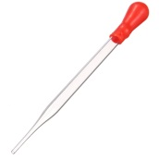
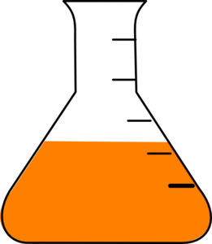
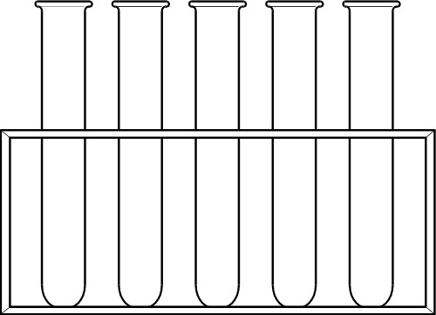
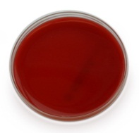
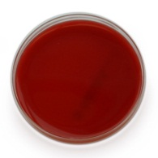
In vitro: Method
1min
PBS
1:2 1:4 1:8 1:16 1:32
~10⁸ CFU / ml pharyngeal isolate
N.gonorrhoeae
0.01ml
0.01ml
0.01ml
0.01ml
0.01ml
0.01ml
Notes:
We added a standard suspension of ~10⁸ colony forming units per ml, of a wild type of a pharyngeal isolate of N.gonorrhoea to a series of dilutions of up to 1:32 of Listerine and to PBS. And after 1 minute of exposure, 10ul aliquots at each dilution and PBS were extracted, spread onto the surface of gonococcal agar plates and then incubated for 2 days.
(Listerine cool mint was chosen as it is commonly used)

Slide 5
In vitro: Results
Mean CFU/ml* Neisseria gonorrhoeae after one minute exposure to Listerine® and saline
 | CFU/ml
Dilution (with saline) |  | Listerine® | Saline
Neat |  | <10² | >10⁵
1/2 |  | <10² | -
1/4 |  | 2x10² | -
1/8 |  | <10⁵ | -
1/16 |  | <10⁵ | -
1/32 |  | <10⁵ | -
^{* ~108}
^{colony forming units per ml}
Notes:
The mean CFUs/ml were calculated after 3 biological replicates and Listerine was found to significantly inhibit the growth of the tested strain of NG at dilutions up to 1:4 and saline and weaker dilutions displayed no inhibitory effect.
<10² was the lowest limit of detection as only 10ul of the post exposure sample was extracted for culture therefore we cannot be absolutely certain that there were zero colonies present.

Slide 6
Randomised Control Trial
Open-label (ACTRN:12615000716561)*
May 2015-Feb 2016
196/213 MSM positive for pharyngeal gonorrhoea by NAAT**
Returning for treatment
Were randomised to Listerine® or saline at 1:4 and later at 1:1
*Australia New Zealand clinical trials registration number; **nucleic acid amplification test
Notes:
We also conducted an open label randomised trial in May 2015 at the MSHC
Where 196 of 213 men returning for treatment after a positive pharyngeal, NAAT test, consented and were randomised into the study, initially at a 1:4 ratio (1 case to 4 controls), and soon after at 1:1, due to low numbers of positivity by culture on return for treatment.

Slide 7
Method
Saline 92 (47%)
196 eligible and randomised
Listerine 104 (53%)
1 withdrew due to gag
Oro-pharyngeal and tonsillar fossae swabs collected
Rinse and gargle 1 minute
Swabs repeated 5 minutes
5
Treated for pharyngeal gonorrhoea
Notes:
- 47% were randomised to the Saline group and 53% to Listerine
- Swabs were taken from the oro-pharynx and the tonsillar fossae swabs and plated for culture
-Then 20mls of either Listerine or Saline was rinsed into the oropharynx and then gargled into the back of the tonsillar fossae for a period of 1 minute.
-5 minutes later the swabs were repeated
- men were then treated for pharyngeal gonorrhoea and having completed a questionnaire, this completed their study involvement

Slide 8
Results 1
Saline
25 (43%)
58/196 positive by culture (30%)
Listerine
33 (57%)
Rinse and gargle 1 minute
Saline
21 (55%)
38/58 positive by culture (66%)
Listerine
17 (45%)
Notes:
58 of 196 men were culture positive before the rinse and gargle, 38 of 58 remained positive after rinse and gargle (66%).

Slide 9
N.Gonorrhoeae positivity at both oral sites
Results 1
P=0.01
Notes:
The results were significant with 84% of men in the saline arm compared to 52% in the Listerine arm remained positive post rinse and gargle, indicating a significant inhibition of n.gonorrhora detection in the Listerine arm.
(OR 0.20,95%CI:0.07-0.72;p=0.014).

Slide 10
Results 2
58 culture positive
pre intervention
43 tonsillar fossae
43 oro-pharynx
Saline (n=20)
Listerine
(n=23)
Saline
(n=20)
Listerine
(n=23)
Rinse and gargle
31 tonsillar fossae
(82%)
38 culture positive
post intervention
27 oro-pharynx
(71%)
Saline
(n=18)
Listerine
(n=13)
Saline
(n=14)
Listerine
(n=13)
Notes:
Looking at the results by swab collection site, 43 men were positive at the oropharynx and also at the tonsillar fossae, pre rinse and gargle.
For the tonsillar fossae site: 18 of the 20 men in the saline arm and 13 of the 23 men in the Listerine arm remained positive.
For the oro-pharynx site: 14 of the 20 men in the saline arm and 13 of the 23 men in the Listerine arm remained positive.

Slide 11
N.Gonorrhoeae positivity at different oral collection sites
Results 2
p=0.02
Notes:
The results were significant at the tonsillar fossae with 90% remaining positive post rinse and gargle in the saline group and only 57% in the Listerine group., showing significant inhibition of N.gonorrhoeae at the tonsillar fossae. There was a similar trend at the oro-pharynx however this did not reach significance.
(small sample size, collection, exploring further in new study)

Slide 12
Summary
First study to demonstrate in vitro and in vivo studies that Listerine® can inhibit N.gonorrhoeae
We explored the influence of a single administration Listerine®
A potentially important novel strategy
To control gonorrhoea transmission
Limitations
-Not blinded
-Short follow up time
-Small sample size with limited power
Notes:
In summary this is the first study to demonstrate that Listerine can inhibit gonorrhoea in vitro and in vivo studies
In the randomised trial, we explored the influence of a single administration of Listerine mouthwash in men with a diagnosis of pharyngeal gonorrhoea and showed that Listerine is potentially an important and novel strategy for controlling gonorrhoea transmission.
However there were some limitations to our study including that the researchers and participants were not blinded, that the follow up time for repeat swabs was short and also the sample size of men positive by culture was small (N=58) and thus offered limited power to detect a difference between groups

Slide 13
Future Research
We are now conducting a double blind RCT (ACTRN:12616000247471)*
To investigate whether daily mouthwash has a sustained effect on the reduction of pharyngeal gonorrhoea
Larger sample size
Currently 25% recruited
* Australia New Zealand clinical trials registration number
Notes:
So, we are now conducting a double blind RCT
To investigate whether daily mouthwash has a sustained effect on the reduction of pharyngeal gonorrhoea
with a larger sample size
(Currently we have 25% of men recruited)

Slide 14
Acknowledgements
Microbiological Diagnostic Unit
Kerrie Stevens
Samantha Twail
Mark Enriquez
Melbourne Sexual Health Centre
Tiffany Phillips
Clare Bellhouse
Afrizal Afrizal
Conflict of interest: Nil Known
Posters: Mouthwash acceptability pilot among MSM (P129). Willingness to change sexual behaviour to reduce pharyngeal gonorrhoea (P145).
Notes:
In finishing, I would like to acknowledge other members of our research team who contributed to this study and direct you to 2 posters associated with this study in the poster area. Thankyou.

