Slide 1
Role of Primary Care in the diagnosis of Sexually Transmitted Infections in England
Martina Furegato
Department of HIV and STI
National Infection Service
Public Health England

Slide 2
Introduction
Sexually transmitted infections (STIs) continue to be a public health concern in England.
The rate of new STI diagnoses made in genitourinary medicine (GUM) clinics in England increased by 28% between 2005 and 2014 to 815.4 per 100,000.
Limited data from general practice (GP) on STI diagnosis.
Notes:
Point 4: This suggests the demographics of those accessing primary care for STI diagnosis may differ from those accessing GUM clinics.

Slide 3
What we did..
Methods
Retrospective analysis of diagnoses of chlamydia, gonorrhoea, genital warts (first episode) and genital herpes (first episode) made in primary care in England between 2005 and 2014 using the Clinical Practice Research Datalink (CPRD)

Slide 4
CPRD
Methods
CPRD provides anonymised records from patients registered at a subset of GPs in the UK
Represents approximately 6.9% of the UK population
Good representation by age, gender and ethnicity
Notes:
Geography representation is poor

Slide 5
CPRD
Methods
Study population
CPRD provides anonymised records from patients registered at a subset of GPs in the UK
Represents approximately 6.9% of the UK population
Good representation by age, gender and ethnicity
All patients aged 15 years and over
Registered at CPRD practices in England
With known gender
Notes:
Geography representation is poor

Slide 6
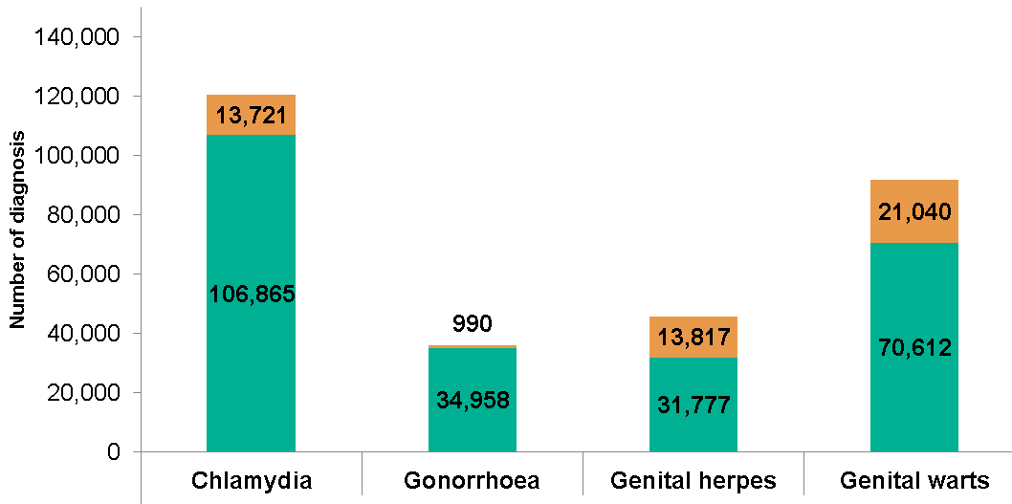
Number of estimated diagnoses in 2014:
GP vs GUM
6%
Notes:
We worked under the assumption that all diagnoses made in GP represented the first patient attendance for care, and that all non-treated episodes had been referred to a specialist service where a diagnosis would have been recorded and treated.
To derive the proportion of the total number of STI diagnoses in England made in GP, we worked under the assumption that an STI not treated 14 days before or after the diagnosis date was referred to GUM (and therefore would appear in the GUM total). The number of untreated cases diagnosed at GP was removed from the GUM total to avoid double counting. The denominator was therefore the number diagnosed in GP plus the number diagnosed in GUM, minus those who were diagnosed but untreated at GP. The proportion untreated at GP was multiplied by the standardised number diagnosed at GP in England to get the total number of untreated patients but diagnosed at GP in England

Slide 7
Number of estimated diagnoses in 2014:
GP vs GUM
4%

Slide 8
Number of estimated diagnoses in 2014:
GP vs GUM
30%

Slide 9
Number of estimated diagnoses in 2014:
GP vs GUM
30%

Slide 10
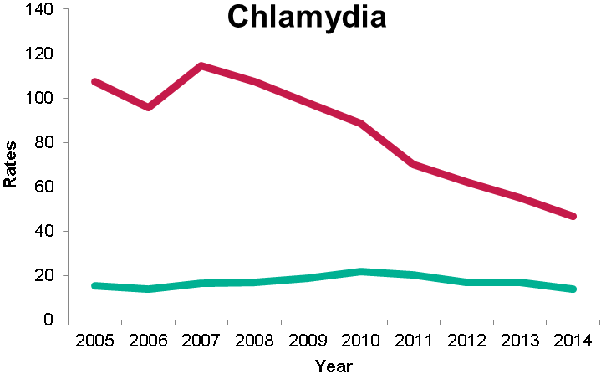
Trends in rates per 100,000 of diagnosis by gender in GP
Female
Male
Age standardised rates
Notes:
Age standardised rates
Between 2005 and 2014 There was strong evidence of a decreasing trend in the rates of diagnosis on chlamydia (p=0.009),in females. There was no evidence of a trend in the rate of diagnoses in males of chlamydia (p=0.05)
The rate of diagnosis from 2005 to 2014 is different between males and females for the diagnosis of chlamydia (p<0.001), gonorrhoea (p=0.007) and genital herpes (p<0.001). There is no evidence that the rate of diagnosis of genital warts differs between males and females (p=0.29).

Slide 11
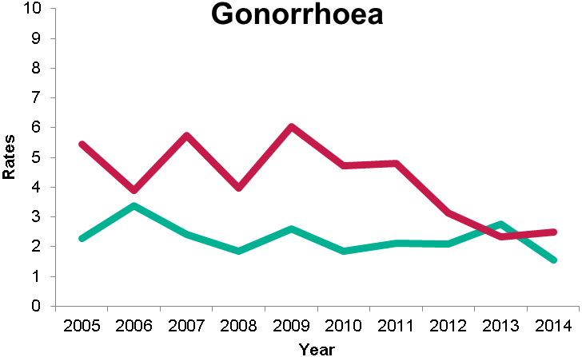
Trends in rates per 100,000 of diagnosis by gender in GP
Female
Female
Male
Male
Age standardised rates
Notes:
There was no evidence of a trend in the rate of diagnoses in gonorrhoea (p=0.22)

Slide 12
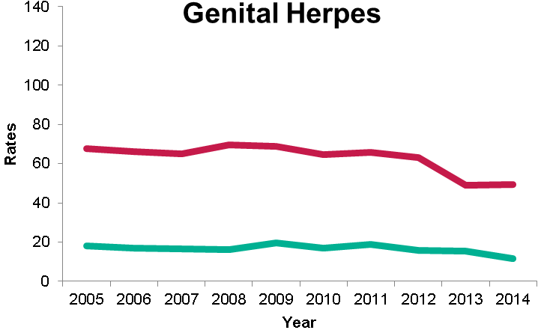
Trends in rates per 100,000 of diagnosis by gender in GP
Female
Female
Male
Male
Age standardised rates
Notes:
Between 2005 and 2014 There was strong evidence of a decreasing trend in the rates of diagnosis on genital herpes (0.024)
The rate of diagnosis from 2005 to 2014 is different between males and females for the diagnosis of genital herpes (p<0.001).

Slide 13
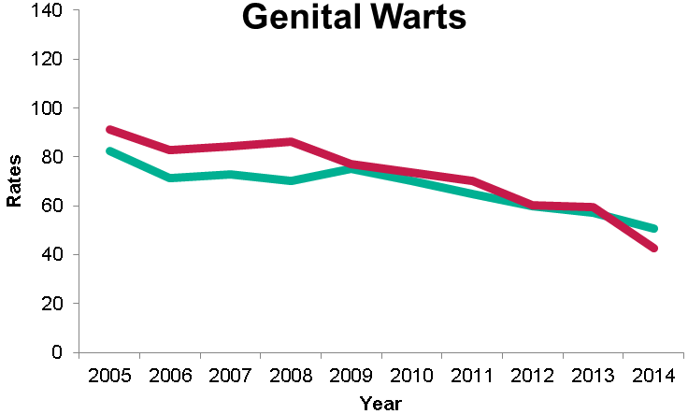
Trends in rates per 100,000 of diagnosis by gender in GP
Female
Female
Male
Male
Notes:
Between 2005 and 2014 There was strong evidence of a decreasing trend in the rates of diagnosis on genital warts (p=0.007)
There is no evidence that the rate of diagnosis of genital warts differs between males and females (p=0.29).

Slide 14
IRRs* for Chlamydia by year in GP
* Estimates adjusted for age group, index of multiple deprivation, practice location
Role of Primary Care in the Diagnosis of Sexually Transmitted Infections in England
Notes:
Due to a clear different trend across the genders and because of the high collinearity between age and gender two separates poisson regression models have been performed to derive the incidence rate ratios of STI diagnosis by year and adjusted for age, index of multiple deprivation and practice location in London or outside London

Slide 15
IRRs* for Genital warts by year in GP
* Estimates adjusted for age group, index of multiple deprivation, practice location

Slide 16
Other findings
IRRs for gonorrhoea and genital herpes by year were consistent with the trends in age standardised rates
IRRs for chlamydia, gonorrhoea and genital warts were higher among practices located in areas of higher deprivation
IRRs for chlamydia and genital warts are higher in practices located outside London
For both genders, those aged 20-24 have the highest likelihood to be diagnosed with an STI
Notes:
Deprivation for both genders

Slide 17
Limitations
Episodes not treated at GPs were referred to GUM
Sexual orientation not included
70% of attendees are females

Slide 18
Conclusions
GPs make an important contribution to the diagnosis of STIs
Higher rates of diagnosis of chlamydia, gonorrhoea and genital herpes are seen among women.
The rates of diagnosis in GP have decreased for chlamydia and genital warts.
Similar patterns were seen in rates of genital warts diagnosed in GUM clinics
Need to investigate the testing patterns overtime in relation to other settings to understand the role that GPs play in the wider context of STI epidemiology
Notes:
Higher rates in women suggests GPs have an important role in the diagnosis of STIs in women although their relative contribution may have declined in recent years.
This might be relate to the protective effect of HPV 16/18 vaccination against GW
GPs are playing less of a role in diagnosis relative to GUM

Slide 19
Acknowledgments
Emma Beaumont
Bersabeh Sile
Hamish Mohammed
Dana Ogaz
Sarah Woodhall
David Mesher
Gwenda Hughes

Slide 20

Thank you!

