Slide 1
National HIV self-sampling service
British Association for Sexual Health and HIV
Annual Conference 2016
Oxford, UK
Presented by: Luis E. Guerra
National Programme Manager
Sexual Health, Reproductive Health & HIV
Luis.Guerra@phe.gov.uk @LguerraC
Authors: Luis Guerra, Louise Logan, Tim Alston, Noel Gill, Ryan Kinsella, Anthony Nardone on behalf of national HIV self-sampling steering group

Slide 2
National self-sampling service
Successful national pilots
Public Health Minister announced national service to deliver “up to 50,000 kits per year”
Co-commission between PHE and local authorities
Successful bidder Preventx/MESMAC
Governance: Project steering group with representation of Local Authorities and PHE.
Transition to Local Authorities 14/1/16

Slide 3
Where are we now?
80 Local Authorities committed to the service implementation
£567’000 sum of value from Local Authorities
Commitment from PHE to continue funding support
50’000 kits (from LAs) + 20’000 kits (from PHE)
Support from National and Local Campaigns
www.freetesting.hiv

Slide 4
Aims
To determine who is accessing the service and whether it reached most at-risk groups (including MSM and Black African communities) and first-time testers.
Methods
Disaggregated anonymised data from service users ordering kits from 18 November 2015 – 31 March 2016 were analysed, including: ethnicity, gender, sexual orientation, local authority residency and self-reported HIV testing information.

Slide 5
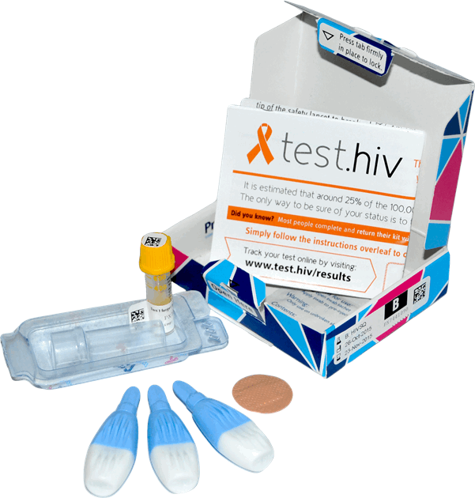
www.FreeTesting.hiv
Kits provided
24/7
2 working days from request
Kits processed
Dual confirmatory test (non-reactive)
Triple confirmatory test (reactive)
Result notification
3 working days (non-reactive)
5 working days (reactive)
3 contact attempts
Linkage to care
Local pathway
Follow-up

Slide 6
Service Summary (Nov 15 - Mar 16)

Slide 7
Service Summary (Nov 15 - Mar 16)
24327 | Number of kits ordered
11428 | Number of kits returned
51% | Return rate (adjusted)
10711 | Number of kits tested
122 | Reactive results
1.14% | Reactive rate

Slide 8
Age of service users (Nov 15-Mar 16)

Slide 9
Sexual Behaviour and Identity (Nov 15 - Mar 16)

Slide 10
Sexual Behaviour and Identity (Nov 15 - Mar 16)
 | Requested | Returned | Reactive | Reactivity
MSM | 18670 | 8439 | 89 | 1.05%
Heterosexual | 5016 | 2045 | 28 | 1.37%
Others | 417 | 107 | 2 | 1.29%
Trans | 224 | 72 | 3 | 4.17%

Slide 11
Black and minority ethnic groups (BME) (Nov 15 - Mar 16)
Of kits ordered by heterosexuals 47% were ordered by users of Black ethnic groups with a reactivity rate of 1.68%
Ethnicity | All Heterosexuals
 | Total | Reactive | Reactive rate
White | 899 | 11 | 1.22%
Black African | 781 | 13 | 1.66%
Black others | 174 | 3 | 1.72%
Asian | 121 | 1 | 0.83%
Others | 70 | 0 | 0.00%
 | 2045 | 28 | 1.37%

Slide 12
Testing History (Nov 15 - Mar 16)
 | Kits Ordered | Kits Returned | Reactive | Reactivity | % Ordered
Over 1 year ago. | 8773 | 4053 | 45 | 1.11 | 37.84
Never tested. | 9020 | 3730 | 40 | 1.07 | 34.82
Within the last year. | 6328 | 2841 | 33 | 1.16 | 26.52
Unknown | 206 | 87 | 4 | 4.60 | 0.81
TOTAL | 24327 | 10711 | 122 | 1.14 | 100 %

Slide 13
Local Authority: return and reactive rates (Nov 15 – Mar 16)
Regions | Returned |  | Reactive
 | Total | % | Total | %
East Midlands | 907 | 8.47% | 7 | 0.77%
East of England | 1151 | 10.75% | 15 | 1.30%
London | 2174 | 20.30% | 30 | 1.38%
North East | 526 | 4.91% | 8 | 1.52%
North West | 1680 | 15.68% | 15 | 0.89%
South East | 1498 | 13.99% | 17 | 1.13%
South West | 862 | 8.05% | 8 | 0.93%
West Midlands | 1026 | 9.58% | 13 | 1.27%
Yorkshire & The Humber | 887 | 8.28% | 9 | 1.01%
 | 10711 | 100.00% | 122 | 1.14%

Slide 14
Conclusion
High volumes managed through internet
Different to clinic populations
Used by those at high risk
72% reported never testing or testing over a year ago.

Slide 15
National self-sampling steering group: Peter Taylor, Simon How, Noel Gill, Meroe Bleasdille, Anthony Nardone, Luis Guerra, Owen Brigstock-Barron, Sam Moses, Louise Logan Michael Brady and colleagues at Terrence Higgins Trusts /HIV Prevention England Alan McOwan, Ann Sullivan, Caroline Rae and colleagues at Dean Street Clinic/Chelsea & Westminster Hospital NHS Foundation Trust Thank you Luis.Guerra@phe.gov.uk @LguerraC
Acknowledgements

