Slide 1


Santé Project: Predicting STI risk among people attending sexual health services:
A triage tool for targeting behavioural interventions in young people
Carina King
c.king@ucl.ac.uk
Infection and Population Health, UCL
BASHH Conference, Oxford 2016

Slide 2

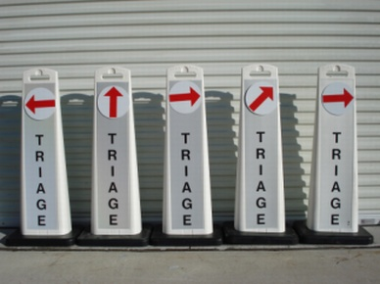

Background
Santé Project: a feasibility study for a trial of targeted sexual risk reduction interventions in UK sexual health clinics
Effective brief behavioural interventions exist
However there are limited resources for delivering sexual health promotion and interventions
We aimed to develop a triage tool for targeting referrals to brief behavioural interventions in young people (16-25 years)

Slide 3
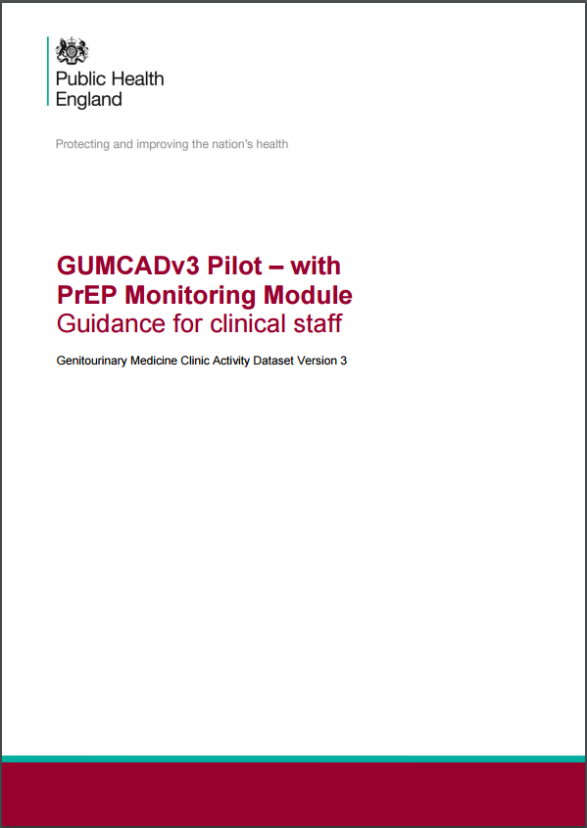
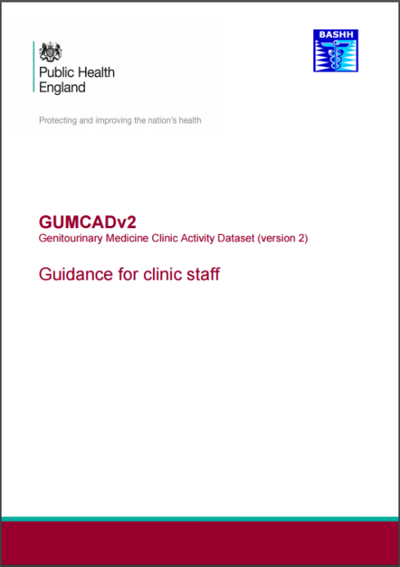
Background
GUMCADv2 has been collecting a basic dataset on sexual health attendances since 2008
GUMCADv3 is an enhancement to this dataset, including:
  Sexual behaviours
  Drug and alcohol use
  PrEP monitoring
This provides an opportunity to embed a triage tool within a routine EPR system

Slide 4
Method
Outcome: Acute STI diagnosis
Logistic regression
Model variables (e.g. age, deprivation, number of partners)
Logistic regression (variable coefficients)
Risk of STI diagnosis
(% likelihood)
Example:
17 year old with 5 partners from a high deprivation area = 47% predicted risk of STI diagnosis
24 year old with 1 partner from a low deprivation area = 3% predicted risk of STI diagnosis

Slide 5
Method
Model 1
GUMCADv2: National mandatory STI surveillance dataset
  All 2014 episodes
  All commissioned Level-2 & 3 clinics
  936,251 patients
  Gender, age, deprivation, sexual orientation, ethnicity, continent of birth, prior GUM, prior STI
Model 2
GUMCADv3 Pilot II: Enhanced STI surveillance dataset
  July 2015 – June 2016
  5 clinics including Level-2 and 3
  9,530 patients
  Model 1 variables + number of partners, new partners, and condom use at last sex

Slide 6
Results – Example
100 patients

Slide 7
Results – Example
100 patients
10% STI prevalence

Slide 8
Results – Example
100 patients
10% STI prevalence
80% Sensitivity
90% Specificity

Slide 9
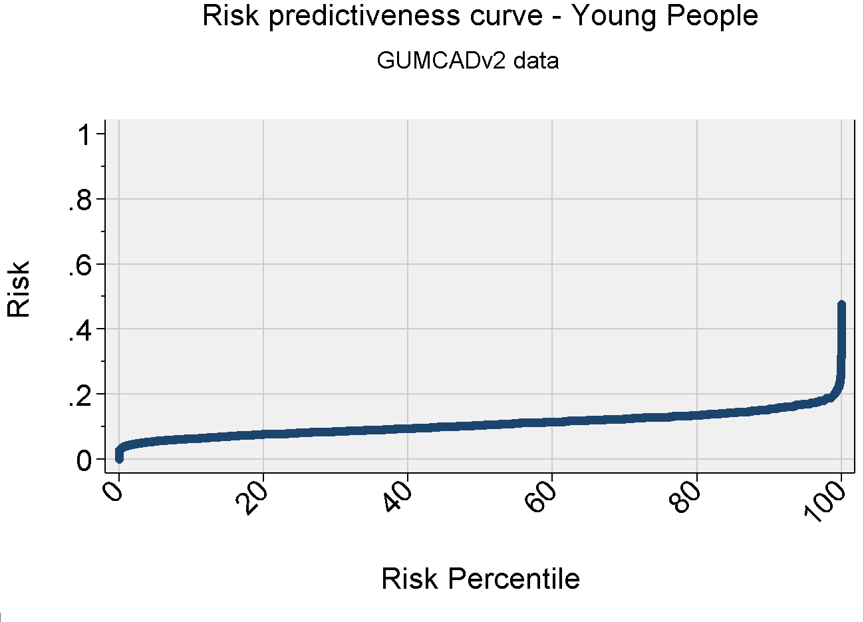
Results – Model 1
11% STI prevalence
Referring the riskiest decile of patients gives:
  Sensitivity = 18%
  Specificity = 89%

Slide 10
Results – Model 2
9.5% STI prevalence
Referring the riskiest decile of patients gives:
  Sensitivity = 33%
  Specificity = 85%
Notes:
C-statistic: 0.68

Slide 11

Conclusion
Routinely collected data could be used to triage young people…
… but high quality behavioural data is needed to make this tool robust
Including further risks (e.g. alcohol and drugs) could improve sensitivity
Next step - implement this tool within an EPR system

Slide 12




Acknowledgments
Co-authors:
Cath Mercer, Martina Furegato, Hamish Mohammed, Andrew Copas, Maryam Shahmanesh, Richard Gilson, Gwenda Hughes
Collaborators:
Funding:
NIHR HTA grant

Slide 13

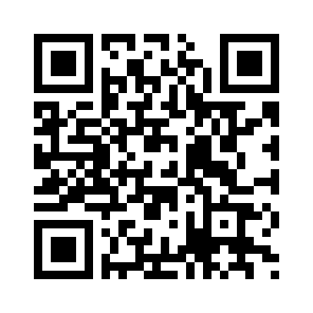
Pilot study clinics needed!
Provider web-survey:
https://opinio.ucl.ac.uk/s?s=37111

