Slide 1
An outbreak of high level azithromycin resistant gonorrhoea in Leeds Actions taken by the clinical team and lessons learnt
Jane Brown, Health Advisor, Leeds Sexual Health
on behalf of
Barbara Davies¹, Sharon Daley¹, Angela Talbot¹, Helen Fifer², Janet Wilson¹
¹Leeds Teaching Hospitals Trust. ²STBRU, PHE

Slide 2
Background
Increasing Neisseria gonorrhoeae (NG) antibiotic resistance is a worldwide problem
Gonococcal Resistance to Antimicrobials Surveillance Programme (GRASP) monitors susceptibility data and recommends any treatment changes
In 2011 treatment changed to ceftriaxone 500mg IM with azithromycin 1g orally due to upward drift of cephalosporin resistance. Azithromycin added as co-treatment to delay onset of further cephalosporin resistance.
LTHT microbiology laboratory refers all NG isolates suspected of showing resistance to ceftriaxone and/or azithromycin to Sexually Transmitted Bacteria Reference Laboratory (STBRU)
Notes:
The purpose of the dual therapy was to help preserve the sensitivity to ceftriaxone
GRASP is just a 3-month sentinal surveillance programme so it is important that laboratories continue to refer possible resistant NG cultures to STBRU throughout the rest of the year.

Slide 3
Identification of outbreak
March 2015 STBRU contacted Leeds Sexual Health as a number of NG isolates with confirmed high level azithromycin resistance (MIC ≥ 256mg/l) had been identified from Leeds in past few months
Between Nov 2014 – March 2015 eight NG isolates with high level azithromycin resistance had been identified 4 had attended for TOC screening before this contact from STBRU
This was on a background of just sporadic cases every 1-2 years - one in March 2014 and prior to that one in 2012
Outbreak control team established on 1st April 2015
We report the actions and outcomes of the clinical team

Slide 4
Look back at notes
How missed?
Results process at LTHT - all hard copy of results reviewed by admin support in health advisers team
Resistance had been identified and discussed with a senior colleague who suggested no immediate concern, keep up recall for TOC and keep vigilant for ceftriaxone resistance
4 Patients had returned to clinic and seen a clinician
Notes:
Big relief when recognised all were heterosexual
We may remove the ethnicity data as may not be enough time to say this

Slide 5
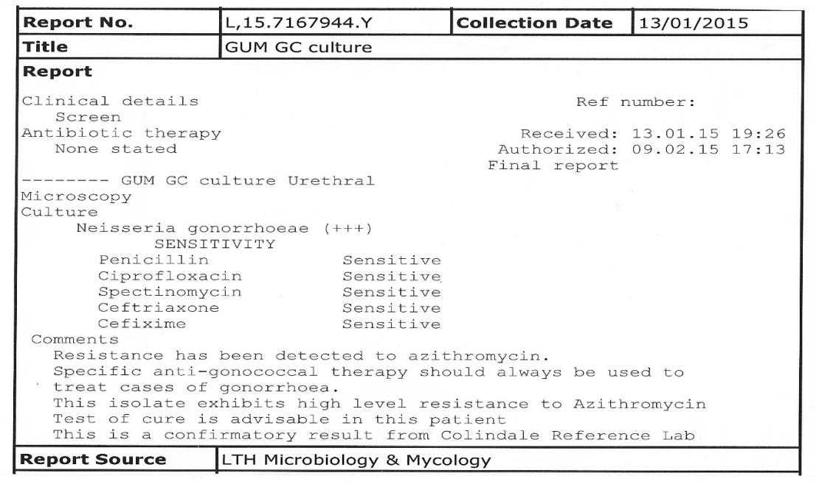
Missed identification
Patient attended, seen by consultant and reassured no resistance
This is how the report was produced:
Notes:
Big relief when recognised all were heterosexual
We may remove the ethnicity data as may not be enough time to say this

Slide 6
Immediate actions - 1
1. Assessment of the 8 cases to identify any patterns
All were heterosexual, 6/8 aged 20 years or younger
2/8 lived in same area and named each other as contacts
4/8 had already had negative TOC at 2 weeks post treatment
2. Notify all clinic staff of outbreak explaining profile of those affected and remind all that:
NAATs and cultures needed from all exposed sites when gonorrhoea suspected and before any treatment given
First face-to-face visit most effective in obtaining partner details
All people with gonorrhoea must have TOC at 2 weeks
Stop issuing postal TOC kits
Notes:
Big relief when recognised all were heterosexual
4/8 white British, 3 Black, 1 mixed white/black

Slide 7
Immediate actions - 2
3. Enhanced partner notification commenced:
Where initial PN incomplete, at least two further attempts at recall
TOC non-attendees contacted by phone to explain they had resistant gonorrhoea and why TOC very important - gave further opportunities to pursue PN
4. Treatment of further cases discussed with Dr Helen Fifer at STBRU
Discussion with STBRU – to treat with ciprofloxacin if culture result available and sensitive - to avoid further pressure on ceftriaxone by using as monotherapy
Notes:
Treatment of further cases discussed with Dr Helen Fifer of STBRU to ensure we used optimal treatment

Slide 8
Outcome – 1
16 people with high-level azithromycin resistance identified
All had the same profile on whole genome sequencing
All isolates fully susceptible to ceftriaxone
All heterosexual; 8 female, 8 male
13/16 (81%) aged 16-20 years
No geographical clustering within Leeds areas
Sites of infection: Males: 7 urethral; 1 conjunctiva infection only
Females: 4 ur/cx infection; 2 ur/cx/pharynx; 1 ur/cx/rectum; 1 pharynx only
Notes:
The profile of all 16 cases remained similar to the first 8
The even numbers of females and males suggested truly heterosexual
2/16 past history of gonorrhoea, 4/16 past history of chlamydia and had taken azithromycin
Mix of ethnicity in keeping with what we expect to see with gonorrhoea

Slide 9
Outcome - 2
Treatments
12 given ceftriaxone 500mg and azithromycin 1g prior to culture result
2 treated for PID prior to culture result
1 given spectinomycin. TOC ur/cx negative but was pharyngeal positive with treatment failure at that site. Retreated with ciprofloxacin 500mg stat.
Conjunctival infection treated with ceftriaxone 500mg for 3/7 plus ciprofloxacin 500mg bd for 7 days
12/16 attended for TOC – all negative
Outbreak in Leeds controlled by November 2015

Slide 10
Negative
1
Nov’14
2
Jan’15
Negative
Casual x1
Casual x3
5
Feb’15
3
Feb’15
Negative
Casual x2
8
Mar’15
4
Feb’15
Casual x1
Casual x1
10
Jun’15
6
Feb’15
Huddersfield
Positive NAAT
Negative culture
11
Jul’15
7
Feb’15
Birmingham
13
Sep’15
9
Mar’15
Huddersfield
15
Oct’15
12
Aug’15
Casual x1
Negative
16
Oct’15 Bradford
14
Sep’15

Slide 11
Lessons learned
Despite these time of financial austerity, block contracts, siting of clinics in community settings and use of private providers in sexual health:
NG cultures for antimicrobial sensitivity testing remain essential – clinics should ensure mechanisms to deliver highest culture sensitivity possible
Any resistance is significant and needs monitoring
Microbiology laboratories must send NG isolates suspected of showing resistance to ceftriaxone and/or azithromycin to STBRU
The role of the Health Advisor is essential in co-ordinating effective PN
Despite enhanced PN many contacts in young heterosexuals are untraceable
Young people should be tragetted and seen as priority in clinics

Slide 12
Acknowledgements
National Outbreak Control Team
Sexually Transmitted Bacteria Reference Laboratory (STBRU)
Dr Helen Fifer
Stephanie Chisholm
Sarah Alexander
Dr Aura.Andreasen
PHE Field Epidemiology Service
Gwenda Hughes
Simon Padfield
Adrian Wensley
Local Outbreak Control team
Leeds Microbiology
Dr Miles Denton
West Yorkshire Health Protection Team
Dr Andrew Lee
All Leeds Sexual Health colleagues

