Slide 1
Mycoplasma genitalium and macrolide resistance in pelvic inflammatory disease (PID)
Gillian Dean¹, Jennifer Whetham¹, Suneeta Soni¹,
Rachel Pitt², Sarah Alexander²
¹Brighton & Sussex University Hospitals NHS Trust, Brighton
²Sexually Transmitted Bacteria Reference Unit (STRBU), Public Health England

Slide 2
Introduction
Pelvic inflammatory disease (PID):
        Caused by spread of STIs and endogenous flora from the lower genital tract
        Chlamydia trachomatis and Neisseria gonorrhoeae are known causative agents
        Mycoplasma genitalium infection is associated
        Inadequately treated infections can result in tubal scarring, chronic pelvic pain, ectopic pregnancy and infertility

Slide 3
Introduction 2
    Diagnostic assays are widely available for C. trachomatis and N. gonorrhoeae
    In some studies^{1,2} the incidence of M. genitalium found to be similar to C. trachomatis in high risk patients but…
    M. genitalium not routinely tested for (unknown burden in PID)
Bjartling C. et al. (2012) American Journal of Obstetrics and Gynecology
Haggerty CL. et al. (2011) Infectious Diseases in Obstetrics & Gynecology

Slide 4
Introduction 3
One of the main obstacles to treatment success is adherence to a 14 day treatment regimen
Current UK PID treatment guidelines recommend 2 weeks of antibiotics:
          ofloxacin 400mg bd plus 400mg metronidazole or
          doxycycline 100mg bd plus 400mg metronidazole plus 500mg ceftriaxone IM
  Neither regimen appropriate for treating M. genitalium
    Ofloxacin and doxycycline show poor activity against Mycoplasma sp. compared with newer fluoroquinolones and macrolide antibiotics¹
1. Manhart LE. et al. (2011) Clinical Infectious Diseases

Slide 5
Antimicrobial Resistance (AMR)
Resistance to antimicrobials is of growing concern in bacterial infectious diseases, including M. genitalium
Molecular markers of macrolide resistance have been described in up to 58%¹ of patients positive for M. genitalium in some studies
Macrolide AMR can be selected for or transmitted
    1 g stat dose of azithromycin known to select for AMR in M. genitalium
    5 day course should not select for AMR
Molecular markers associated with resistance to fluoroquinolones have also been reported in between 5%² and 15%³ of positive specimens in some studies
1. Gesink D. et al. (2016) Canadian Family Physician
2. Pond MJ. et al. (2014) Clinical Infectious Diseases
3. Couldwell DL. et al. (2013) International Journal of STD and AIDs

Slide 6
Methods
Randomised controlled trial for women with mild to moderate PID (oral presentation 06)
Comparing standard of care to a short course of antibiotics
        Arm 1: standard 14 day regimen ofloxacin & metronidazole
        Arm 2: 1g azithromycin on day 1 then 500 mg od for 4 days, 400 mg metronidazole bd 5 days, stat 500mg ceftriaxone IM
Clinical specimens were tested for C. trachomatis, N. gonorrhoeae and M. genitalium (M. genitalium testing done at STBRU*) - TOC at 6 weeks
    M. genitalium positive specimens were analysed retrospectively for the presence of macrolide resistance associated mutations
        23S rRNA gene sequencing
*Sexually Transmitted Bacteria Reference Unit

Slide 7
Results
Specimens were received from 265 patients between 2011 and 2015
10% (27/265) were positive for M. genitalium
TOC were received for 12 (44%) M. genitalium positive patients
        67% (8/12) negative
        33% (4/12) positive (at least once)

Slide 8
23S rRNA sequencing
Results available for isolates from 19 patients
*A2058, A2059
All macrolide (AZI) AMR mutations present at base-line
 | No. patients | Genotype | % of total
Wild-type* | 8 | Susceptible | 42%
AMR | 11 | Resistant | 58%
A2058G | 2 (18%) | Resistant
A2058T | 1 (9%) | Resistant
A2059C | 3 (27%) | Resistant
A2059G | 5 (45%) | Resistant

Slide 9
Treatment received
M. genitalium positive (19)
ARM1- ofloxacin
(8, 42%)
ARM2 - azithromycin
(11, 58%)
Susceptible
(4, 50%)
AZI-resistant
(4, 50%)
Susceptible
(4, 36%)
AZI-resistant
(7, 64%)
2 TOC -ve, WT
1 TOC +ve,
2 TOC –ve,
A2058G/A2059G
3 TOC +ve, all A2059G
1 TOC –ve, A2059C
No recorded treatment failures in ARM2 susceptible specimens

Slide 10
Macrolide resistance - clinical outcome
 | Patient | 1st rx at first visit | 2nd rx after M gen pos test | Symptoms resolved at 6 weeks? | TOC at 6 weeks | Outcome
ARM1 | 1 | Ofloxacin | - | Yes | not available | Returned to Japan
 | 2 | Ofloxacin | Azithromycin | Yes | positive | LTFU?
 | 3 | Ofloxacin | ? | ? | not available
 | 4 | Ofloxacin | Moxifloxacin | Yes | negative
ARM2 | 5 | Azithromycin | Azithromycin | Yes (UPSI) | positive | LTFU
 | 6 | Azithromycin | - | No | positive | Moxifloxacin, pain free
 | 7 | Azithromycin | Azith/oflox/mtz | No | positive | LTFU
 | 8 | Azithromycin | LTFU | LTFU | not available | LTFU
 | 9 | Azithromycin | - | Yes | not available | LTFU
 | 10 | Azithromycin | Doxy/mtz | No | not available | LTFU
 | 11 | Azithromycin | - | Yes | not available

Slide 11
Macrolide resistance - clinical outcome
 | Patient | 1st rx at first visit | 2nd rx after M gen pos test | Symptoms resolved at 6 weeks? | TOC at 6 weeks | Outcome
ARM1 | 1 | Ofloxacin | - | Yes | not available | Returned to Japan
 | 2 | Ofloxacin | Azithromycin | Yes | positive | LTFU?
 | 3 | Ofloxacin | ? | ? | not available
 | 4 | Ofloxacin | Moxifloxacin | Yes | negative
ARM2 | 5 | Azithromycin | Azithromycin | Yes (UPSI) | positive | LTFU
 | 6 | Azithromycin | - | No | positive | Moxifloxacin, pain free
 | 7 | Azithromycin | Azith/oflox/mtz | No | positive | LTFU
 | 8 | Azithromycin | LTFU | LTFU | not available | LTFU
 | 9 | Azithromycin | - | Yes | not available | LTFU
 | 10 | Azithromycin | Doxy/mtz | No | not available | LTFU
 | 11 | Azithromycin | - | Yes | not available

Slide 12
Fluoroquinolone AMR
Also looked at gyrA & parC, involved in fluoroquinolone resistance
Two patients carried isolates with mutations in the QRDR of gyrA
            One isolate also carried macrolide AMR mutation (A2059G)
Significance?
One patient carried an isolate with a mutation in parC
        Previously reported in moxifloxacin resistant strains^{1,2,3}
        Isolate also carried macrolide AMR mutation (A2059G)
1. Gesink D. et al. (2016) Canadian Family Physician
2. Couldwell DL. et al. (2013) International Journal of STD and AIDs
3. Tagg KA. et al. (2013) Journal of Clinical Microbiology

Slide 13
Discussion & Conclusions
10% (27/265) of patients with mild to moderate PID were positive for M. genitalium
Of the 19 patients (70%) for whom 23S rRNA sequencing data available 58% (11/19) carried AMR associated mutations
    3 patients treated with azithromycin had positive TOCs
      All isolates from these patients carried macrolide AMR associated mutations at base-line and TOC
      No evidence that AMR was selected for
    3 isolates exhibited mutations in fluoroquinolone associated genes. Two of these isolates also showed macrolide resistance associated mutations
      neither regimen may have cleared infection??

Slide 14
Discussion & Conclusions
  During the study M. genitalium positive patients were thought to be treated appropriately (5 day course of azithromycin or moxifloxacin) but…
    Highlights the need for diagnostic and AMR testing prior to treatment

Slide 15
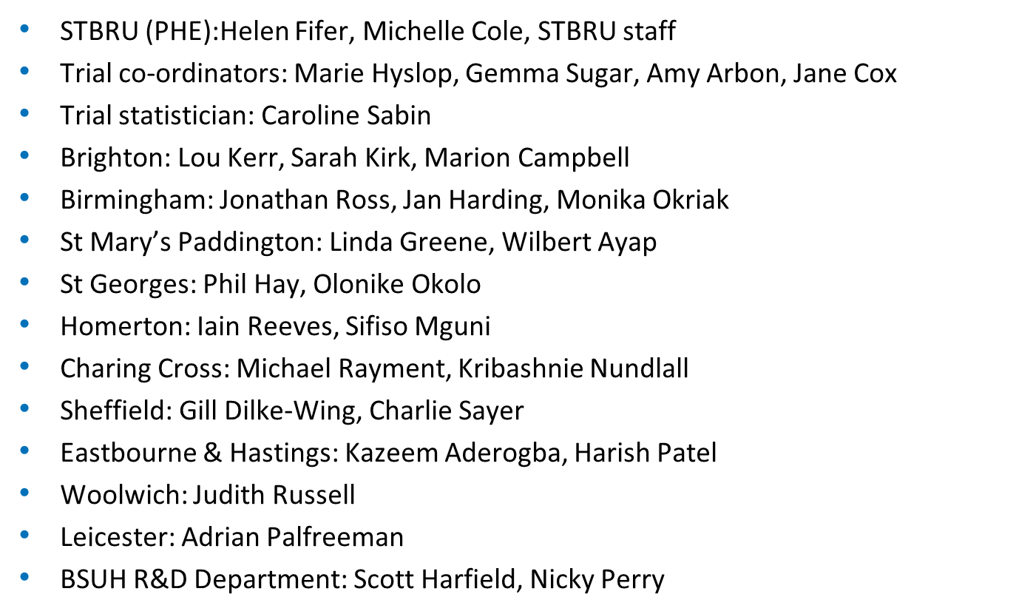
Acknowledgments

