Slide 1
Sexual and reproductive health consultations in an NGO primary care facility over a nine week period.
Charline Bradshaw^{1,2} Fionnuala Finnerty^{1,2} Elaine Ortiz ¹ Daniel Richardson^{2,3}
1. The Hummingbird Project, 2. Brighton & Sussex University NHS Trust, 3. Brighton & Sussex Medical School

Slide 2
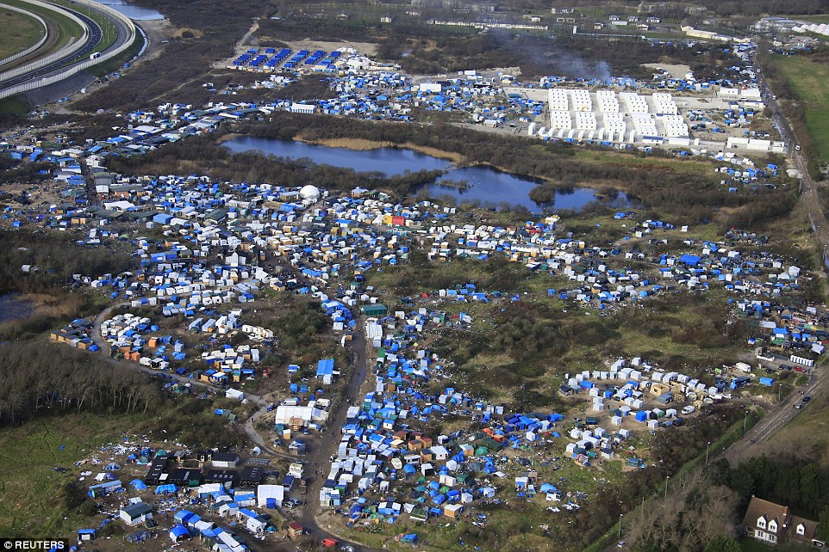
Notes:
The emergence of the “jungle” camp in Calais has been described as a humanitarian emergency. Between 1 January and 31 December 2015, an estimated 1,008,616 people fled to Europe
49% from syria, 21% from Afghanistan and 9% from Iraq
17% were women and 25% were children under the age of 18
An Estimated 7000 people living in Calais (February 2016)
Calais – calais has housed refugees for a long time with a previous red cross reception centre opened in 1999 called the sangatte which was shut down by sarcozy in 2002.
There have been various "jungle" camps around Calais since 2002, where migrants set up camp on unoccupied land, moving to new locations when camps are closed down by the French authorities. At the same time other migrants squat in abandoned buildings. In April 2015, The Guardian reported that the "official" and principal "jungle" in Calais was located at a former landfill site, three miles from the centre of town, and occupied by 1,000 of the 6,000 migrants in Calais. According to the paper, it was one of nine camps then existing in Calais. This jungle for the first time had showers, electricity and toilets, plus one hot meal served per day, but without proper accommodation
Calais and the surrounding areas are a good place for refugees to try and get to the UK so the number swelled IN APRIL 2015 again
In response, the french govt opened the jULES ferry centre to provide housing. However, this only provides accomodation for 100 or so women and children.
The camp sprung up and was home to approx 7000 refugees in Febrauary
Refugees are mostly men, and young. They are fit and strong and there are a number of unaccompanied children and adolescents. That figure is estimated at a 1000
A mini city sprung up with a night club, church, book shop and restaurants. The conditions are squalid and abysmal.
There are limited showering facilities, there are few toilets and no access to laundary facilities. MSF run a clinic from MONDAY – FRIDAY and they have 4 doctors, several nurses, a physio and a field pharmact. There is a hospital near by. There is currently a vaccination program run by a UK based charity called hands international who are focussing efforts on measles following the recent outbreak.
in January 2016, a complex of 125 container housing units for 1500 people was opened by the French government, to increase sanitary conditions in the area. But because registration is mandatory for migrants who want to live in the units, the units are mostly vacant, as migrants fear that registration will prevent them from living in the

Slide 3
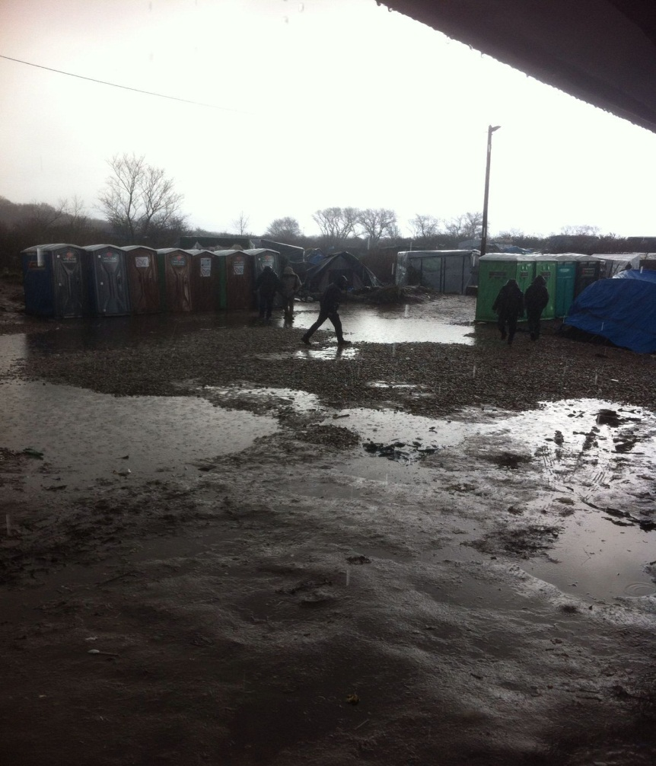
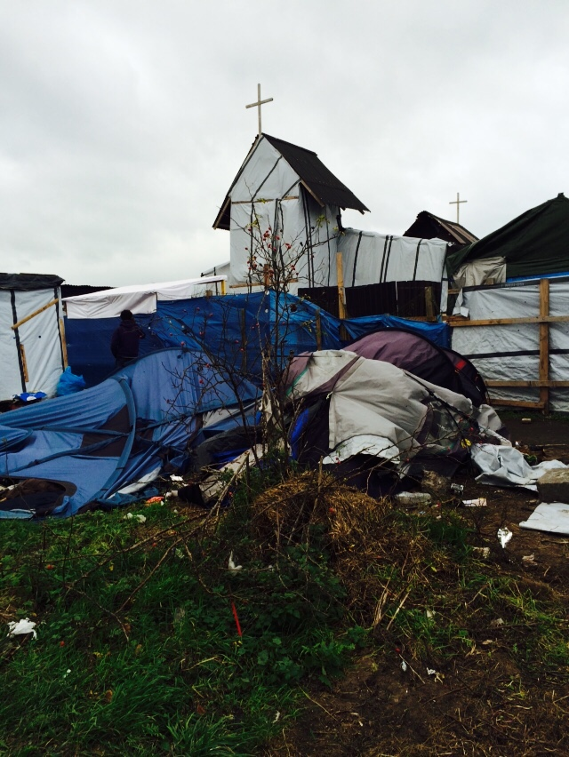

Slide 4
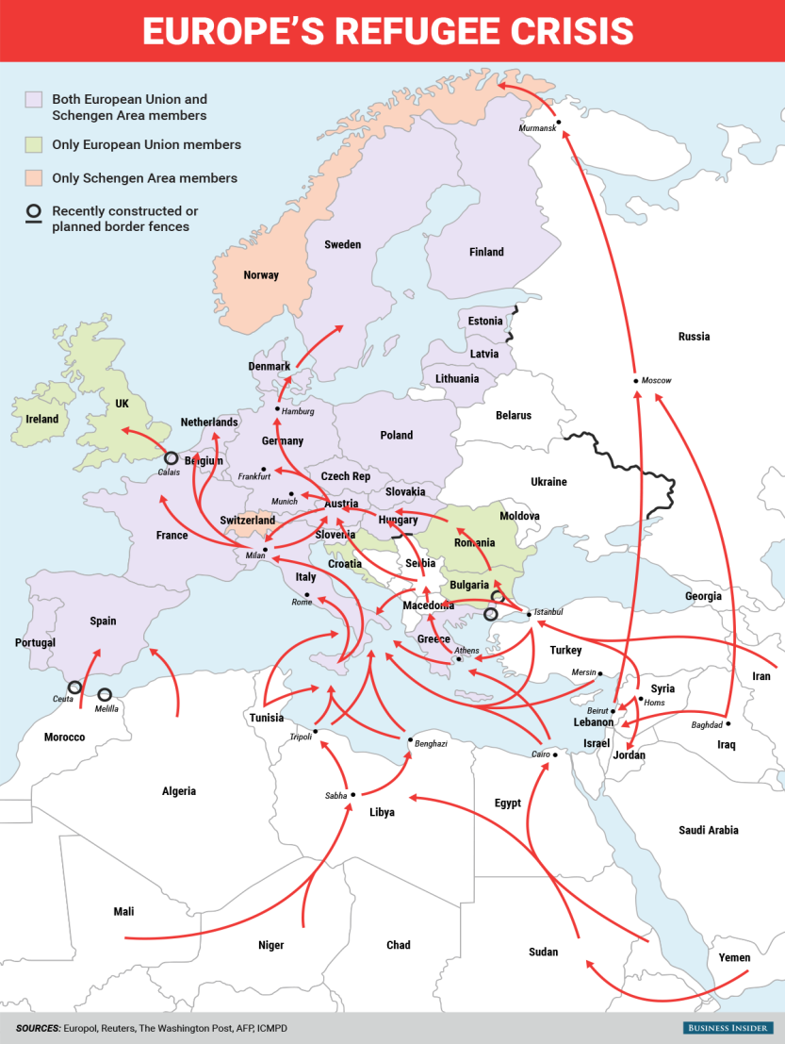
Notes:
Croatia, Serbia, Slovenia and Hungary are all on the west Balkan route to western Europe, which begins on the shores of Turkey, crosses the Aegean to the Greek islands and then moves north through the Greek mainland and Macedonia – with a destination of either Austria or Germany. According to the EU border agency it has surpassed the central Mediterranean route from Libya to Italy as the main entry point for refugees into Europe.
Progress has been slow towards an agreement over how to accommodate tens of thousands of refugees. Germany has led calls for the EU to accept mandatory quotas but central and eastern European members are resisting. Meanwhile, Germany, Austria and Slovakia have suspended the EU's Schengen zone by introducing border checks, while Hungary has built a razor-wire fence on its frontier with Serbia. Croatia and Slovenia have also regularly opened and closed their borders
European countries have been overwhelmed in all aspects by recent events
Europe is facing unprecedented challenges with large influxes of people
The future of refugees in Europe is very uncertain
2015 will be remembered as the year in which europe catastrophically failed in its responsibility to respond to the urgent needs of assistance and protection of hundreds of thousands of vulnerable people. not only did the european countries and its member states collectively fail to address the urgent humanitarian and medical needs of refugees and migrants arriving at external or internal eU borders, but the european Union’s deterrence and anti-immigration policies – developed over the last 15 years and further strengthened in 2015 – have increased the demand for migrant smuggling networks and pushed people towards ever more dangerous routes which jeopardise their health and lives. these policies have largely contributed to the patterns of the reception crisis we are witnessing today : with those desperate to come to europe forced to cross the sea and southern eU countries failing to respond to their needs.

Slide 5
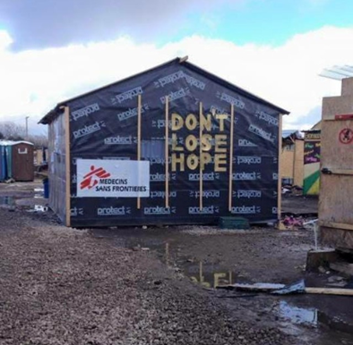
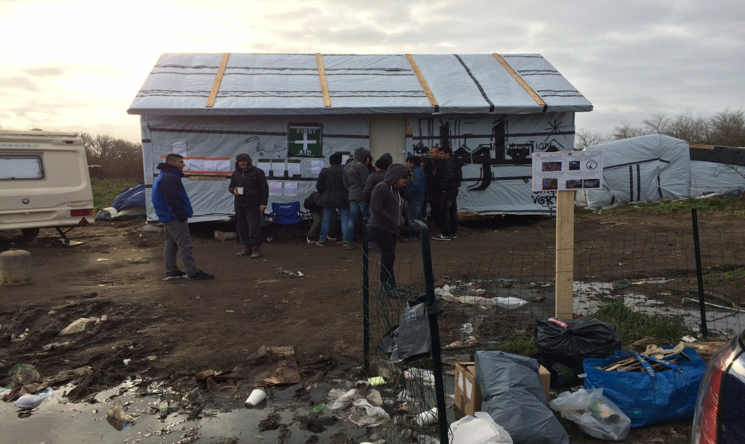

Slide 6
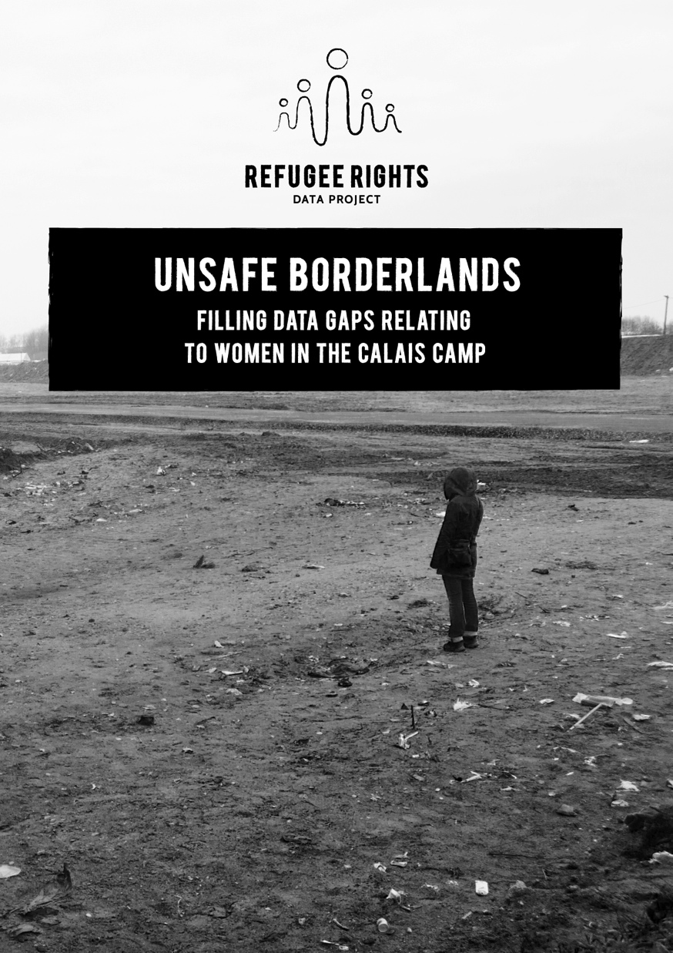
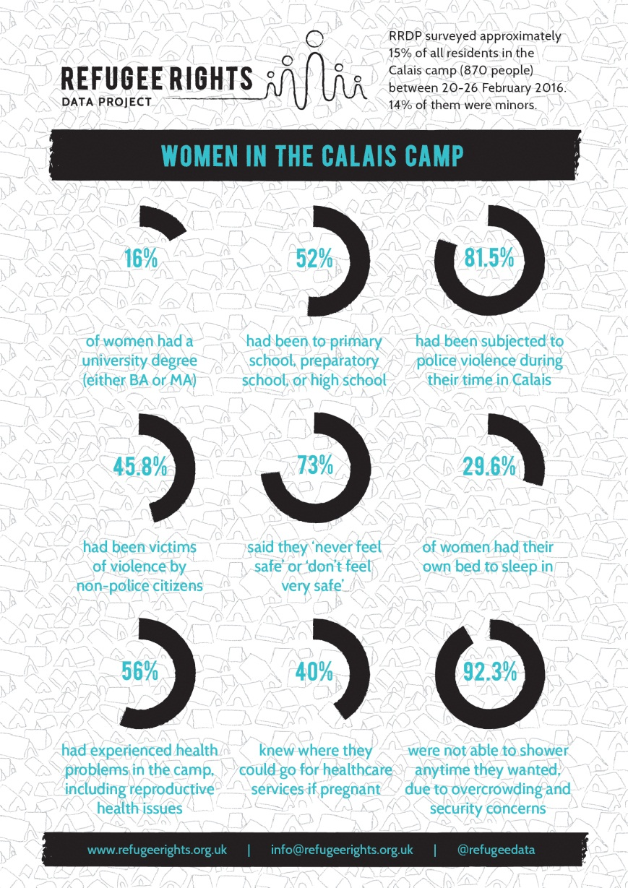
Notes:
With a specific focus on women in the camp, there has been a recent head count conducted by a group called Refugee Rights. As you can see from the infographic, 56% of women interviewed, had experiences health problems, inccluding RH issues, and only 40% knew where they could go for healthcare services if pregnant. The overall theme of lack of security, inadequate provision of basic healthcare.

Slide 7
Notes:
The Minimum Initial Service Package (MISP) for Reproductive Health (RH)
is a coordinated set of priority activities designed to: prevent and manage the consequences of sexual violence; prevent excess neonatal and maternal morbidity and mortality; reduce HIV transmission; and plan for comprehensive RH services in the early days and weeks of an emergency.
This set of activities must be implemented at the onset of an emergency in a coordinated manner by trained staff. The MISP can be implemented without a new needs assessment because documented evidence already justifies its use. The MISP is a standard in the 2004 revision of the Sphere Humanitarian Charter and Minimum Standards in Disaster Response.
The components of the MISP form a minimum requirement and it is expected that comprehensive RH services will be provided as soon as the situation allows. The implementation of the MISP requires essential equipment and supplies, which are available in pre- packaged kits for emergency deployment.

Slide 8
Method
All clinic attendances over 9 weeks reviewed
Data regarding sexual health attendances were extracted.
Notes:
Don’t forget to talk about the clinic

Slide 9
Results
Women aged 15-44 | Men aged 15-44
394 | 6118
17 women (1.8 per week) | Requested pregnancy tests
9 women (1 per week) | Requested termination of pregnancy
2 women (0.7 per week) | Consultation where sexual violence disclosed
22 men (0.4% overall population) | Advice or treatment for STI
12 (1.3 per week) | Requests for contraception
Notes:
394 women and 6118 men aged 15-44 attended the primary care clinic during the study period.
Of these, 22 men (0.4%) and 39 women (10%) women sought a consultation regarding SRH.
There were 17 requests for pregnancy tests (1.8 per week), 9 termination of pregnancy requests (1 per week) and 2 consultations where sexual violence in women was disclosed, (0.7 per week). 22/6118 men (0.4%) sought advice or treatment for a sexually transmitted infection during the study period.

Slide 10
Results 2
Standard
Leader to implement MISP – reproductive health officer in place NOT MET
Prevent sexual violence and assist survivors NOT MET
Reduce transmission of HIV NOT MET
Prevent obstetric and newborn morbidity/mortality Partially met
Plan for comprehensive sexual health services integrated into primary health care NOT MET

Slide 11
Conclusion
Provision of (sexual) & reproductive health in Calais is limited
Demand is high: men do not access the service leaving women particularly vulnerable to poor sexual health and possibly violence.
The data is likely to represent the tip of an iceberg. Given the extent of the current refugee crisis and the increase in transit camps around Europe.
Lessons need to be learned from the Calais “jungle” camp.

Slide 12
Notes:
Women who present to the clinic are the tip of the iceberg
No data on MSM’s

