Slide 1
Saliva use as a lubricant for anal sex is a risk factor for rectal gonorrhoea among men-who-have-sex-with-men, a new public health message: a cross sectional survey
Eric Chow⁽¹⁾⁽²⁾ Vincent Cornelisse⁽¹⁾⁽²⁾ Tim Read^{(1)(2),} David Lee⁽¹⁾⁽²⁾⁽³⁾ Sandra Walker ⁽¹⁾⁽²⁾ Jane Hocking⁽³⁾ Marcus Chen⁽¹⁾⁽²⁾ Catriona Bradshaw⁽¹⁾⁽²⁾ and Kit Fairley⁽¹⁾⁽²⁾
Melbourne Sexual Health Centre⁽¹⁾
Monash University, Melbourne⁽²⁾
The University of Melbourne⁽³⁾
Notes:
Good morning.
On behalf of the authors, I would like to thank the organizers for accepting our paper at BASSH.
It is indeed a privilege to present at this prestigious conference.
I hope that this study will lead to a lively discourse about reducing ano-rectal gonococcal transmission.
It is timely as well, seeing that we are looking at global worldwide antibiotic resistant strains of the gonococcus.

Slide 2
BACKGROUND
Anal sexual practices apart from penile-anal sex are common in men-who-have-sex-with-men (MSM)
Is there a plausible explanation(s) for findings that are common across many studies but hard to explain
  Oral sex is associated with anal gonorrhoea (GC)
  Anal GC occurs relatively frequently in men who use 100% condoms
  Anal GC is so common given that urethral GC is present for such a short duration at a population level
Notes:
Understanding the transmission of gonorrhoea in MSM is the key to its successful control.
Gonorrhoea transmission is still occurring in the absence of UPAS
If however, the penis is not solely involved in the acquisition of anal gonorrhoea, an alternative explanation is required
Saliva use as a lubricant for anal sex is common practice among MSM

Slide 3
Aim of Study
Evaluate if any other anal sex practices are risk factors for An GC in MSM
  Rimming (oral-anal contact / licking);
  Fingering
  Nudging / dipping (Penis ‘slightly inserted’ but not fully pass the anal verge)
  Saliva-use (as a lubricant)
  STAG Study (Poster P089)
  The gonococcal bacterial loads in saliva are strikingly high among MSM with untreated pharyngeal gonorrhoea.
Notes:
Very little is known about the role of saliva in the transmission of STIs
We aimed to quantify the proportion of MSM engaged in other anal sexual practices (rimming, fingering and use of partner’s saliva as a lubricant for anal sex.)
And I am not talking about Caroline’s quite mistaken notion of wetting the rim of a glass and making a tune
Previous to this study, we had found that gonorrhoea was present in saliva on culture up to 14 days of positivity.
I invite you to view this poster on this at P085

Slide 4
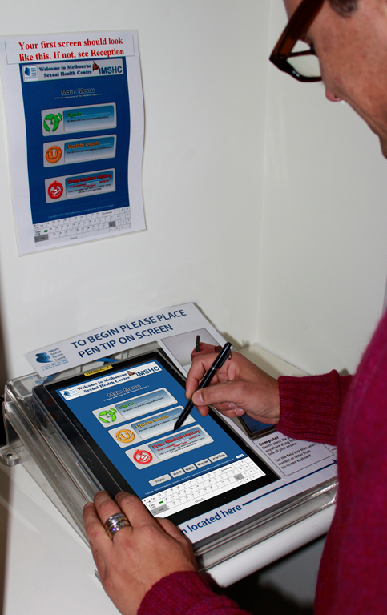
Method
Cross sectional study (2014/2015)
Population and Sampling
  MSM attending clinic requiring to do CASI*
  MSM who did not have an An GC test excluded
Measurement
  Additional 6 questions with CASI
  Epidemiological risk characteristics
  *Computer Assisted Sexual History Inventory
Notes:
This was a cross sectional study conducted at the Melbourne Sexual Health Centre for 12 mths in 2014 / 2015.
CASI is a Computer Assisted Sexual Self Interview which is completed at initial registration and 3 monthly
MSM who were required to do CASI were invited to answer an additional sex questions

Slide 5
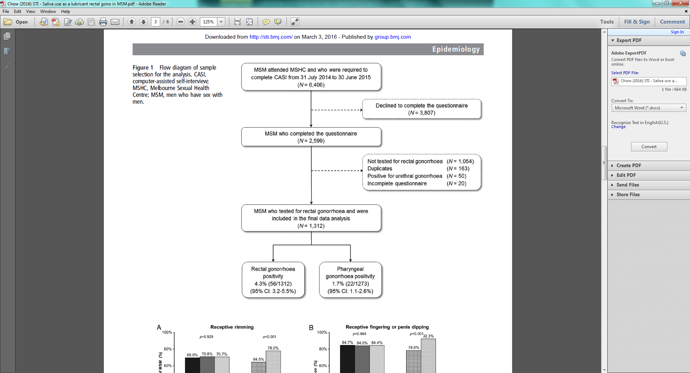
Results
Notes:
In the period of the study, over 6400 men completed CASI.
Of these half declined to participate
Of the remaining 2500, 1312 were tested for anal gonorrhoea.
The positivity of anal gono was 4.3%

Slide 6
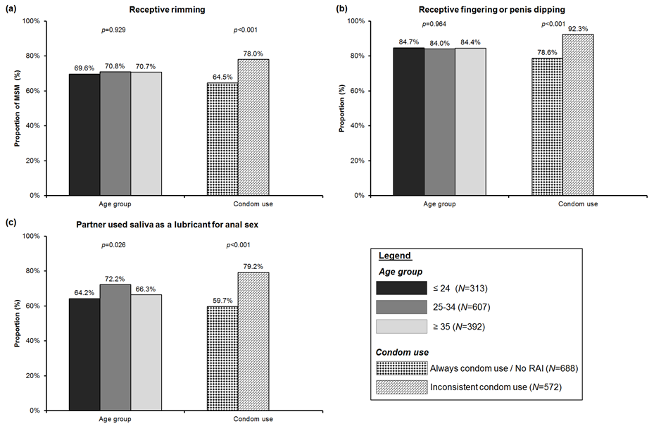
Proportion of MSM who engaged in (a) receptive rimming, (b) receptive fingering or penis dipping, and (c) saliva use as a lubricant for anal sex, by age group and condom use for receptive anal intercourse.
Notes:
Of the 1312 men, the median number of sex partners in the last 3 months was 3 (IQR 2-5).
75% reported receptive rimming. The median number of rimming partners in the last 3 months was 1 (IQR 0-3)
84.3% reported receptive fingering or penis dipping; with the median fingering / dipping was 2 (IQR 1-4)
Receptive rimming and fingering / dipping did not differ by age groups.
68.5% reported use of partner’s saliva as a lubricant for anal sex in the last 3 months.
Men who reported not always using condoms for RAS were more likely to have receptive rimming, receptive fingering / dipping and using partner’s saliva as lubricant compared with those who used condoms always or reported no RAS in the last three months.
2.5% of the sample were HIV positive and there was no significant association observed between anal sexual practices and HIV serostatus.

Slide 7
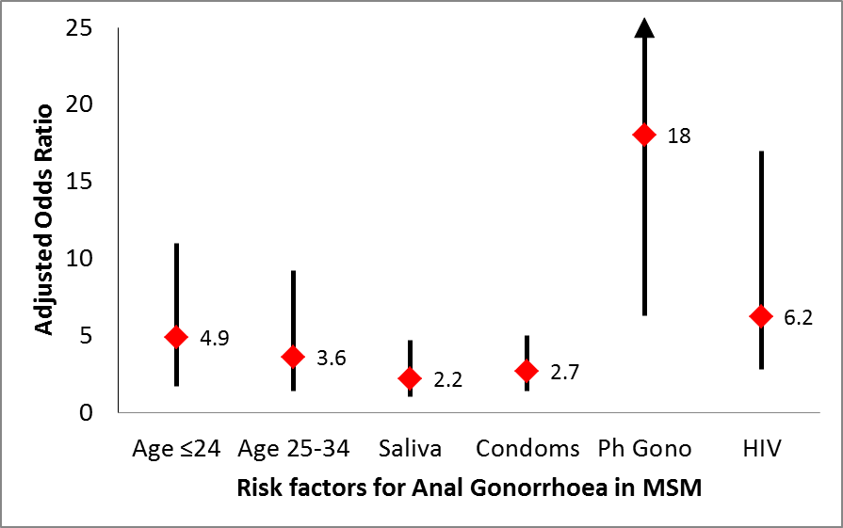
AOR and Risk factors for An GC among MSM
Notes:
In the model, we adjusted for age, condom use for RAS, pharyngeal gono positivity and HIV serostatus
There were six factors associated with anal gonorrhoea.
These were younger age <24 years old, saliva use as lubricant, condoms for receptive anal sex; pharyngeal gonorrhoea and HIV
Use of saliva as a lubricant was 2 times more likely to be associated with acquiring anal gonorhhoea.
Condom use had a similar magnitude of risk.
Rectal gonorrhoea was 2 times more likely significantly associated with using partner’s saliva as a lubricant (OR 2.5) but not as
associated with receptive rimming or fingering / dipping.
Rectal gonorrhoea was strongly associated with throat gonorrhoea in both univariate and multivariate analysis.
The adjusted odds of having rectal gono were 2 times higher among those who used partners saliva as lubricant compared those who did not after adjusting for.
The crude population-attributable fraction of anal gono with partner saliva as lubricant was 49%, and the adjusted PAF of anal gono was 41.4% after adjusting for age, condom use for RAS, pharyngeal gono positivity and HIV statu
Mo
Age group
Use of saliva
Th Gono
HIV
del 6 factors a/w rectalh\

Slide 8
Limitations
• Sampling bias (low response rate ~ 41%)
• Recall bias – data self reported
• Setting – urban specialized clinic
• May not be generalizable to broader community-based MSM
• Testing - culture gono testing; poor sensitivity (~53%)
      •Underestimate true prevalence of rectal gono (as opposed to NAAT)
• Cautious interpretation - wide CI of PAF (7-72%) and adjusted OR
    (1-5) of using partner’s saliva as a lubricant

Slide 9
Discussion
Potentially 1/3 of An GC may contribute to partner saliva use for anal sexual practices.
Saliva operating as a medium may be the key to understanding rectal infections
The public health implication is complex given that saliva is commonly used as part of sexual activity among MSM.
Notes:
It is possible that saliva operates as a potential medium for transmission of anal gono.
This is the first study to show that using partner’s saliva for anal sexual practices may be a substantial risk factor for rectal gonorrhoea, potentially contributing to about 40% of rectal infections.
The public health implications for a preventive message for STI is likely complex and challenging given that saliva is commonly used as part of sexual activity among MSM.
There are several limitations to our study:
Saliva use as a lubricant involves a larger volume of saliva in comparison with the exposure of saliva through rimming.
The strong association with pharyngeal gono in the adjusted analysis, highlights how important the pharynx is, in the overall transmission.
We hope that this first study on the association between saliva use as lubricant and anal gonorrhoea, will be explored in future studies, in different settings.

Slide 10



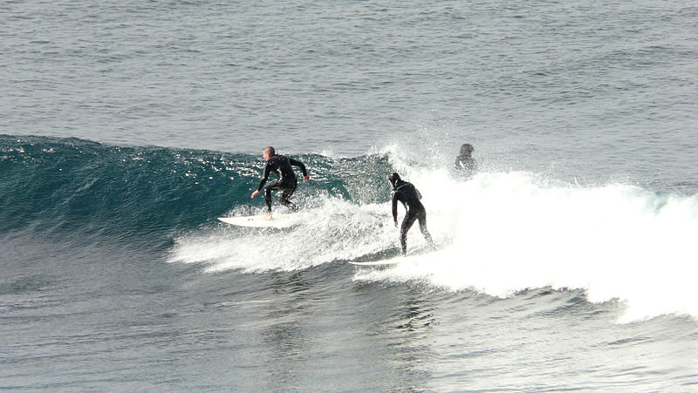

Notes:
Acknowlegements

