Slide 1
Low proportion of MSM tested for hepatitis C despite high prevalence in the tested population
Pasvol TJ, Khan PY, Thiagarajan A, Dakshina S, Sarner L, Orkin CM
BASHH 2016, Oxford

Slide 2
UK Guidelines HCV Testing = targeted testing
At-risk populations:
PWID (about 90% being tested ¹)
Prisons (8% of receptions tested within 30 days¹)
Immigration centres
‘Promote’ testing in GUM to high risk MSM²
Cosgrove P. Public health England Report: Hepatitis Epidemiology in the South East
Brook G et al. United Kingdom National Guidance on the management of the viral hepatitides A, B and C 2015. Int J STD AIDS. 2016 Jan
Notes:
MSM
75 non injecting
33 injecting
86 under influence of drugs
High proportions of UPSI

Slide 3
HCV in MSM
Data from the UK CHIC Study showed a cumulative hepatitis C (HCV) prevalence of 8.9% in HIV+ MSM¹ (1996-2007)
In the PROUD pilot study , the HCV incidence in high-risk, HIV negative MSM was 3.1%^{2.}
Screening for HIV and HBV is recommended in MSM
HCV testing encouraged in HIV +ve MSM
We present data on BBV testing in MSM at 2 London GUM clinics over 1 year
1. Turner et al. The prevalence of hepatitis C virus (HCV) infection in HIV-positive individuals in the UK - trends in HCV testing and the impact of HCV on HIV treatment outcomes. J Viral Hepat. 2010 Aug: 17(8):569-77
2. McCormack et al. Pre-exposure prophylaxis to prevent the acquisition of HIV=1 infection (PROUD): effectiveness results from the pilot phase of a pragmatic open-label randomised trial. The Lancet 2016 Jan; 387(10013):53-60
Notes:
393 participants enrolled, 160 screened for HCV & 5 incident HCV infections by 31/12/2013

Slide 4
Methods
Collected retrospective data from electronic patient records
All MSM attendances 01/07/14 – 30/06/15
Demographics
Number of attendances
BBV testing
STI diagnoses
BBV diagnoses
Comparing:
High-risk vs low risk MSM
HIV+ vs HIV– MSM

Slide 5
Results
4,415 MSM attended during 11,832 visits over one year
Median visits: 1 (IQR 1-3)
Median age: 34 (IQR 23-47)
Visit Type

Slide 6
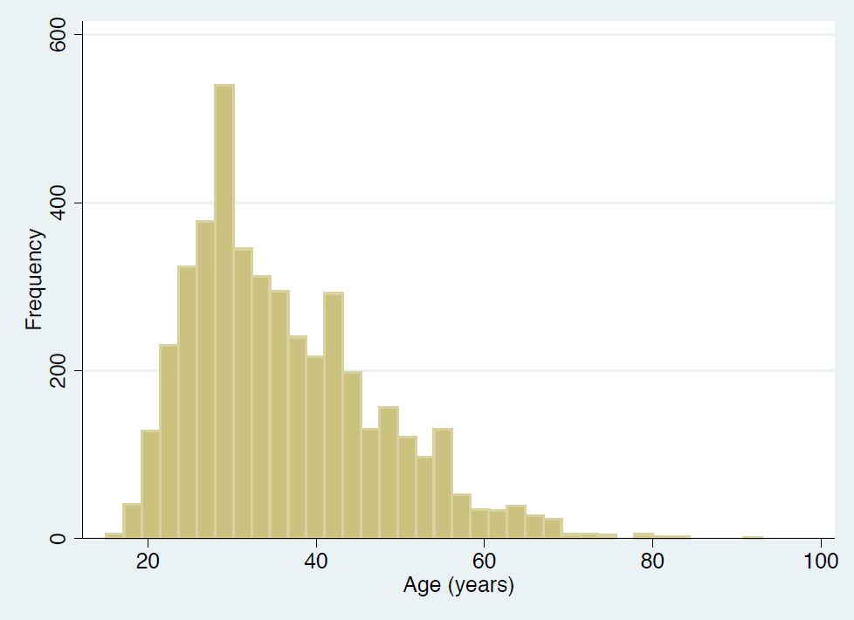
Demographics
Age
Ethnicity
Notes:
Insert age piechart

Slide 7
STIs
Overall 1,003 (23%) diagnosed with an STI
Gonorrhoea 640 (14.5%)
Chlamydia 398 (9.0%)
Syphilis 159 (3.6%)

Slide 8
BBV testing
 | HIV Ab | HCV Ab | HBV cAb
Tested | 3,526 (94.4%) | 794 (18.1%) | 2,162 (49.1%)
Positive | 48 (1.5%) | 18 (2.3%) | 11 (0.5%) (sAg +ve)
New diagnoses | 48 (100%) | 12 (67%) 8 (67%) viraemic | 4(36%)

Slide 9
New HCV positives

Slide 10
New HCV positives

Slide 11
New HCV positives
HIV
HIV
HIV
HIV

Slide 12
New HCV positives
HIV
HIV
HIV
HIV
UPSI
UPSI
UPSI
UPSI
UPSI

Slide 13
New HCV positives
HIV
HIV
HIV
HIV
UPSI
UPSI
STI
STI
STI
UPSI
UPSI
UPSI
STI
STI
STI

Slide 14
New HCV positives
HIV
HIV
HIV
HIV
UPSI
UPSI
STI
STI
STI
UPSI
UPSI
UPSI
STI
STI
STI
Country of origin

Slide 15
New HCV positives
HIV
HIV
HIV
HIV
UPSI
UPSI
STI
STI
STI
UPSI
UPSI
UPSI
STI
STI
STI
Country of origin

Slide 16
New HCV positives
HIV
HIV
HIV
HIV
UPSI
UPSI
STI
STI
STI
UPSI
UPSI
UPSI
STI
STI
STI
Country of origin
UPSI
HIV
HIV
HIV
STI
UPSI
UPSI
UPSI
STI
Country of origin

Slide 17
Testing patterns and outcomes in high-risk vs low-risk MSM (high risk >1 STI)
 | High Risk (n=1003) | Low risk (n=3412)
Tested for HCV | 282 (28.3%) | 512 (15.1%)
- HCV Ab+ | 10 (3.5%) | 8 (1.6%)
- HCV RNA+ | 7 (70%) | 2 (33.3%)
Tested for HBV | 545 (54.6%) | 1617 (47.5%)
- HBsAg+ | 4 (0.7%) | 7 (0.4%)
Tested for HIV | 672 (91.7%) | 2617 (87.1%)
- HIV Ab+ | 23 (3.4%) | 25 (1%)
STI diagnoses
- no concomitant STIs | 0 (0.0%) | 3412 (100%)
- 1-2 concomitant STIs | 923 (92.0%) | 0 (0.0%)
- 3+ concomitant STIs | 80 (8.0%) | 0 (0.0%)

Slide 18
HIV positive vs HIV negative
 | HIV+ (n=727) | HIV- (n=3485)
Tested for HCV | 198 (27.8%) | 587 (16.9%)
- HCV Ab+ | 12 (6.1%) | 6 (1.0%)
- HCV RNA+ | 5 (50%) | 4 (66.7%)
Tested for HBV | 191 (26.5%) | 1942 (55.8%)
- HBsAg+ | 6 (3.1%) | 5 (0.3%)
Tested for HIV | N/A | N/A
- HIV Ab+ | N/A | N/A
STI diagnoses
- no concomitant STIs | 434 (59.7%) | 2799 (80.3%)
- 1-2 concomitant STIs | 248 (34.1%) | 651 (18.7%)
- 3+ concomitant STIs | 45 (6.2%) | 35 (1.0%)

Slide 19
Conclusions
MSM were less likely to be tested for HBV & HCV than HIV
HCV prevalence was over 5x the national prevalence overall and 2.5x the national prevalence in HIV negative MSM
Prevalence of viral hepatitis was highest in HIV positive and in high-risk MSM
Half of the new HCV viraemic patients were HIV negative
Testing efforts should be increased and we are currently redeveloping local guidelines

