Slide 1


Behavioural factors associated with HPV vaccine acceptability amongst MSM in the United Kingdom
Tom Nadarzynski
Helen Smith, Daniel Richardson, Stephen Bremner & Carrie Llewellyn
Brighton and Sussex Medical School

Slide 2
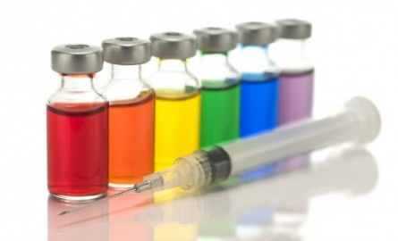
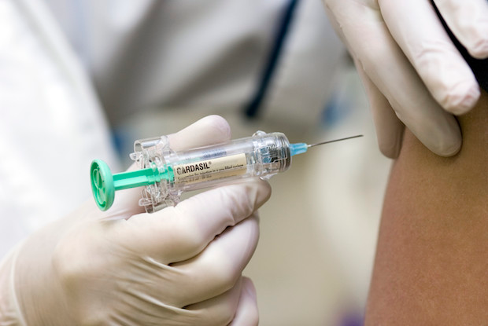
HPV vaccination for MSM
Genital warts and anal cancer
JCVI recommendation (Nov 2015)
- Sexual health and extended (e.g. GPs) settings
- MSM < 45 years old
Cost-effectiveness by PHE
- Predicted 89% initiation and 49% completion
Vaccination for MSM in Wales
Pilot for 40,000 MSM from Summer 2016
Notes:
HPV vaccination for MSM
Men who have sex with men (MSM) are at higher risk of genital warts and anal cancer due to HPV.
Female HPV vaccination has decreased genital warts in heterosexual men, but not MSM.
Last year, the Joint Committee on Vaccination and Immunisation recommended a targeted HPV vaccination programme for MSM, up to the age of 45 years, delivered in sexual health clinics.
It was based on cost-effectiveness modelling produced by Public Health England which predicted 89% initiation and 49% HPV vaccine completion rates.
These estimates were taken from hepatitis B vaccination uptake in MSM.
The funding of the targeted vaccination programme has been agreed in Wales and there are plans for a pilot of HPV vaccination for 40,000 MSM in England.
Our study aimed to examine factors associated with HPV vaccine acceptability to predict potential uptake.

Slide 3
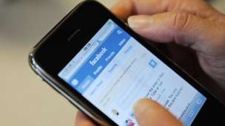

Methods
Online survey (July-August 2015)
Participants
- Geographically dispersed MSM
- Recruited via Facebook advertisement
Measurements (64 items)
- Demographic and behavioural variables
- Perceptions of HPV and the HPV vaccine
- 7-Item HPV vaccine acceptability scale
Notes:
Methods
In July and August last year, we conducted an online survey of attitudes towards HPV vaccination amongst MSM across the entire UK.
We recruited participants through Facebook, so men who declared their interest in other men were shown the study advert.
Our survey had 64 questions in total.

Slide 4
Results
(Sample: N=1508, mean age=24, SD=8)
Notes:
Results
1508 men took part in the survey.
70% of the sample were MSM below the age of 26.
Our participants were mostly self-identified men, gay, born in the UK, residents of England, dispersed around the country and living in big cities but also small towns. Most were single, in education and White.

Slide 5
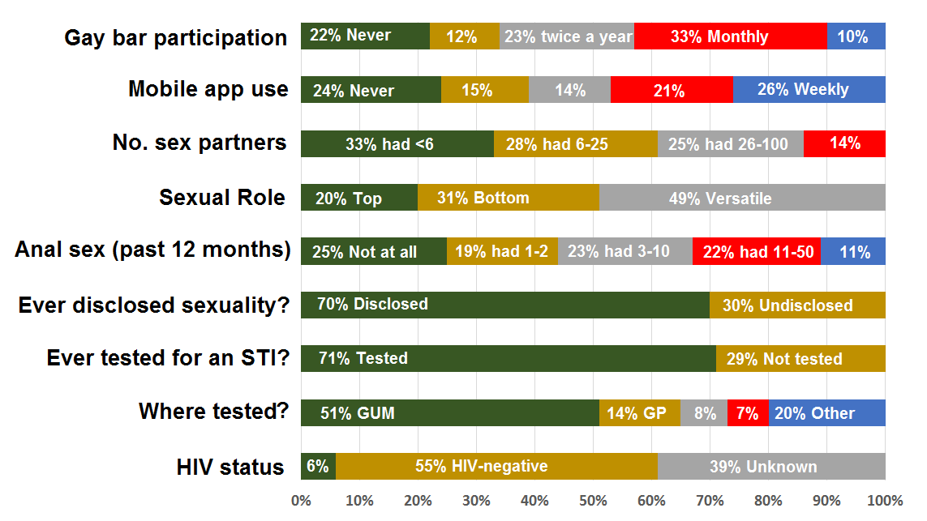
Behavioural characteristics
Notes:
Behavioural characteristics
A fifth of our sample had never used dating apps or visited a gay bar.
A third reported less than 6 lifetime sexual partners, so a large proportion of our sample were men at the beginning of their sexual activity with limited access to sexual networks.
25% have never engaged in receptive anal intercourse.
A third of the sample had not disclosed their sexual orientation to a healthcare professional
Also a third had never been tested for an STI.
Only half of the sample utilised GUM clinics for their STI testing, others used GP practices, blood donation services and home testing kits.
6% of our sample were men with diagnosed HIV and 39% did not know their status.

Slide 6
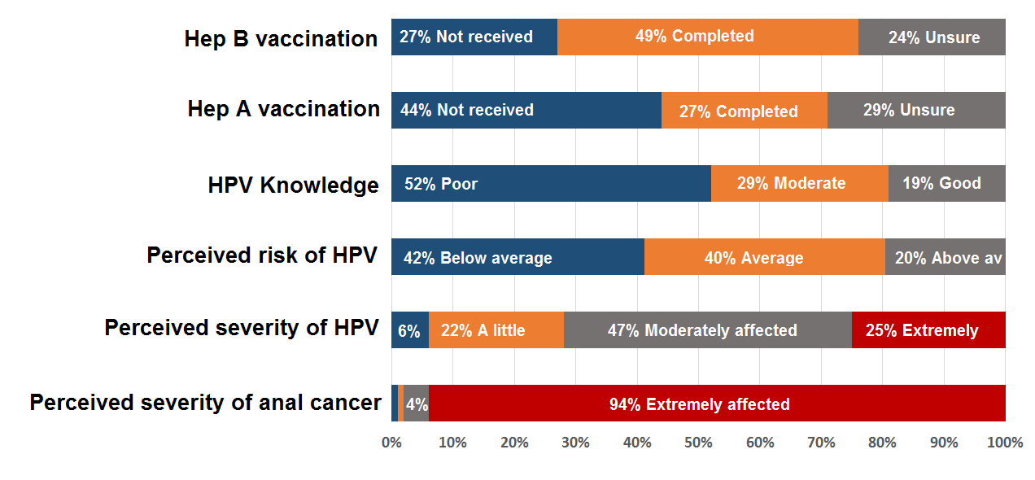
HPV-related characteristics
Notes:
HPV-related characteristics
49% of our sample reported completing the Hepatitis B vaccination
Less than a third completed the hepatitis A vaccination.
Only 19% had a good knowledge about HPV
42% of men believed they were not at risk of HPV compared to their peers.
Half of the sample answered that they would be moderately affected by HPV.
Nearly all, 94% perceived anal cancer to be a serious disease.

Slide 7
Perceptions of the HPV vaccine
Notes:
Perceptions of the HPV vaccine
Half of the sample thought the HPV vaccine was very effective and 15% believed that the effectiveness was only slight or non-existent.
The HPV vaccine was perceived to be highly beneficial in general.
From the list of 24 potential barriers such as “I don’t have time to be vaccinated”, “my doctor will not recommend it to me”, “My moral beliefs would prevent me from being vaccinated”, half of the sample reported between zero to five barriers, 42% reported up to 10 barriers and 7% reported up to 15 barriers.

Slide 8
Notes:
HPV vaccine acceptability
78% would consider being vaccinated against HPV.
72% would visit a sexual health clinic and 61% would disclose sexual orientation in order to receive the HPV vaccine.
55% would ask a doctor about the HPV vaccine.
However, if the vaccine was offered by a doctor 89% would accept it and 85% would complete the three dose course.

Slide 9
Factors associated with HPV vaccine acceptability
Variable | Factor | OR | 95% CI
Mobile app use | Monthly | 1.50 | (1.06-2.12)
 | Never
Disclosed sexuality | Yes | 2.02 | (1.39-3.14)
 | No
STI screening setting | Sexual health clinic | 1.82 | (1.29-2.57)
 | Other
HIV status | HIV-positive | 1.96 | (1.09-3.53)
 | HIV-negative
HPV knowledge | Good | 2.23 | (1.53-3.26)
 | Poor
Notes:
Factors associated with HPV vaccine acceptability slide 1
We then explored factors associated with HPV vaccine acceptability using regression analysis.
We found that men who frequently use dating apps, who had disclosed their sexual orientation, had accessed sexual health clinics, who were HIV-positive and who had a good knowledge about HPV were more likely to accept the HPV vaccine.
Disclosure of sexual orientation and HPV knowledge were the strongest predictors of HPV vaccine acceptability.
There were no significant differences in HPV vaccine acceptability according to age, number of sexual partners, geographical location, relationship status or sexual role.

Slide 10
Factors associated with HPV vaccine acceptability
Variable | OR | 95% CI
Comparative risk perceptions | 1.31 | (1.05-1.63)
Perceived seriousness of HPV infection | 1.89 | (1.16-3.01)
Perceived HPV vaccine effectiveness | 1.54 | (1.14-2.08)
Perceived benefits of HPV vaccination | 1.61 | (1.14-3.01)
Perceived barriers to HPV vaccination (Rev) | 4.46 | (2.95-6.73)
Notes:
Factors associated with HPV vaccine acceptability slide 2
Men who considered themselves at risk of HPV, who perceived HPV to be more serious, those who believed that the HPV vaccine is very effective were more likely to accept the HPV vaccine.
Those who perceived HPV vaccine to be highly beneficial and who reported fewer perceived barriers were also more likely to accept the vaccine.
Perceived barriers was the stronger predictor of HPV vaccine acceptability, with those reporting more barriers being less willing to receive the vaccine.

Slide 11
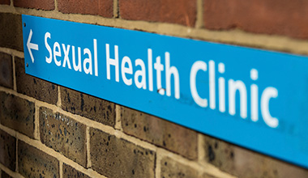
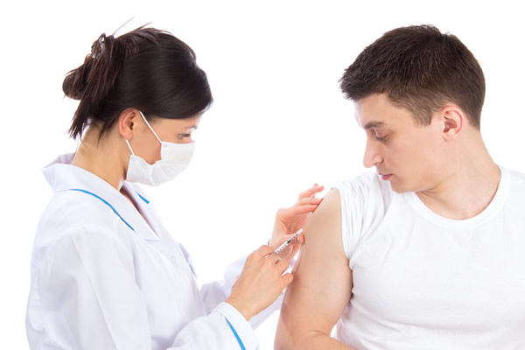
Discussion
89% of MSM would accept the HPV vaccine
But, only half (55%) would actively pursue it
Hep B vaccination (49%) a marker of uptake
Predictors:
- Access to sexual networks and sexual health services
- Openness about sexuality
- HPV knowledge and decision-making processes
Notes:
Discussion slide 1
The majority of MSM are receptive to HPV vaccination, but only half are prepared to actively pursue it.
Our findings support the Public Health England modelling predicting 49% completion rates.
HPV vaccine is highly acceptable, but over a half of MSM face multiple barriers to vaccinations at sexual health clinics.
These barriers are related to the access of young MSM to sexual health services, openness about same-sex experiences, limited HPV knowledge and specific decision-making processes such as perceptions of risk.

Slide 12
Discussion
Need for HPV education, support with access to clinics and disclosure of sexuality
Strengths & weaknesses:
- Views on young MSM at the beginning of their sexual activity
- Need for the measure of uptake rather than acceptability
Future research:
- Interventions to increase uptake of HPV and Hep A-B vaccines in MSM
Notes:
Discussion slide 2
There is a need for HPV vaccine education and support programmes allowing young MSM to access sexual health services and discuss health matters related to sexuality.
This study offers data on views of young MSM at the beginning of their sexual activity.
But it would benefit from a measure of actual uptake rather than acceptability as there could be significant gap between motivation and the actual behaviour.
Future studies are needed to explore the effectiveness of interventions that aim to increase uptake of HPV and hepatitis vaccinations in MSM.

Slide 13


Thank You
Tom Nadarzynski
(T.Nadarzynski@bsms.ac.uk)

