Slide 1
Trichomonas vaginalis: Treatment and test of cure analysis in a GUM clinic population
Gabriella Bathgate, Melissa Perry, John White
Department of Genitourinary Medicine
Guy’s & St Thomas’ NHS Trust
BASHH Annual Conference 2016
July 10, 2016

Slide 2
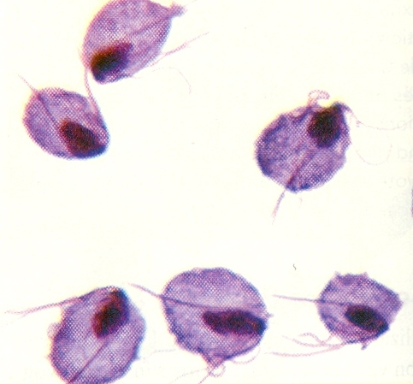
Background
Most common non-viral STI worldwide
– Estimated 276 million new infections globally, 2008 (WHO, 2012)
– 6,000-6,500 new diagnoses annually in England, 2011-14 (Public Health England, 2016)
Advances in understanding of the organism’s molecular structure and genetic diversity
– TV genome sequenced 2007 (Carlton, Hirt et al., 2007)
– 2 phenotypic subtypes based on association with TV virus (T1/T2) (Snipes, Gamard et al., 2000; Conrad, Gorman et al., 2012)
– Nitroimidazole resistance, estimated 4-10% in vitro metronidazole resistance; more common in TV virus-associated strains (T2)
Trichomonas vaginalis – motile flagellated protozoan

Slide 3
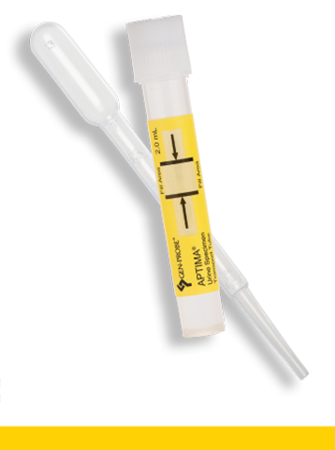
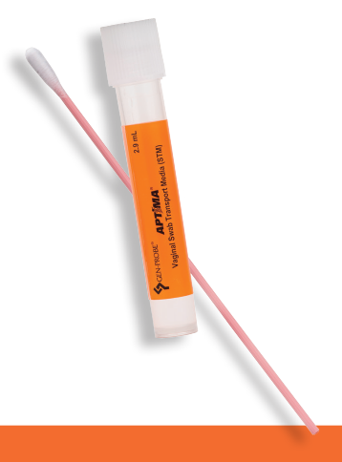
Background
Diagnosis:
Gold standard: NAAT (Hologic, BD, Cepheid)
Other modalities: wet mount microscopy (WMM), culture, POCTs
Treatment:
Recommended first-line regimens:
Metronidazole 2g STAT
Metronidazole 400-500mg BD 5-7 days
Tinidazole 2g STAT
HIV: MTZ 400mg BD 5 days
Partner notification & treatment
Follow-up & test of cure:
Local protocols e.g. F/u 2 weeks after diagnosis
TOC recommended if symptoms persist or recur following treatment
(BASHH 2014)

Slide 4
Aims
Examine a large cohort of T. vaginalis cases to explore:
1. Demographics & symptomatology
2. Clinical and parasitological response to treatment
– 1st line
– following initial treatment failure
3. Test of cure – timing & testing modality

Slide 5
Methods
January 2013 – September 2015
All patients testing positive for T. vaginalis by NAAT (Aptima TV TMA, Hologic) identified
Data on symptoms, treatment regimen and TOC (if performed) collected from our electronic patient record system

Slide 6
Results
557 TMA +ve results in 500 patients (2013-2015)
Demographics:
Sex: 391 female (78%), 109 male (22%)
Age: Mean 33 years (range 13-73)
Ethnicity: Black British/African/Caribbean/mixed 64%
Non-black 14%
Not disclosed 22%
Symptoms:
Confirmation of 1st infection: 47% symptomatic (F 54%, M 25%)
All subsequent attendances: 28% symptomatic (F 29%, M 18%)
Concurrent infection:
HIV 9%
CT 9%
GC 3%
Bacterial vaginosis 39% (F)
Non-gonococcal urethritis 21% (M)

Slide 7
Results
Treatment regimens
Figure 1: 1st-line treatment regimen & outcome, 1st attendance, n=308
Table 1: Parasitological cure rate, MTZ 2g stat vs multiple daily dose regimens
Regimen | Parasitological cure
MTZ 2g stat | 69.9% | X² = 6.895 p=0.0086
MTZ multi-dose regimens | 77.8%
Table 2: Parasitological cure, M vs F
Sex | Parasitological cure
Female | 72.5% | X² = 61.503 p<0.0001
Male | 88.2%

Slide 8
Results
Treatment failure
Single treatment course: 397 patients (79%)
≥2 courses of treatment: 63 patients (13%)
Female: 17% (60% symptomatic)
Male: 9% (40% symptomatic)
Table 3: Courses of treatment per patient
Courses of treatment | n
0 | 21
1 | 397
2 | 44
3 | 11
4 | 8
5 | 1
Unclear/not documented | 18
Total | 500
2nd attendance
1st line regimens repeated in 72%
2nd line regimens in 23%
Not recorded 5%
Subsequent attendances
Typically 2nd line regimens including:
MTZ 400mg TDS 5-7 days
MTZ 2g 5-7 days
TDZ 2g 5-7 days

Slide 9
Results
Test of cure
Figure 2: Percentage negative WMM and TMA results, shown by time elapsed until test of cure (weeks), 1st episode, n=332
Median time to TOC = 4.0 weeks
IQR = 2.4-7.4 weeks
Baseline: WMM sensitivity compared to TMA = 65.6%
TOC: Agreement between TMA and WMM = 78.5%

Slide 10
Discussion
Significant asymptomatic, microscopy-negative burden of infection
Higher parasitological cure rates in males following 1st line treatment (88.2% vs 72.5%)
Distinct infection phenotypes: asymptomatic, WMM –ve infection more common in males
Higher rate of spontaneous clearance of infection in males (Poole & McLelland, 2013)
Lower cure rates than the 90% found in 2003 Cochrane systematic review (Forna & Gülmezoglu, 2003)
Data suggest MTZ single oral dose inferior to multiple dose regimens, clearance 69.9% vs 77.8% (p=0.0086)

Slide 11
Discussion
TMA positivity rate following treatment relatively constant when TOC performed ≥2 weeks after diagnosis
Suggests treatment failure responsible, rather than other factors (re-infection, timing of TOC)
May be appropriate to test ≤6 weeks post-treatment (despite current guidance, this clearly reflects practice in our service)
Current guidance recommends against routine TOC in absence of persistent symptoms
These data suggest, in view of high treatment failure rate, that TOC should be offered universally, especially in women

Slide 12
Discussion
Further work
Study treatment outcomes using tinidazole as first-line
Local studies of molecular epidemiology & exploration of aetiology of host/microbial factors conferring treatment resistance
Is there a need for formal susceptibility testing in UK for treatment failures?

Slide 13
Questions?

