Slide 1

Extra-genital samples for gonorrhoea and chlamydia in women and MSM
Self-taken samples analysed separately compared with self-taken pooled samples
Janet Wilson¹, Harriet Wallace¹, Michelle Loftus-Keeling¹,
Helen Ward², Claire Hulme³, Mark Wilcox⁴
¹ Leeds Centre for Sexual Health, Leeds Teaching Hospitals NHS Trust, UK,
²Department of Infectious Disease Epidemiology, Imperial College, London, UK,
³Academic Unit of Health Economics, University of Leeds, UK
⁴Department of Clinical Microbiology, Leeds Teaching Hospitals NHS Trust, UK,

Slide 2
Introduction
In MSM the majority of gonorrhoea (NG) and chlamydia (CT) infections are extra-genital so rectal and pharyngeal swabs are required which trebles the diagnostic cost
Recent studies in women suggest a significant number of NG and CT infections are being missed by just VVSs and extra-genital sampling is suggested in those disclosing AI and OI
Performing additional extra-genital NAATs in women would be very costly and unaffordable to many services as large numbers of women attend sexual health clinics

Slide 3
SYSTEMATIC
(Swab-yourself trial with economic monitoring and testing for infections collectively)
Objective: Compare sensitivity and specificity of pooled self-taken samples from genital tract, rectum and pharynx with self-taken samples analysed individually
Study population: Women and MSM aged 16 and over
Exclusion criteria:
Antibiotics in the preceding 28 days
Rectal symptoms (discharge, pain or bleeding, as these would necessitate an examination with clinician-taken swabs via a proctoscope)
Unable or unwilling to perform self-taken swabs or have clinician performed swabs

Slide 4
Methods - Randomisation
Each participant had three sets of samples:
clinician-taken rectal and pharyngeal processed separately
self-taken rectal, pharyngeal and VVS or FCU processed separately
self-taken rectal, pharyngeal and VVS or FCU processed pooled
Order randomised using computer generated simple randomisation
Clinician / Self-taken pooled / Self-taken individual
Clinician / Self-taken individual / Self-taken pooled
Self-taken pooled / Self-taken individual / Clinician
Self-taken individual / Self-taken pooled / Clinician

Slide 5
Methods - Pooling technique
Women
Self-taken pharyngeal swab inserted into NAAT transport medium, agitated for 5 seconds, removed and discarded
Self-taken rectal swab inserted into same container, agitated for 5 seconds, removed and discarded
Self-taken VVS inserted into the same container, stem broken off leaving the swab in the container
5 seconds thought adequate as cell lysis instantaneous
No reduction in VVS sensitivity unless inhibition from other sites but increased detection of rectal and pharyngeal infections

Slide 6
Methods - Pooling technique
MSM
Self-taken pharyngeal swab inserted into urine NAAT transport medium, agitated for 5 seconds, removed and discarded
Self-taken rectal swab inserted into same container, agitated for 5 seconds, stem broken off leaving the swab in the container
FCU sample pipetted into same container to between the lines
5 seconds thought adequate as cell lysis instantaneous
No reduction in rectal sensitivity unless inhibition from other samples but increased detection of pharyngeal and urethral infections

Slide 7
Methods - Microbiology analysis
All samples analysed by Aptima Combo 2 (AC2)
AC2 positive samples retested by Aptima GC or CT:
Laboratory staff blinded to samples being self or clinician-taken and unable to link pooled samples to individual samples
Patient infected status - at least two confirmed positive samples from any of the sites and including pooled sample, or a positive culture for NG
Pooled infected status - at least one other confirmed positive sample as well as pooled

Slide 8
1191 women and 387 MSM recruited Jan 2015 to June 2016 by 5 clinicians
Results
MSM
Mean age 34 years (18-77) Median 30 years
Sexual history:
354 (91.5%) had ever given AI
351 (90.7%) had ever received AI
383 (99.0%) had ever given OI
385 (99.5%) had ever received OI
Women
Mean age 25 years (16-71) Median 23 years
Sexual history:
1190 (99.9%) had ever had VI
548 (46%) had ever had AI
1142 (95.9%) had ever given OI

Slide 9
Results - gonorrhoea
MSM
Patient Infected Status: 39
Overall prevalence: 10.1%
Site Infected Status:
Urethral 2.8% (11)
Rectum 6.7% (26)
Pharynx 6.2% (24)
Women
Patient Infected Status: 60
Overall prevalence: 5.0%
Site Infected Status:
Urogenital 4.6% (55)
Rectum 3.9% (46)
Pharynx 2.9% (35)
Overall Patient Infected Status MSM plus women: 99
Site Infected Status:
Urethra/cervix 66
Rectum 72
Pharynx 59

Slide 10
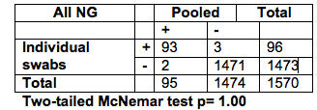
Results - gonorrhoea
Analysed separately versus pooled
7 false positive results, 6 analysed separately, 1 pooled
2 false negatives analysed separately – both culture and pooled positive (1 VVS, 1 MSM phar)
3 false negative pooled samples
1 missing pooled sample
No difference between separately and pooled

Slide 11
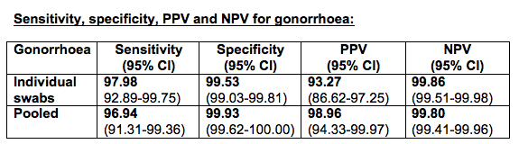
Results - gonorrhoea
2 false negatives analysed separately – both culture and pooled positive (1 VVS, 1 MSM phar)
3 false negative pooled (1 VVS pos, 2 MSM rectal)
No difference in sensitivities of separately and pooled samples

Slide 12
Results - chlamydia
MSM
Patient Infected Status: 31
Overall prevalence: 8.0%
Site Infected Status:
Urethra 1.8% (7)
Rectum 6.7% (26)
Pharynx 1.0% (4)
Women
Patient Infected Status: 227
Overall prevalence: 19.1%
Site Infected Status:
VVS 16.5% (197)
Rectum 17.6% (209)
Pharynx 4.7% (56)
Overall Patient Infected Status
MSM plus women: 258
Site Infected Status:
Urethra/cervix 204
Rectum 235
Pharynx 60

Slide 13
Results - chlamydia
By definition no false negative VVS or FCU in PIS definition as only included if pooled sample also positive because no cultures
So comparison made between VVS and pooled sample in women and rectal SIS and pooled sample in MSM

Slide 14
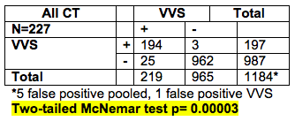
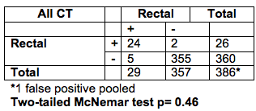
Results - chlamydia
Analysed separately versus pooled
Pooled sample performed better than VVS

Slide 15
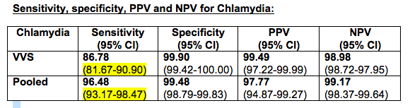
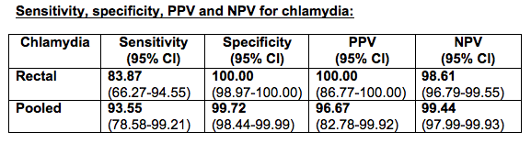
Results - chlamydia
Pooled samples performed better than VVS

Slide 16
Conclusions
Pooled samples performed as well as samples analysed separately in the diagnosis of NG missing 1 sole VVS and 2 rectal infections
Pooled samples were superior to a VVS for diagnosing CT
Increasing diagnostic costs to take triple swabs in most women is unaffordable for most health systems
A pooled sample has equal efficacy for NG and is superior to a VVS for CT at the current laboratory cost of a VVS so is an affordable option

Slide 17
Acknowledgements
NHS National Institutes Health Research, Research for Patient Benefit Programme
This presentation presents independent research funded by the National Institute for Health Research (NIHR) under its Research for Patient Benefit (RfPB) Programme (Grant Reference Number PB-PG-0212-27041). The views expressed are those of the authors and not necessarily those of the NHS, the NIHR or the Department of Health.
Hologic for providing the extra swabs for the pooled samples and the sample kits and reagents for the environmental samples
All the staff and patients at Leeds Sexual Health

