Slide 1
Chemsex related admissions to a city centre hospital
Chris Ward¹, Annaliese Ashman², Terri Anderson³, Rebecca Evans¹, Debbie Thomas¹, Orla McQuillan¹
1 Central Manchester University Hospital NHS Foundation Trust, 2 University of Manchester, 3 Manchester Integrated Drugs and Alcohol Service
Contact: Reach@cmft.nhs.uk
BASHH Conference Oxford 2016

Slide 2
Introduction
Recreational drug use associated with significant harms
Significant effects on morbidity and mortality
Rise in chem drugs use exacerbating problem
Unpredictable effects and imprecise dosing leading to increased toxicity

Slide 3
Aims/Methods
Aim
To review admissions and look at associations with recreational drug use
Methods
Prospective analysis of admissions between April 2015 and March 2016
Data on demographics, admission details, complications and drug use

Slide 4
Results

Slide 5
Admissions

Slide 6
Discussion
Almost 10% of all admissions to our service
Chemsex drugs GHB, mephedrone and crystal meth responsible for at least 40% of these
Lack of reporting in HIV negative MSM
Likely to be an underestimate of the problem
Considerable problems with drug-drug interactions

Slide 7
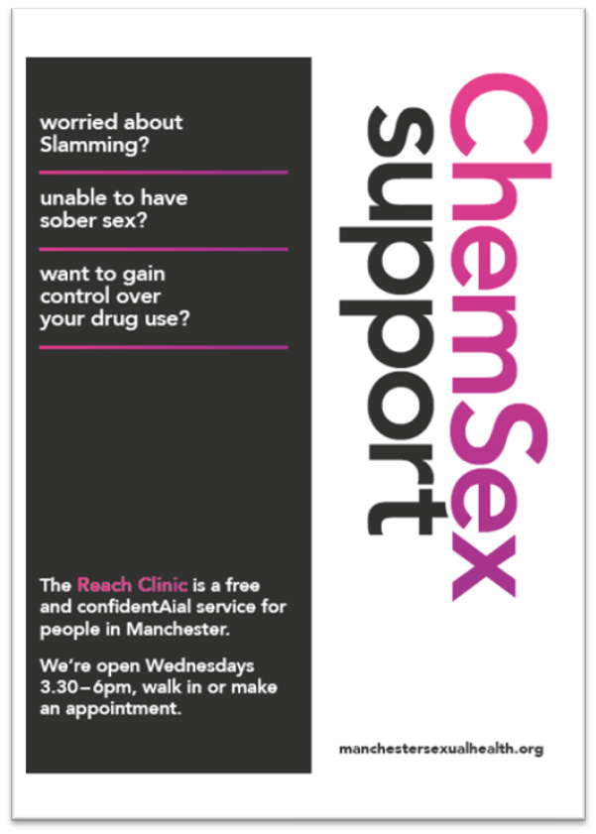
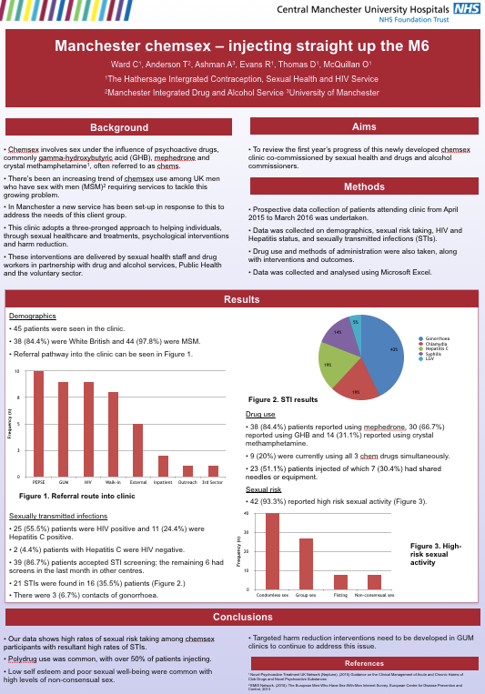
REACH
Chemsex clinic, REACH
Sexual healthcare and treatments
Psychological interventions
Harm reduction
89% condomless sex
51% injecting rate
36% STI rate

Slide 8
Manchester response
City-wide task and finish group
Multi-agency collaboration
Greater Manchester chemsex website
Targeted advertising campaign
Netreach
Awareness raising events
Chemsex teaching and training

Slide 9
Conclusions
New and ongoing challenges to sexual health services.
Regular review of recreational drug use
Timely chemsex interventions needed
Acknowledgements – LGBTF, MIDAS, Manchester City Council, PHE

