Slide 1




Establishment of a monitoring service for men who have sex with men (MSM) taking generic co-formulated tenofovir disoproxil fumarate (TDF)/emtricitabine (FTC) as pre-exposure prophylaxis (PrEP) against HIV infection
Tara Suchak^{1,} Nneka Nwokolo¹, Xinzhu Wang², Marta Boffito^{1,2,3}, Myra McClure², Jonathan Alldis¹, Roxanna Korologou-Linden², Andrew Hill³, Gary Whitlock¹
1 56 Dean Street, Chelsea and Westminster Hospital, London, UK
2 Imperial College, London, UK
3 St Stephen’s AIDS Trust, London, UK

Slide 2
Background
Truvada® PrEP taken daily or intermittently reduces HIV acquisition by >86%
56 Dean Street diagnoses 400+ new HIV+ve/year
However, Truvada® not available on the NHS as PrEP

Slide 3
56 Dean Street PrEP Clinic
Established September 2015
Clinic guideline – basis for subsequent guidance from BASHH/BHIVA
At-risk individuals purchase Truvada® at NHS list price (£400/30 pills)
PrEP counselling, renal function monitoring, risk reduction
3/12ly HIV, STI testing and urinalysis in general GUM clinic
Notes:
3 monthly follow up as per BASHH recommended testing for high risk MSM

Slide 4
Generic PrEP
Increasing numbers of MSM presenting to GU service asking about PrEP
Many accessing generic TDF/FTC online but no access to advice or monitoring
Concerns about authenticity of online medication
No clear mechanism to ensure generic medication genuine

Slide 5
Generic PrEP monitoring
1st February 2016 – started to formally offer monitoring for individuals taking, or intending to start taking generic PrEP within routine GUM service
Patient information available in clinic and on 56 Dean Street PrEP clinic website www.getprep.uk based on data from PROUD and Ipergay studies
Obtained grant from St Stephen’s AIDS Trust to perform TDM
Medical and nursing staff trained

Slide 6
Assessment
Sexual history including time of last HIV test, risk behaviour (including chemsex), and hepatitis B vaccination status
Medical and family history including history of renal and bone disease and current medications
Baseline eGFR and urinalysis
HIV and STI screening at baseline

Slide 7
Service provision
Advice on how to access generic PrEP
Risk reduction including chemsex support
Offered TDM
3/12ly HIV and STI screening
  HIV test at 3/4 weeks if in window
3/12ly renal function
  3/12 urine dip
  Yearly eGFR
Notes:
In prep clinic only given 1 month of meds so brought back at 3 weeks to make sure they didn’t run out

Slide 8
Results
1 February – 7 June 2016
161 individuals
100% MSM
74% White
Median age 39 years
Median follow-up 119 days
73% (118/161) were Hep B immune, 20% unknown hep B status and 7% non immune.
1 patient had mild CKD at baseline with no change in renal fxn at first follow-up visit

Slide 9
Results (2)
Of people with data available:
115/129 (90%) on daily PrEP
13/129 (10%) on event driven PrEP
TDM performed in 125 individuals
Notes:
TDM done by Academic lab at imperial college, validated in house assay
Can be done in private labs, £120 upwards per test
90% daily – prob different to what we see in private clinic
TDM at least 3 doses and come in 12-20 hours post dose

Slide 10
Source of PrEP
Details of source
www.alldaychemist.com | 14.3 % (23/161)
www.iwantprepnow.co.uk | 6.2 % % (10/161)
www.unitedpharmacies-uk.md | 32.3 % (52/161)
Hospital | 0.6 % (1/161)
www.aids-drugs-online.com | 1.2 % (2/161)
www.alldaypharmacy.co.uk | 6.2 % (10/161)
www.callchemist.com | 0.6 % (1/161)
www.buylowdrugs.com | 0.6 % (1/161)
Not stated/unknown | 37.9% (61/161)
Notes:
I want prep now website and will have been one other pharmacy but that wasn’t documented

Slide 11
PrEP manufacturer
In 103 individuals PrEP manufacturer was:
Cipla Ltd 101 (98%) (India) – Tenvir-EM®
Mylan 1 (1%) (Netherlands) – Ricovir®
Aspen Pharma 1 (1%) (South Africa) – Tencitab®
Other brands included Tavin-EM® (Emcure Pharmaceuticals Ltd.) and Trivir® (Sain Medicaments Pvt. Ltd.)

Slide 12
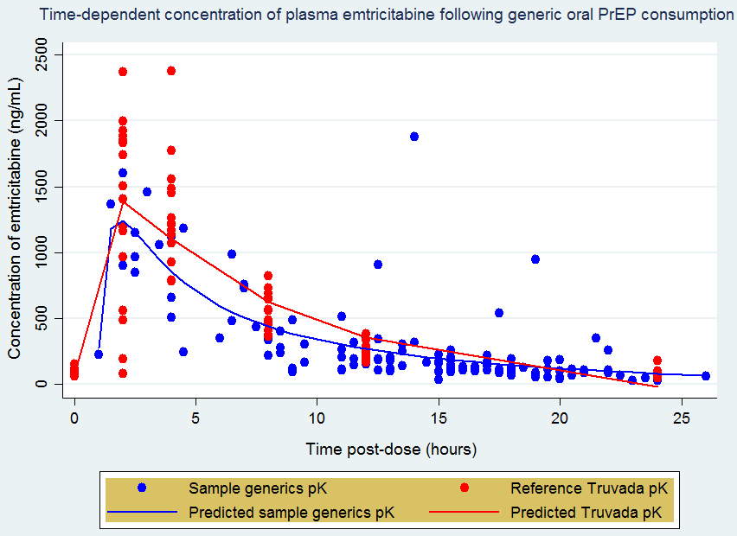
Notes:
Red dots are concs of ftc in hiv neg healthy controls – historic data
Blue dots are actual ftc measurements from our patients who had TDM done
High inter individual variability but all levels were above established median plasma cut off

Slide 13
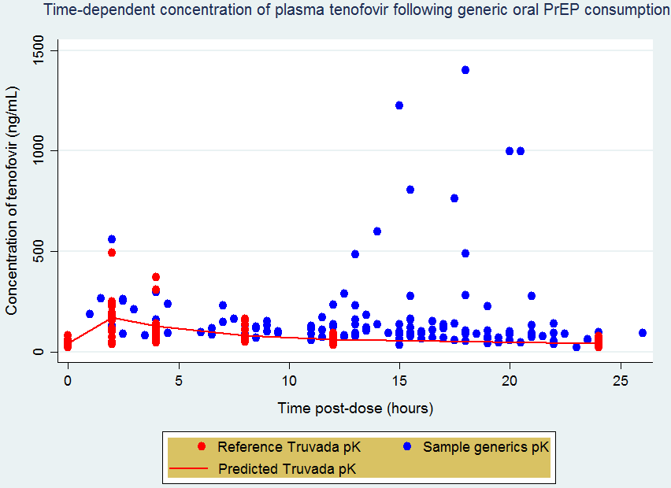
Notes:
Lot of variability reasons unclear ?genetic factors as to how tfv is metabolised, documentation wrong as to when dose was taken, laboratory factors

Slide 14
STI diagnosed within 3/12 PrEP
39/161 (24%) had STI at baseline or within 3/12 of starting PrEP (36% rectal STI or syphilis)
13/161 (15%) had STI at at least one follow-up visit (72.7% rectal STI or syphilis)
No new cases of HIV, hepatitis B or C
Notes:
However we have had 1 case of hiv in patient who attended private Prep clinic, bought prep and then didn’t take it. He is now engaged with HIV carse

Slide 15
Summary
Monitoring on generic PrEP is feasible within GUM
TFV and FTC levels adequate in all tested samples
High rates of STIs at baseline and follow-up (consistent with PrEP studies in literature)
PrEP guidelines should incorporate regular STI screening and risk reduction interventions
Notes:
Risk reduction – mot interviewing, condoms etc

Slide 16
Acknowledgements
Nneka Nwokolo
Xin-zhu Wang
Roxanna Korologou-Linden
Andrew Hill
Isaac Day-Weber
Myra McClure
Gary Whitlock
Marta Boffito
Jonathan Alldis
The clinical staff and patients of the Chelwest HIV/GUM Directorate

