Slide 1
Hitting the bull’s-eye:
Partner Notification real-time metrics
Dr Anatole S Menon-Johansson & Leigh Barlow
SXT Health CIC (www.sxt.org.uk)
BASHH Annual Conference
Oxford, 10th July 2016

Slide 2
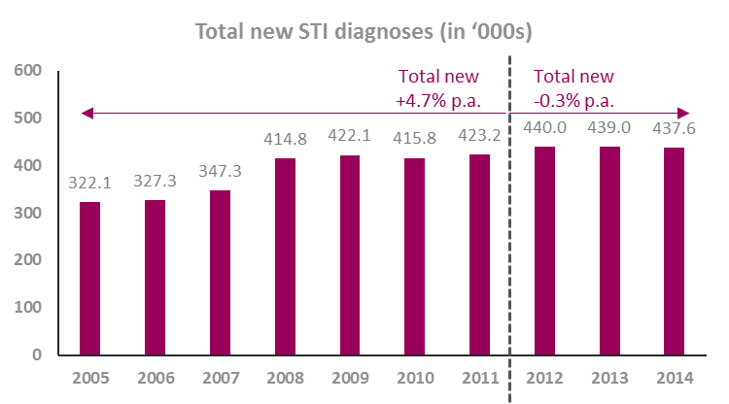


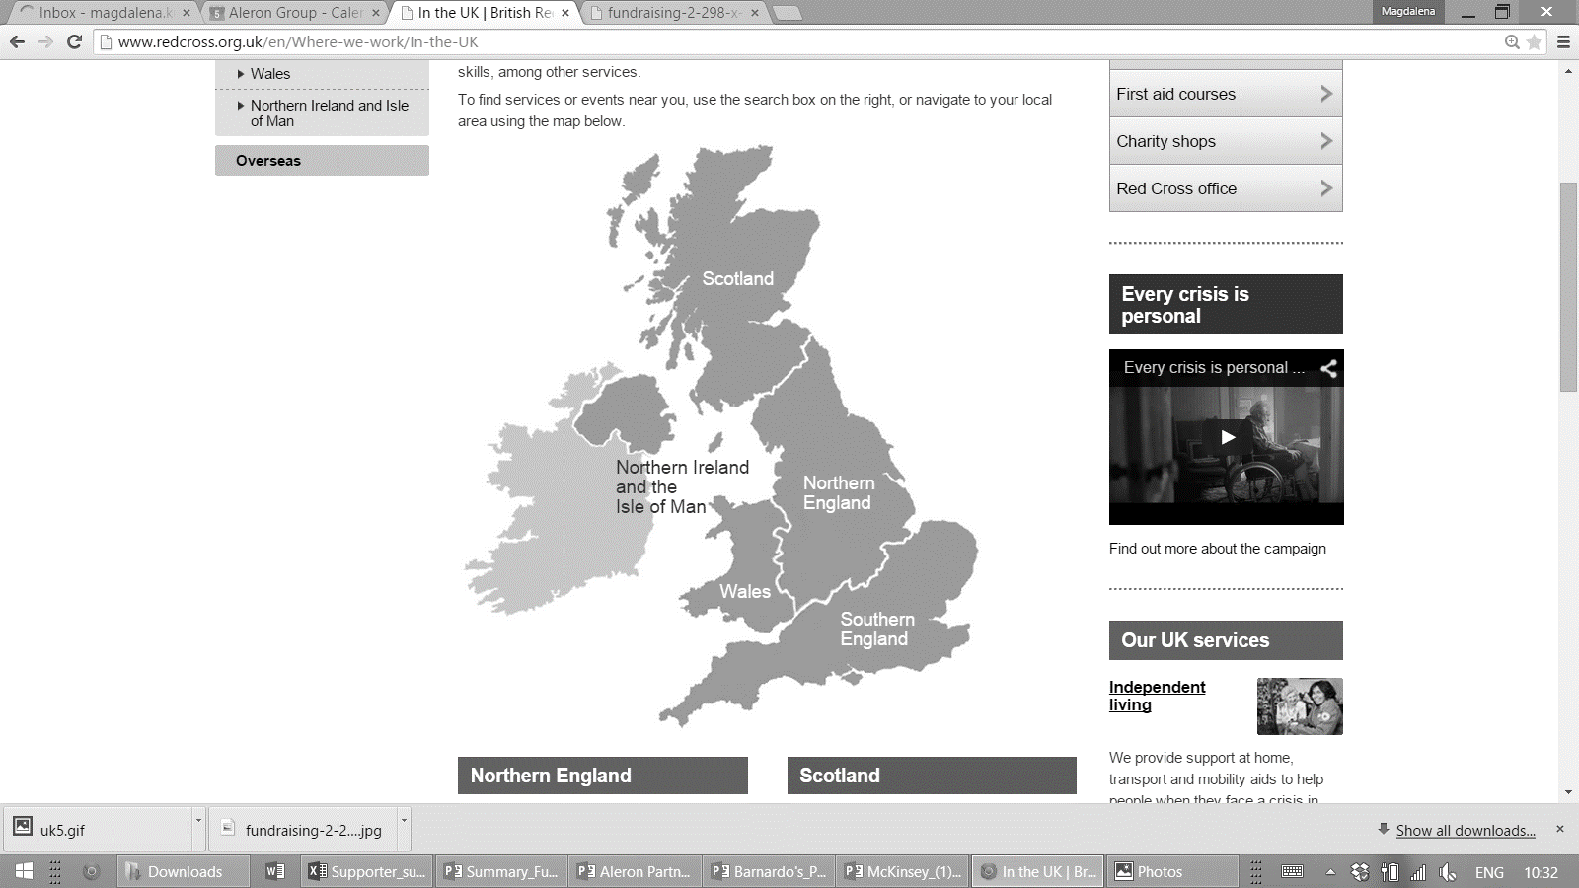
STIs are a growing source of concern for the national health system: bacterial diagnoses have increased and in European comparisons the UK is falling behind
The case for improved partner notification
Chlamydia
Gonorrhoea
Syphilis
HIV
Chlamydia accounts for 47% of all newly diagnosed STIs
17% p.a. increase of new Gonorrhoea diagnoses between 2012 and 2014
21% p.a. Increase of new Syphilis diagnoses between 2012 and 2014
3.7% p.a. Increase of HIV prevalence between 2013 and 2014
8.0 per 100,000 population (2014)
An estimated 18,100 (17%) PLWH are unaware of their diagnosis & transmission risk (2014)
19%
5.5 per 100,000 population (2012)
41%
The UK has the third highest rate of Chlamydia per 100,000 population in the EU (after Denmark & Iceland)
At an average rate of 55.8 per 100,000 population (2012-2014), the UK has one of the highest prevalence rates in Europe.
Syphilis rates have been increasing across Europe since 2010, particularly among men which account for >90% of cases in England.
HIV prevalence rates higher across Europe, at 5.9/100,000 population compared to 1.9/100,000 in the UK
*Please note that data for new STI diagnoses cannot be compared from 2012 onwards due to new reporting standards for Chlamydia.

Slide 3

Partner notification reduces the risk of transmitting infections. However, up until today, health service providers face logistical challenges:
The toughest problem to solve in sexual health
Challenges
Consequences
Lack of an effective monitoring solution
Difficulty to capture correct information
Time and capacity constraints of Health Care Workers to follow up on partner notification
Emotional barriers for index patients
Fewer patients inform their partners
No clear account of current PN effectiveness
Partners are not notified and new STI diagnoses keep increases
      SXT has the solution: the interactive digital Contact Slip

Slide 4
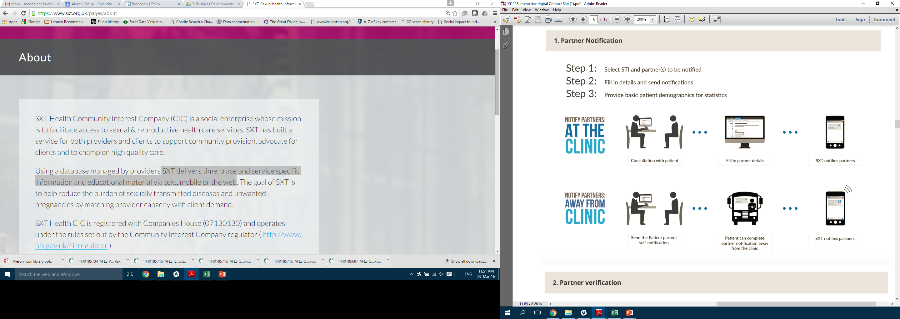
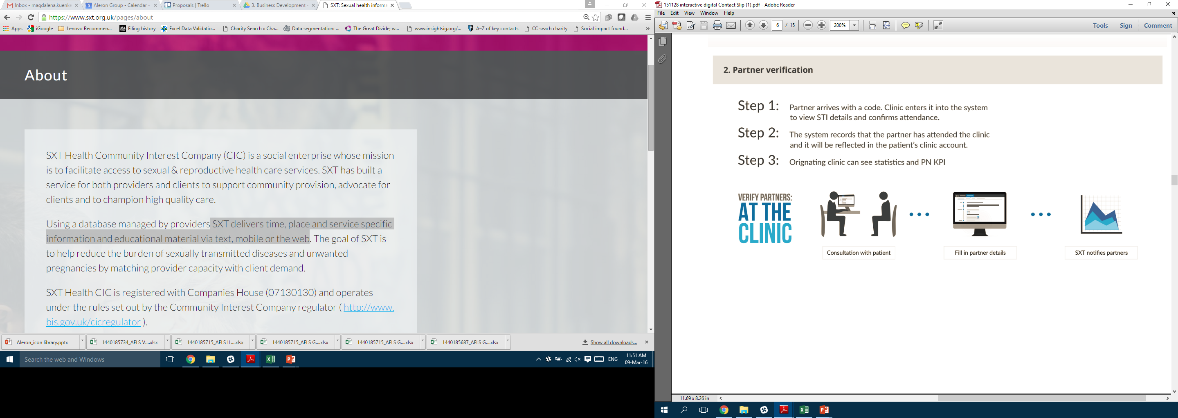
The idCS provides anonymous partner notification and allows sexual health service providers to track effectiveness and individual performance
Provider and patient delivered PN
Partner notification
Partner verification

Slide 5
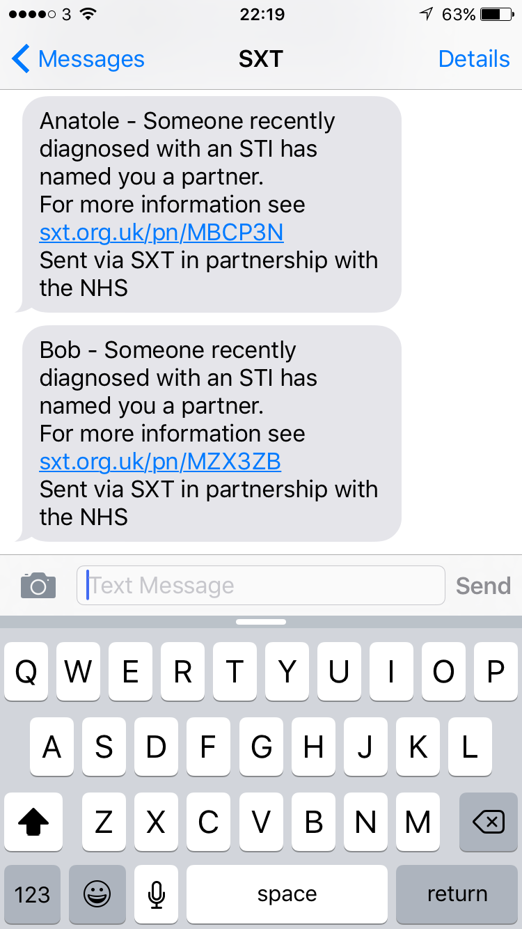
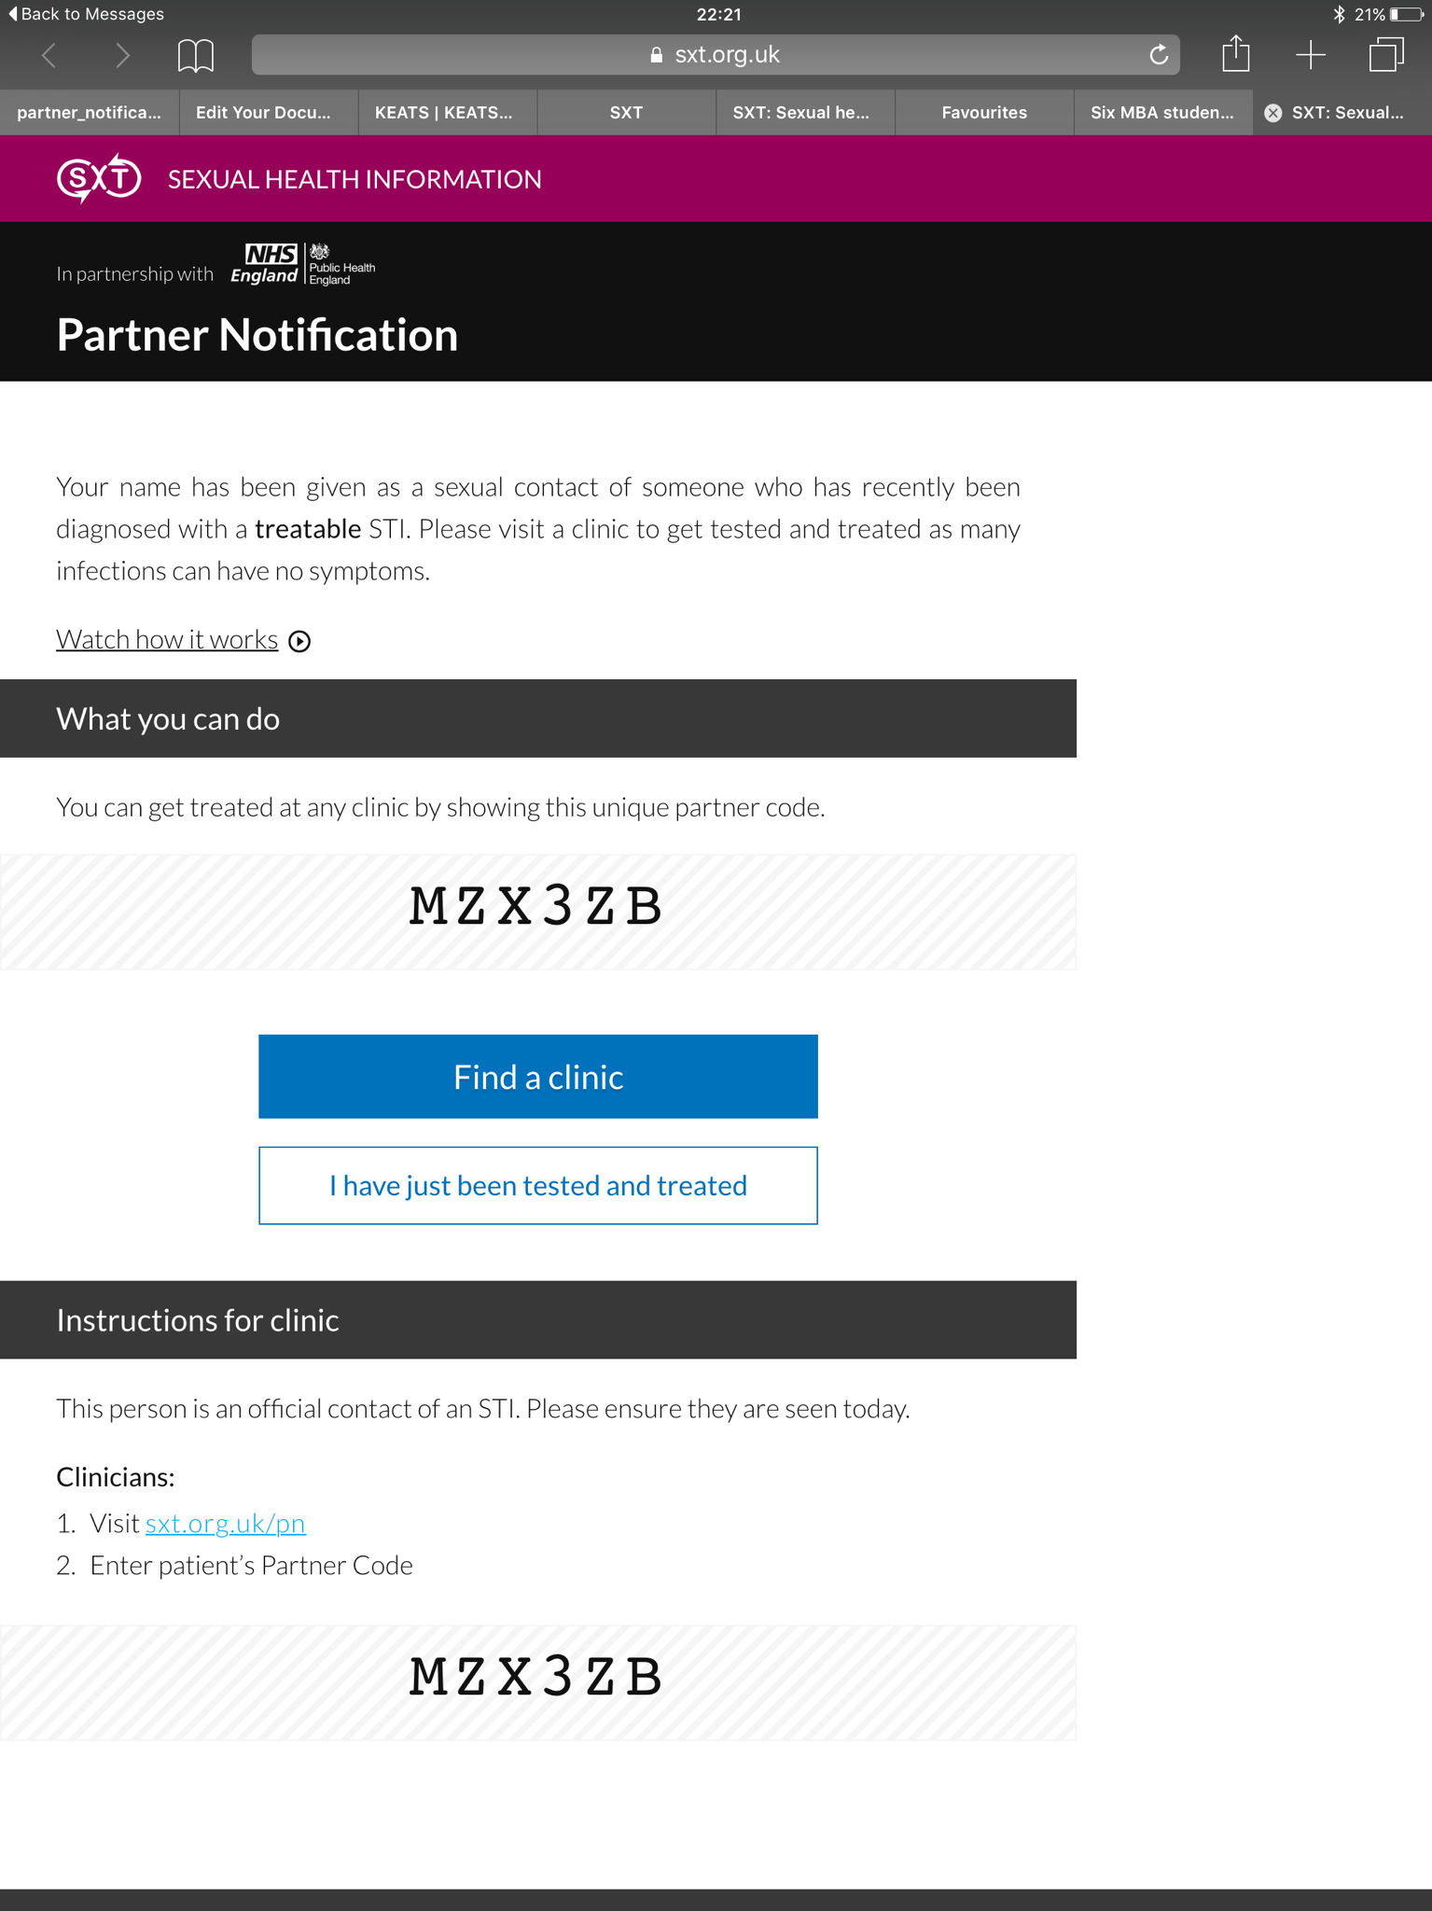
What the partner receives from SXT
Supporting partners to get tested
Explanation that their name has been given as a sexual contact of someone who has recently been diagnosed with a treatable STI
How it works video
Click on the link
Blue button directs partner to a local clinic for testing and possible treatment
Mobile number or email address is not stored by SXT

Slide 6
The who, the what & the how
Analysis up to 7th July 2016
Breakdown of usage | Number
Number of venues initiated PN using the SXT tool | 14
Number of different providers who signed off partners | 31
Number sexually transmitted infections or diagnoses | 19
Maximum number of STIs at one time | 4
How have partners been informed? | Number
Text message | 719
Email | 22
Both Text message & email | 19

Slide 7
Index patient demographics
Analysis up to 7th July 2016
Breakdown of index patients | Number | Percentage
Not captured by health care worker | 138 | 14%
Gender
Male | 523 | 55%
Female | 297 | 31%
Sexuality
Heterosexual | 476 | 50%
Men who have sex with men / Bisexual | 335 | 35%
Women who have sex with women | 6 | <1%
Ethnic groups | 14
Age range | 15 – 75 years

Slide 8
Timing & distance
Analysis up to 7th July 2016
Partner testing metrics | Median | Range
Time to self-verification (n = 31) | 0 days | 0 – 27 days
Time to partner being seen (n = 108) | 2 days | 0 – 47 days
Distance from clinic where PN initiated and partner(s) being seen | 2.89 km | 0 – 338 km

Slide 9

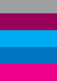
Understanding where each step of PN is working
  … we have data to show that information technology enables
  effective partner notification
The idCS pilot launched on 27 January 2016
899
1,543
Index
Patients
declared
Contactable
Partners
40%
of contactable partners were notified using the tool
55%
of those notified opened the link
Partners declared
Contactable partners
Partners contacted
Partners opening the link
Partners verified in clinic
30%
of those who opened the link were seen by a Health Care Worker
Based on the data collected between 27/01/2016 - 02/07/2016

Slide 10
Not all STIs are equal in partner notification behaviour
Analysis of idCS up to 2nd July 2016
Based on the data collected between 27/01/2016 - 02/07/2016

Slide 11
Follow up tool & dashboard
Supporting health advisors to deliver PN
http://bit.ly/SXT_PN

Slide 12








Supporters

Slide 13

Any questions?

Slide 14
Sources
Statistics on STI diagnoses and rates in England
Published by Public Health England
Last updated: 13 January 2016
Available at: https://www.gov.uk/government/statistics/sexually-transmitted-infections-stis-annual-data-tables
Statistics on Sexually transmitted infections in Europe
ECDC Surveillance Report 2013
Available at: http://ecdc.europa.eu/en/publications/Publications/sexual-transmitted-infections-europe-surveillance-report-2013.pdf
Statistics on SXT website traffic and effectiveness of the idCS:
Data collected by SXT Health CIC
Available upon request from Dr Anatole Menon-Johansson
anatole@sxt.org.uk

