Slide 1
Digital sex and the city
Prevalent use of dating apps amongst heterosexual attendees of genito-urinary medicine clinics
Dr Malika Mohabeer Hart

Slide 2
Notes:
Once upon a time in 1990s Hollywood, Tom and Meg met online, their love bloomed through several AOL messages and the rest as they say is history.
Some of you may be too young to remember this film, but once You’ve Got Mail was released, it had become clear that the Internet was going to change every aspect of our lives— including love and romance.
Match.com was founded in 1995, with complex algorithms designed to match people up to a life partner.
By 2007, online dating had become the second highest online industry for paid content.
The smartphone further revolutionized this with the advent of mobile apps and
over the last half a decade mobile dating has become mainstream.
Importantly, dating apps have followed wider social trends and changing behaviours that have been unfolding over time, including
The liberalisation of attitudes towards the number of partners, the status of relationships, and towards marriage.
25% of Britons surveyed have 1 or more dating apps on their smartphone¹
37% of those surveyed saying they had met a partner via such an app
In the UK, Tinder is the most downloaded app, boasting 24millions matches globally²
“Not since the introduction of the contraceptive pill in 1960 has anything affected people's sex lives more than dating apps”

Slide 3
And
the rest
is history…
Notes:
By the time Tom Hanks and Meg Ryan AOL’d each other in You’ve Got Mail, it was clear that the Internet was going to change every aspect of our lives forever — including love and romance. Match.com was founded in 1995, and by 2007, online dating had become the second highest online industry for paid content. Dating apps are following wider social trends and changing behaviours that have been unfolding for decades.
There’s a liberalisation of attitudes towards the number of partners, the status of relationships, towards marriage, 25% of Britons surveyed have 1 or more dating apps on their smartphone¹37% of those surveyed saying they had met a partner via such an appIn the UK, Tinder is the most downloaded app, boasting 24millions matches globally²
“Not since the introduction of the contraceptive pill in 1960 has anything affected people's sex lives more than dating apps”

Slide 4
Why talk about this?

Slide 5
Authors | Title | Study design | Conclusion
Lehmiller et al. 2014 | Social networking smartphone applications and sexual health outcomes among MSM | Cross-state US internet study n=112 | Users reported more sexual partners and had a higher prevalence of ever being diagnosed with an STI
Winetrobe et al. 2014 | Associations of unprotected anal intercourse with Grindr-met partners among Grindr-using young MSM in Los Angeles | Anonymous online questionnaire of Grind users | Of 146 MSM who reported sex with Grindr-met partners, 20% had (UAI) at last sex with their Grindr-met partner
Yeo et al. 2016 | Sexual risk behaviors among apps-using young MSM in Hong Kong | Cross-sectional survey n=213 | Sexual partnering via apps doubled the odds of inconsistent condom use with regular and non-regular partners

Slide 6
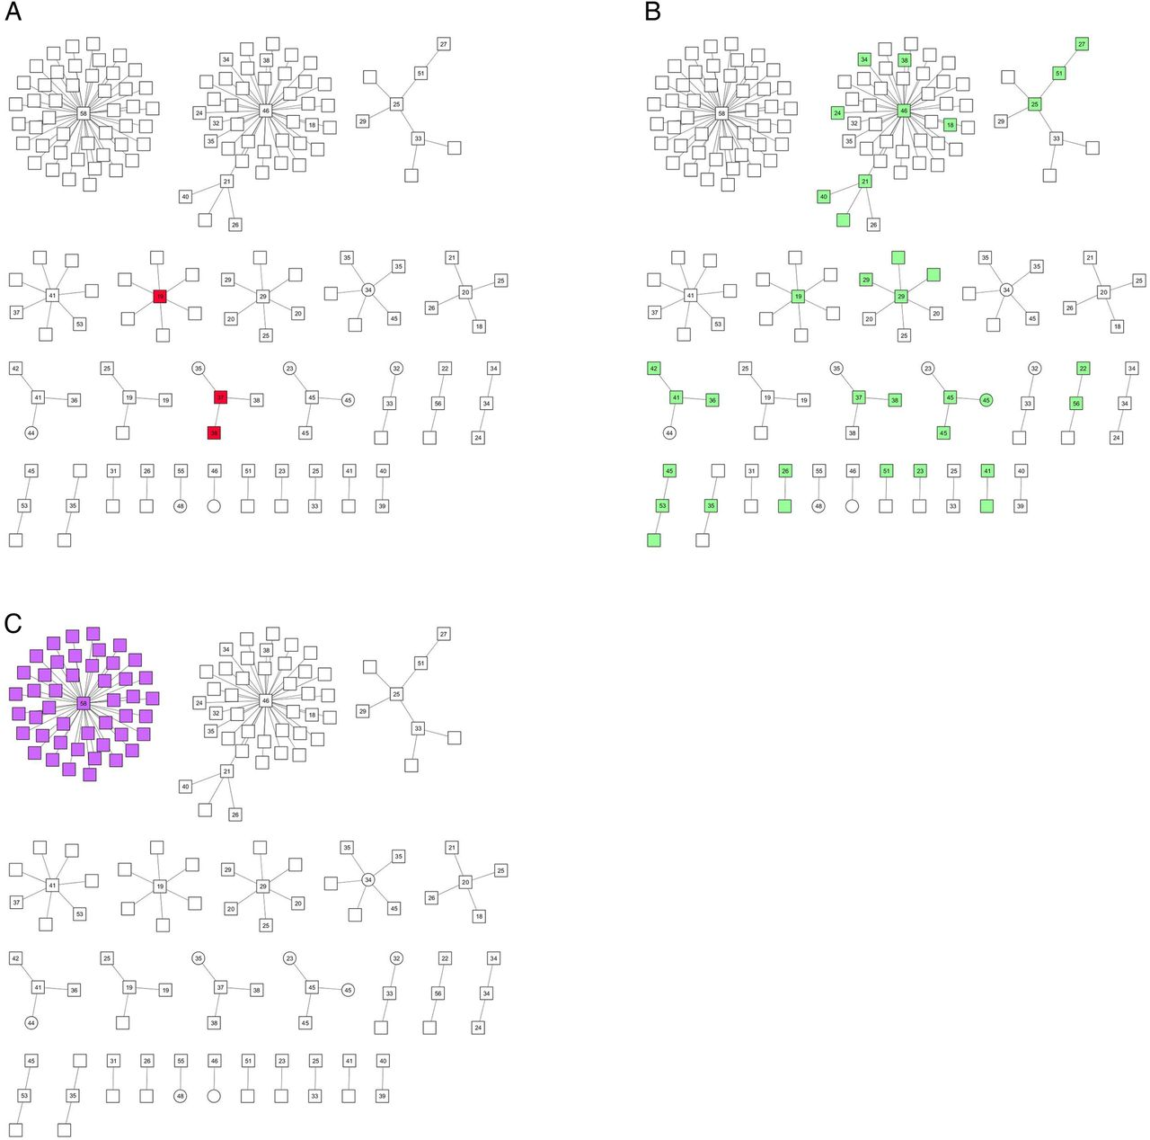
Authors | Title | Study design | Conclusion
Thomas et al. 2016 | Outbreak of syphilis in MSM living in rural Nth Wales associated with the use of SM | Outbreak investigation | Use of mobile apps was reported by 40% of MSM cases, including those who identified as bisexual
Nodes are shaded to indicate individuals in the network known to use:
(A) cruising sites, (B) mobile phone applications or (C) sauna to meet sexual partners.
Notes:
Following reports of an increase of syphilis in North Wales, a multidisciplinary Outbreak Control Team (OCT) was established. investigated in detail, the use of apps was a common feature in the network.
In 2003, only 9% of infectious syphilis cases in Wales reported finding their sexual partners using the internet. By 2013, this had increased to 55%

Slide 7
Why this study?
Paucity of research re. use of dating apps in heterosexuals
Objective: To quantify and explore heterosexual use of dating apps
Anonymised unlinked questionnaires offered to attendees of two GUM clinics throughout August 2015
Aims and frequency of app use, number of sexual partners, recreational drug use (RDU), condomless sex
Notes:
Anonymous and not linked to clinical record to encourage candid responses

Slide 8
Results
Total responders: 539
Men = 377 (70%) of whom 12% had used SM
Women = 162 (30%) of whom 54% had used SM
Most were of age 21-30yrs

Slide 9
Ethnicity
2%
Notes:
Comparable to our typical cohort attending clinic in during this period in age range although there was a larger proportion of white respondents varying by about 10% compared to general clinic attendees, and proportionally more male respondents.

Slide 10
Reason for attending

Slide 11
Had ever used a dating app = 132 (24%)
Notes:
51% of men and women in 21-30 range and
38% of men and 45% in 31-40
31% of women and 29% of men used two apps or more to meet a partner

Slide 12
Frequency of app use to meet a partner
 | Men % (n=45) | Women % (n=87)
Every month | 15% | 10%
Every few months | 31% | 23%
Yearly | 27% | 28%
Less than once a year | 27% | 38%

Slide 13
Aims

Slide 14
Nos. of partners over 12months

Slide 15
UPSI with SM partner
56%
31%
Notes:
31 % of women using SM and
56% of men using SM said yes

Slide 16
RDU with SM partner
24%
2%
1%
Notes:
2% men RDU frequently
24% of men RDU occasionally, only 1% of women saying yes occasionally

Slide 17
STI concerns
Men
Yes 58% No 27%
Women
Yes 66% No 17%
STI discussion
Men
Yes 44% No 33%
Women
Yes 39% No 45%
STI diagnosed
Men
Yes 4% No 73%
Women
Yes 5% No 77%

Slide 18
Results
57% would welcome sexual health information via apps
62% would request STI testing kit via app

Slide 19
Conclusions
App use to meet a partner is prevalent – 24%
Condomless sex with app partners is significant
RDU was an interesting finding
Importance of understanding how sexual networks form and interact with other networks

Slide 20
Conclusions
Users welcome sexual health promotion and testing via dating apps
There is an untapped role for SM in this area
More research needed in heterosexuals
Sex is going digital and so should sexual health

Slide 21
Acknowledgements
Dr Jey Zdravkov
Dr Farhad Cooper
Dr Komal Plaha
Dr Rachael Jones
Dr Sara Day
Katie Allen
Lisa Fuller Thank you

