Slide 1

What effect do practice visits have upon opportunistic chlamydia screening test uptake and case detection in primary care?
An audit of 81 general practices in Oxfordshire.
Presented by
Omotayo Adebanji
July 10 – 12, 2016
British Association for Sexual Health & HIV (BASHH) Annual Conference.
Omotayo A. Adebanji¹, Leon R Maciocia¹, Jackie Sherrard¹, and Adrian D. Smith²,
1 - Genito-Urinary Medicine Department, Oxford University Hospital NHS Foundation Trust; 2 - Nuffield Department of Population Health, University of Oxford

Slide 2
Study Aims
To evaluate the trend in chlamydia screening test uptake and positive case identification before and after practice visits in Oxfordshire between April 2012 and March 2014.
To assess the association between training attendance and other practice characteristics, such as surgery size and location, on screening coverage and case detection rates after visits.

Slide 3
Background
N.A.O ‘Value for Money’ Review 2009 ; NCSP 2008/09 Annual report
Support visit in general practice – what do we do?
Existing Study & Research Gap

Slide 4
Methods
Study design
Longitudinal study (Before- & After-)
Data collection
All 81 practices between 2012-2014 routinely collected on Exelicare data base
Monthly test uptake, test positives and proportion positive
Additional characteristics
Staff attendance at practice visits, surgery size, location.
Visit characteristics – calendar month of visit

Slide 5
Methods
Statistical analysis (STATA software)
Generalised estimating equations (GEE) matched on practices.
  Logit link function for proportions
  Negative binomial link function for counts
  Practice visit effects was expressed as:
  Relative count (incidence rate ratio) or proportion (odds ratio) -
  at 3 months and 6 months after practice visits, relative to 3 month prior to visits within the same practice.
Multivariate confounder adjustment for practice and calendar characteristics

Slide 6
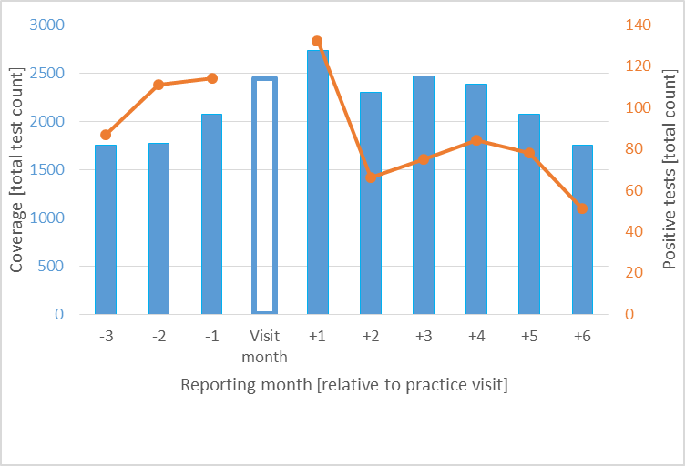
Result
Fig. 1 Pattern of Chlamydia screening coverage and cases diagnosed in GP in Oxfordshire

Slide 7
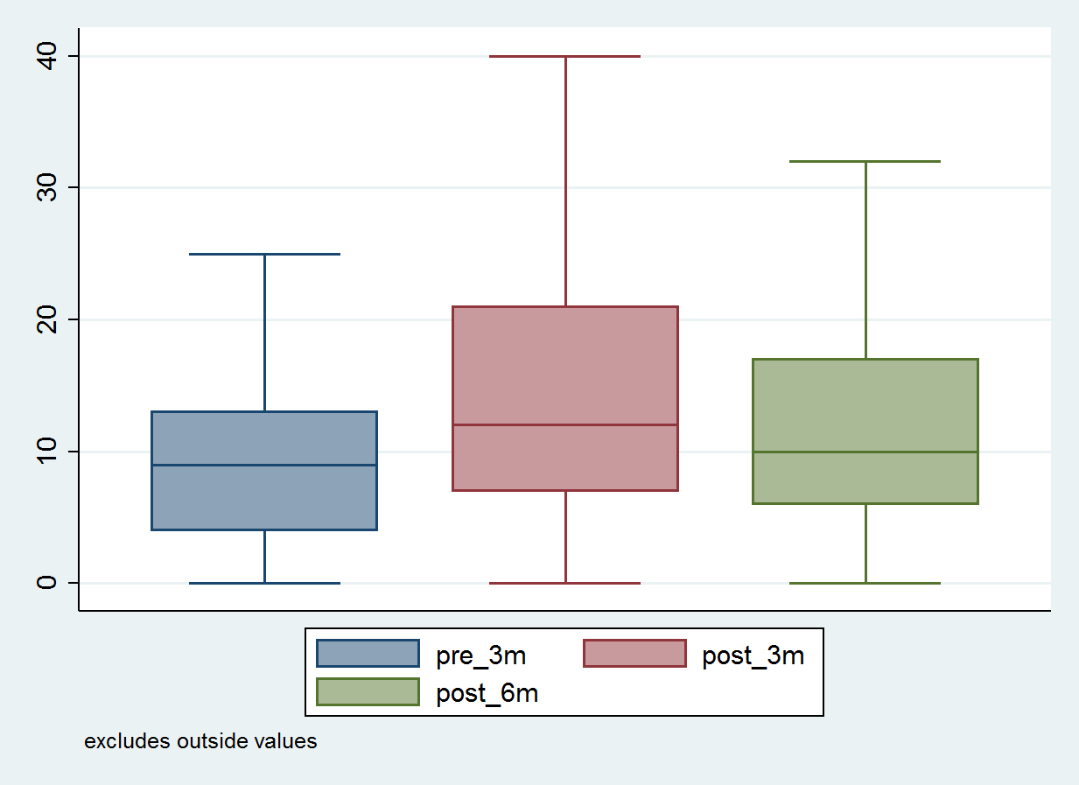
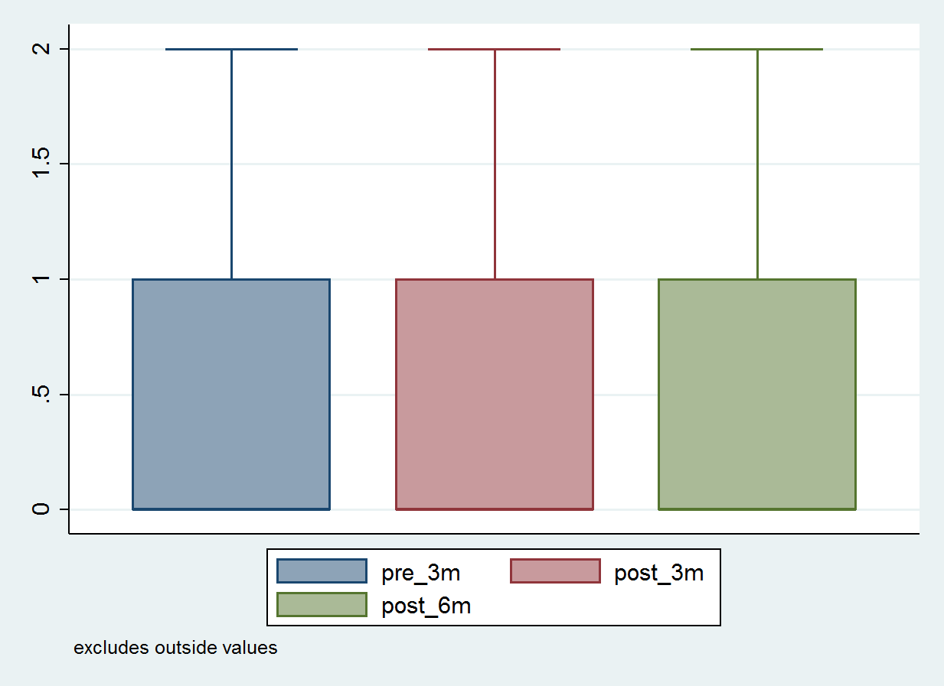
Result
Fig 2 – Quarterly median count of Test uptake per practice
Fig 3 – Quarterly median count of Cases diagnosed per practice

Slide 8
Result
Table A: Pre- and post-practice visit measures of CT screening coverage and case detection, Oxfordshire GP practices, 2012-14
NS p>0.05 *p<0.05 **p<0.01 ***p<0.001 ; ‡Models adjusted for calendar month, practice location, practice size and number of attendees at training visit
†Generalised estimating equations, using negative binomial link function, exchangeable correlation structure, and grouping on practice id
†† Generalised estimating equations, using logit link function, exchangeable correlation structure, and grouping on practice id
 |  | Baseline (pre visit) | Post visit
 |  | 3 months prior to visit | Up to 3 months after visit |  |  | 3 to six months after visit
 | Number of periods / practices | Practice measure mean or median(IQR) | Practice measure mean or median(IQR) | Ratio vs baseline, unadjusted (95% CI) | Ratio vs baseline, adjusted (95% CI)‡ | Practice measure mean or median(IQR) | Ratio vs baseline, unadjusted (95% CI) | Ratio vs baseline, adjusted‡ (95% CI)
Coverage
Number of CT screening tests performed | 136 | 9 (5-15) | 12 (7-22) | 1.36† (1.20-1.54) *** | 1.35† (1.19-1.52) *** | 11 (7-17) | 1.08† (1.02-1.14) ** | 1.07† (1.01-1.14) *
Case detection
Number of positive CT tests | 103 | 0 (0-1) | 0 (0-1) | 0.85† (0.70-1.03) NS | 0.89 † (0.61-1.30) NS | 0 (0-1) | 0.95† (0.67-1.34) NS | 0.87† (0.71-1.06) NS
Proportion of screening tests positive for CT | 103 | 7.7% | 5.2% | 0.63†† (0.48-1.06) NS | 0.63†† (0.37-1.11) NS | 5.2% | 0.70†† (0.54-0.90) ** | 0.71†† (0.54-0.94) *

Slide 9
Result
Multivariate analysis
1. Attendance:
 | Relative effect | 95% C-I | P-value
Coverage | IRR
0-3 month | 1.09 | 1.04-1.15 | 0.001
3-6 month | 1.08 | 1.02-1.14 | 0.006
Proportion positive | OR
0-3 month | 1.07 | 0.93-1.22 | 0.334
3-6 month | 1.07 | 0.93-1.22 | 0.341
2. Location
3. Practice size
4. Calendar month
No significant effect

Slide 10
Discussion & Conclusion
Study findings - McNulty et al 2014; Kalwij et al. 2012; Bilardi et al. 2010
Study validity & limitations
Recommendations / Implications for research
Support visit Coverage Case diagnoses.
Adjunct intervention(s) is needed to enhanced and sustain outcomes

Slide 11

Thank you!

Slide 12
ON-GOING WORK
General Practice Survey
2015/2016

Slide 13
ON-GOING WORK

Slide 14
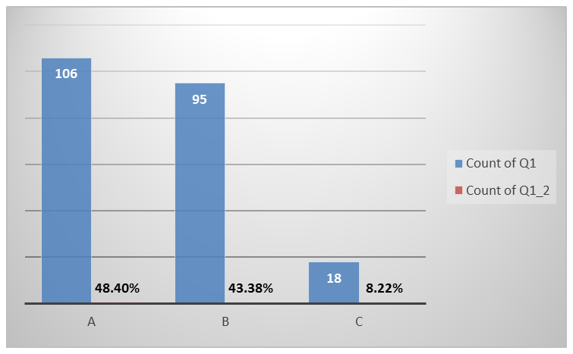
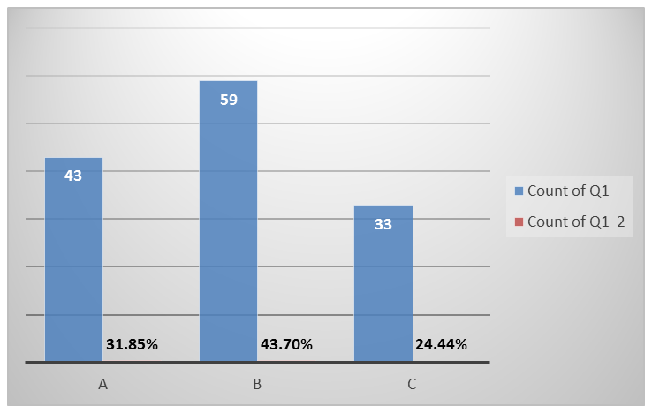
ON-GOING WORK
Q1: How would you describe the level of staff participation (or interest) in the chlamydia screening programme in your practice?
<5% Oxon coverage
>=5% Oxon coverage
A. All clinical and non-clinical staff are fully on-board
B. Only clinical staff are involved
C. Only a few staff are screening

Slide 15
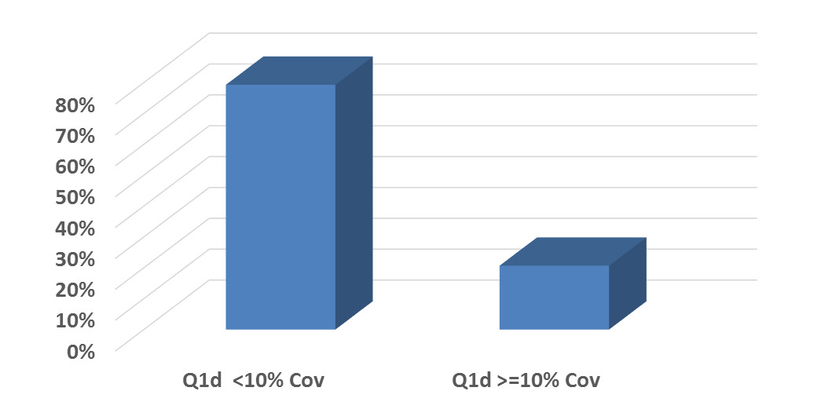
ON-GOING WORK
Q1(D). I am not sure who coordinates the programme in our surgery

Slide 16
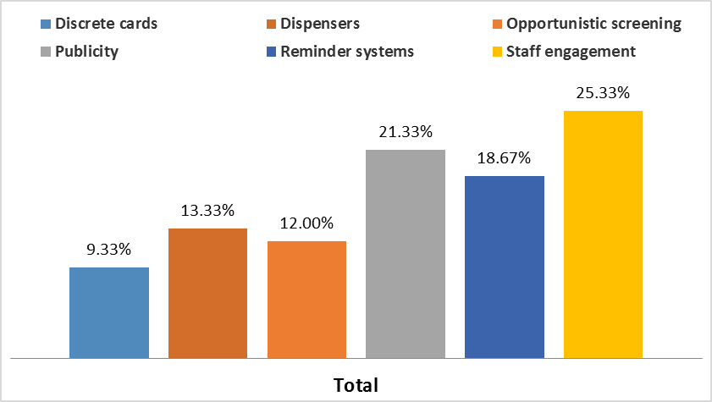
ON-GOING WORK
Q5. What other interventions/activities in your opinion could possibly increase screening offers and uptake rates in your practice?

Slide 17
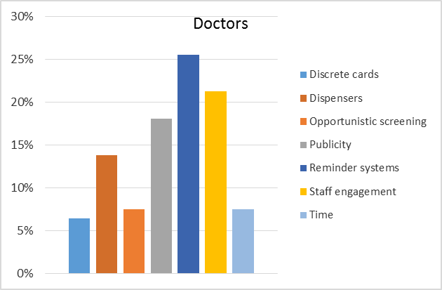
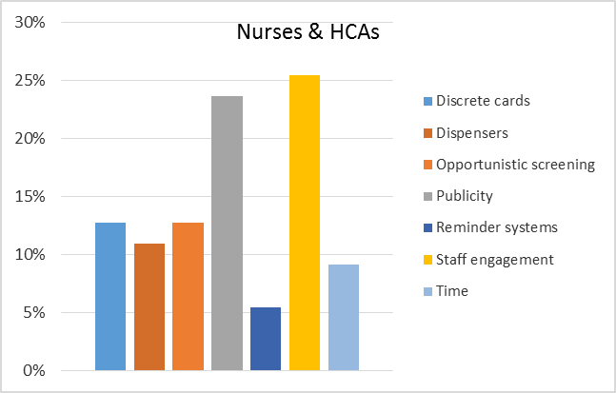
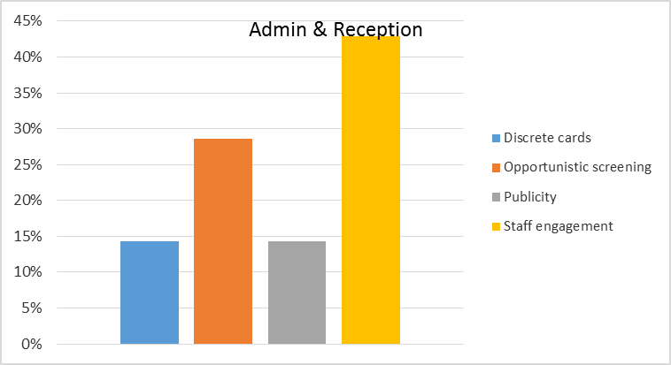
ON-GOING WORK
Q5. What other interventions/activities in your opinion could possibly increase screening offers and uptake rates in your practice?

Slide 18
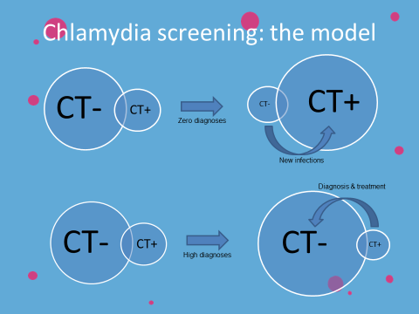
ON-GOING WORK

Slide 19
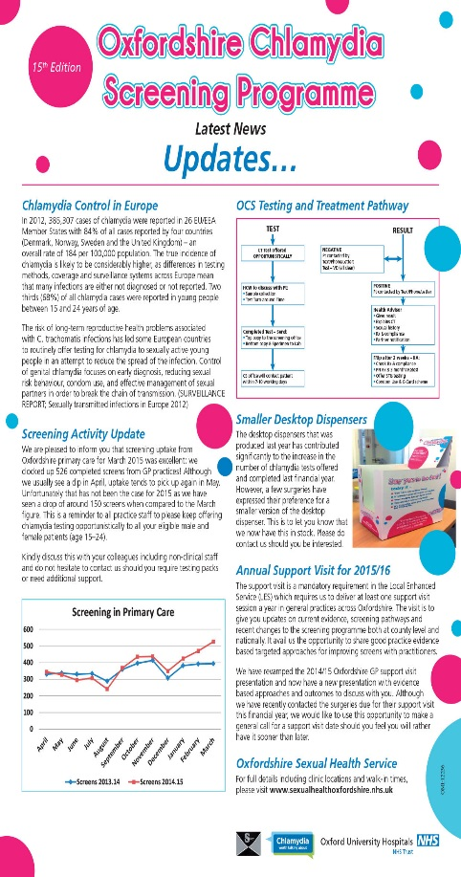
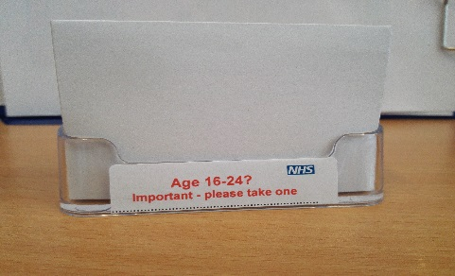
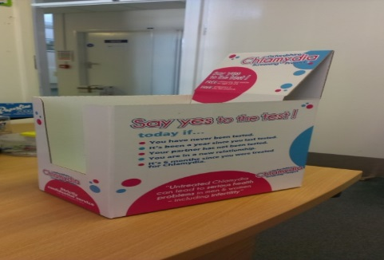




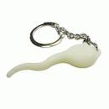
OTHER INTERVENTIONS

