Slide 1
Are we meeting the needs of Young People?
Justine Orme¹, Eleanor Morad¹, Deborah Williams¹, Lauren Bignell¹, Daniel Richardson^{1,2}
1. Brighton and Sussex University Hospitals NHS Trust, 2. Brighton and Sussex Medical School

Slide 2
Background
Adolescence is a time when young people start to take responsibility for their own health.
It is a key period in the emergence of health inequalities
There is a growing recognition that meeting the particular needs of
young people needs to be a key component of national public health agendas.¹
¹You’re Welcome – Quality Criteria for Young People Friendly Health Services. DH – Children and Young People. 15/04/2011.
Notes:
There is now a burgeoning understanding of the importance and distinctiveness of adolescent health. Adolescence is a key period in the emergence of health inequalities and back in (2001?) there was a global call for the development of young people friendly health services. The Department of Health’s You’re Welcome Standards, first published in 2005, set out a set of principles for all health services to become more young people friendly, and research tells us that young people value health services that provide easy access with confidential, prompt and comprehensive care.

Slide 3
All young people are entitled to receive appropriate health care wherever they access it. The Department of Health Quality criteria for young people friendly health services lay out principles that will help health services – both in the community and in hospitals – to ‘get it right’ and become young people friendly.¹
Factors that young people have raised as important to them are: opening hours, location, convenience, publicity, privacy and confidentiality²
¹You’re Welcome – Quality Criteria for Young People Friendly Health Services. DH – Children and Young People. 15/04/2011.
²NCVSP (2006) New frontiers: Annual Report of the National Chlamydia Screening Programme in England 2005/6

Slide 4
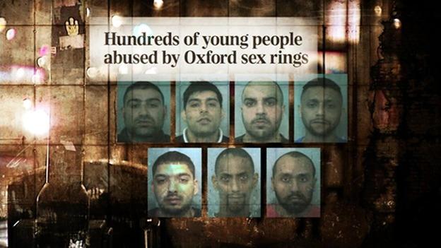
“Urgent action is required so that professionals and practitioners recognise the many warning signs that children display when being subjected to sexual exploitation…”¹
¹“I thought I was the only one. The only one in the world.” The Office of the Children’s Commissioner’s Inquiry into Child Sexual Exploitation in Gangs and Groups. Interim Report. November 2012.
Notes:
As we know, sexual health services have always been ahead of the game in terms of looking at making services young people-friendly due to the link between those who are at high risk of infections and other high risk behaviours and vulnerability factors. However, we were called to reflect on how well we were detecting possible victims of sexual exploitation following high profile cases in the media, subsequent serious case reviews, and reports from bodies such as the Office of the Children’s Commissioner.

Slide 5
A standardised approach to identifying risk factors to sexual exploitation.
Notes:
After adopting the BASHH/Spotting the Signs proforma – designed to give professionals a standardised approach to elicit information from young people about vulnerability factors – we decided to undertake a brief patient satisfaction survey. Partly we wanted to check how well we were meeting the quality standards. We also wanted, however, to focus in on one area of our under 18 proforma – the issue of sexting.

Slide 6
¼ reports of child sexual exploitation related to online grooming
Sexting is a behaviour that young people often engage in without understanding the full consequences
1,200 young people called Childline about sexting in 2015
Ringrose, J. Rosalind, G. Livingstone, S. Harvey, L. A Qualitative Study of Children, Young People and Sexting. NSPCC. 2012
Notes:
Sexting' is an increasingly common activity among children and young people, where they share inappropriate or explicit images online or through mobile phones. It can also refer to written messages. We have a growing understanding of the link between sexting and online grooming. CEOP estimates that a quarter of all reports of child sexual exploitation are related to online grooming (reference).Childline reports that in 2015 they dealt with 1,200 cases of young people worried about indecent images they had shared, or who felt pressured into sexting. Because of this link we decided to incorporate a couple of questions about sexting into our under 18 proforma. This survey was a good way of giving us an insight into the prevalence of sexting among our patient group, and how well we were doing in asking questions about this topic.

Slide 7
Method
Anonymous survey
November 2015 and March 2016
54 responses
<18 year olds
Attendance at a once-a-week drop-in clinic
Notes:
The survey was given out by receptionists prior to consultation and patient’s were encouraged to complete after consultation. 54 out of 311 eligible responses, which works out at a completion rate of 17.36%.

Slide 8
Waiting room relevant and interesting for young people | 98%
Waiting time <30 mins | 63%
Confidentiality explained | 85%
Contraception discussed | 61%
Condom Card offered | 41%
Did service meet expectations? | 100%
Notes:
In terms of the quality standards, our patients told us we were doing well in meeting their expectations of a service, that they were seen quickly and promptly, and that we were generally very good at explaining confidentiality and its limitations. Clearly there is room for improvement around providing a comprehensive service, with only 61% of patients reporting a discussion around contraception, and only 41% being offered a condom card.

Slide 9
Have you ever sent a sexually explicit image of yourself to someone else?
46%
54%
Notes:
Pretty much half of our respondents admitted to ever sending a sexually explicit image of themselves on to someone else, showing just how prevalent this behaviour is amongst young people.

Slide 10
Have you experienced a negative outcome from sexting?
26%
74%
Notes:
A quarter of those who had engaged in sexting had reported a negative outcome. The nature of this negative outcome wasn’t specified in the questionnaire. According to the NSPCC, young people commonly report feeling regret after sexting, and they estimate that 1 in 5 young people have passed sexual images they haver received onto others, or even posted it onto the internet.

Slide 11
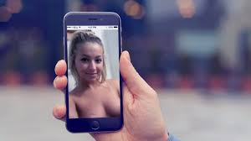
Case study
Evie is 16. At his request, she sent a naked photo of herself to a boy she fancied at college.
He forwarded this on to many of his friends. Soon she was not only being bullied, but was being constantly harassed by boys asking her to perform sexual acts on them. She started going absent from college…

Slide 12
Were you asked about sexting in your consultation today?
86%
Notes:
As you can see, however, the majority of our respondents reported not being asked about sexting during their consultations. You’ll be relieved to hear, however, that since the survey was carried out, we have undertaken further staff training around this issue.

Slide 13
Discussion
Many young people are sexting
Significant minority experiencing negative outcome
Sexual health professionals are well placed to discuss this issue
The topic is often not routinely discussed in consultations

Slide 14
Recommendations
Routine questions on sexting included on under 18 assessments
Ongoing training required to build confidence in asking non-clinical questions.
PHSE – ensure consistent approach to include sexting into online safety
Future patient surveys to be completed on tablets

Slide 15
Checklist to Prevent Regret
Why am I being asked to do this?
What would happen if I say no?
How would I feel if other people saw it?
Am I comfortable with my image being accessible on the internet forever?
¹Devon, N. A Checklist of Regrets: Sexting Edition. www.tes.com/us/news. 14/04/2016
Notes:
An idea from America……..The internet is immediate, constant, urgent and demanding. It robs young people of time to reflect upon whether this is something they really want to do. In my youth, if I wanted to send a saucy image of myself to someone, I’d have to wait for the film to get developed at Boots and then bribe a friend to collect the snaps for me so I didn’t have to face the knowing looks of the sales assistants. Needless to say this meant that most of the time the thought of all this palava would put me off doing it. What if we gave young people some trigger thoughts and encouraged them to take a minute to reflect upon them before pressing ‘send’?

Slide 16
Acknowledgements
Lauren Bignall, Eleanor Morad, Daniel Richardson and Debbie Williams.

Slide 17
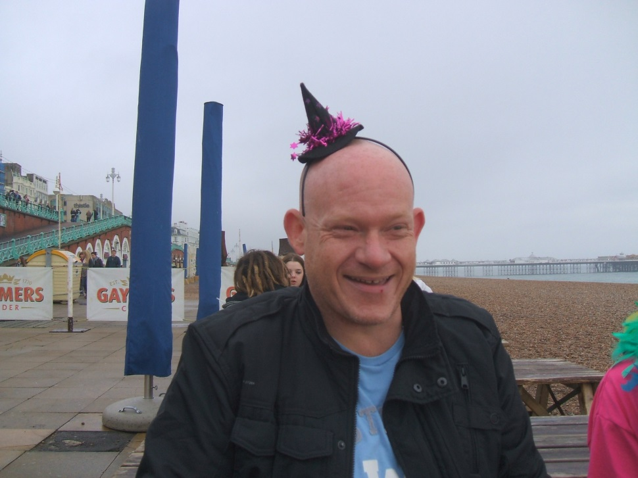
In memory of Alan Phillips

