Slide 1

The 2012 BASHH National Audit of Asymptomatic Screening & using web forms for real-time data capture and analysis
Dr Anatole S Menon-Johansson
Consultant in GU/HIV Medicine, London, UK
On behalf of the BASHH National Audit Group
29th June BASHH / ASTDA Spring Conference

Slide 2
BASHH 2012 Audit standards
Sexually Transmitted Infections: UK National Screening and Testing Guidelines August 2006 http://www.bashh.org/guidelines
Recommended Tests for Asymptomatic Patients
This presentation builds upon the recommendations from the 2009 audit

Slide 3
Case definition
No symptoms offered on presentation (either on a triage form, or similar form, or on direct questioning by a healthcare worker)
Seen during a first meeting in a new or re-book episode

Slide 4
Methods
Audit interval:
  Cases seen 1st October to 31st December, 2011
Data collection period:
  Launched 7th January to 15th April, 2012
  Up to 40 consecutive cases
  Data submitted using an online form
Participation:
  Level 3 services: BASHH NAG Regional Chairs network
  BASHH website, emails, BASHH Newsletter

Slide 5
Results from 2012 National Asymptomatic audit
Gender | Heterosexual Number (%, regional range) | Homosexual Number (%, regional range) | Bisexual Number (%, regional range) | Total Number
Male | 3020 (90%, 83–95%) | 266 (8%, 4–15%) | 62 (2%, 0–3%) | 3348
Female | 3291 (99%, 98–100%) | 10 (0.3%, 0-1%) | 20 (0.6%, 0-2%) | 3321
Total | 6311 | 276 | 82 | 6669

Slide 6
2009 Audit: Suggested Areas for Practice Improvement/Intervention
  Increased documentation of discussion about oral and anal sex, as recommended in the BASHH recommendations on sexual history taking, to identify which anatomical sites need to be sampled for infection
  Regional strategies should be considered to balance nucleic acid amplification testing (NAAT) for gonorrhoea with culture testing to monitor antibiotic sensitivity
  Increased screening for hepatitis B in MSM is needed in some regions
  Increased screening for HIV is needed in some clinics

Slide 7
Oral sex discussion
Gender | Occurred Number (%, regional range) | Did not occur Number (%, regional range) | Declined to answer Number (%, regional range) | Not asked Number (%, regional range) | No record Number (%, regional range) | Total Number
HeteroMale | 866 (29%, 22–63%) | 646 (21%, 7–29%) | 1 | 45 (2%, 0-13%) | 1462 (48%, 8-62%) | 3020
MSM | 279 (85%, 67-100%) * | 23 (7%, 0-33%) (86%, 75-100%) | - | 1 | 25 (8%, 0-22%) (41%, 0-100%) | 328
Female | 1038 (32%, 9–74%) * | 699 (21%, 11-33%) (12%, 0-30%) | 2 | 43 (1%, 0-12%) | 1539 (46%, 3-70%) (1%, 0-6%) | 3321
Total (= M+F) | 2183 | 1368 | 3 | 89 | 3026 | 6669
* ‘Receptive oral sex documented’ in 2009

Slide 8
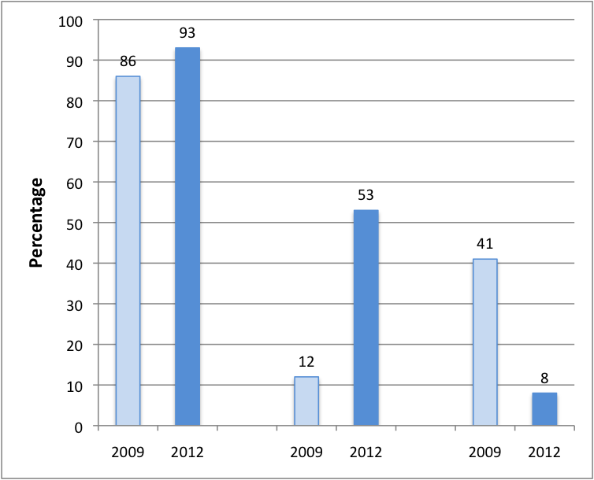
Oral sex discussion
MSM
Women
No Record

Slide 9
Anal sex discussion
Gender | Occurred Number (%, regional range) | Did not occur* Number (%, regional range) | Declined to answer Number (%, regional range) | Not asked Number (%, regional range) | No record Number (%, regional range) | Total Number
HeteroMale | 36 (1%, 0–6%) | 987 (33%, 15–63%) | 2 | 13 (0.4%, 0-2%) | 1105 (37%, 18-51%) | 3020
MSM | 218 (66%, 48-92%) * | 82 (25%, 8-60%) (84%, 67-100%) | 1 | - | 27 (8%, 0-18%) (44%, 0-100%) | 328
Female | 177 (5%, 1–14%) * | 1494 (45%, 26-80%) (12%, 0-100%) | 3 | 12 (0.4%, 0-2%) | 1635 (49%, 3-70%) (1%, 0-13%) | 3321
Total (= M+F) | 431 | 3668 | 6 | 25 | 2539 | 6669
* ‘Receptive anal sex documented’ in 2009
* Includes ‘Not applicable’

Slide 10
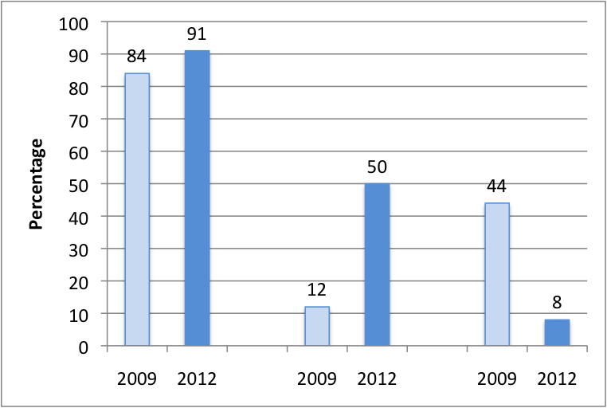
Anal sex discussion
MSM
Women
No Record

Slide 11
Gonorrhoea testing: Men
Test | Yes Number (%, regional range) | Declined Number (%, regional range) | No Number (%, regional range) | NA Number (%, regional range)
Urine NAAT | 2245 (67%, 14-95%) (36%, 0-100%) | 23 (0.7%, 0-3%) | 671 (20%, 1-53%) | 409 (12%, 0-52%)
Urethral Culture | 1086 (32%, 1-84%) | 51 (2%, 0-7%) | 1683 (50%, 16-93%) | 528 (16%, 1-62%)
Urethral microscopy | 130 (4%, 0-13%) | 3 (0.1%, 0-1%) | 2182 (66%, 43-99%) | 1006 (30%, 1-57%)
Urethral NAAT | 61 (2%, 0–12%) | 4 (0.1%, 0–1%) | 2361 (70%, 39-96%) | 922 (27%, 1-61%)
Percentage in 2009

Slide 12
Gonorrhoea testing: MSM
Test | Yes Number (%, regional range) | Declined Number (%, regional range) | No Number (%, regional range) | NA Number (%, regional range)
Rectal NAAT | 163 (50%, 0-89%) (16%, 0-67%) | 7 (2%, 0-12%) | 95 (29%, 0-80%) | 63 (19%, 4-75%)
Rectal culture | 136 (41%, 11-89%) | 10 (3%, 3-12%) | 130 (40%, 11-67%) | 52 (16%, 0-46%)
Rectal microscopy | 16 (5%, 0-44%) | 3 (1%, 0-12%) | 217 (66%, 42-91%) | 92 (28%, 7-69%)
Oro- pharyngeal NAAT | 164 (50%, 13-92%) | 4 (1%, 0-11%) | 108 (33%, 0-73%) | 52 (16%, 0-57%)
Oro-pharyngeal culture | 170 (52%, 0-83%) | 6 (2%, 0-8%) | 115 (35%, 0-87%) | 37 (11%, 0-46%)
Percentage in 2009

Slide 13
Gonorrhoea testing: Women
Test | Yes Number (%, regional range) | Declined Number (%, regional range) | No Number (%, regional range) | NA Number (%, regional range)
Urine NAAT | 181 (6%, 0-16%) (10%, 0-36%) | 9 (0.3%, 0-2%) | 2248 (68%, 37-96%) | 883 (27%, 1-61%)
Vulvo-vaginal NAAT | 1289 (38%, 1-81%) | 36 (1%, 0-3%) | 1338 (40%, 9-68%) | 658 (20%, 3-55%)
Vulvo-vaginal culture | 195 (6%, 0-34%) | 8 (0.2%, 0-1%) | 2197 (66%, 30-98%) | 921 (28%, 12-60%)
Cervical NAAT | (20%, 1-55%) (12%, 0-44%) | 41 (1%, 0-4%) | 1940 (58%, 30-81%) | 684 (21%, 1-44%)
Cervical culture | 1310 (39%, 0-83%) | 50 (1%, 0-4%) | 1450 (44%, 16-98%) | 511 (15%, 1-51%)
Urethral NAAT | 181 (6%, 0-16%) | 9 (0.3%, 0-2%) | 2248 (68%, 37-96%) | 883 (27%, 1-61%)
Urethral culture | 872 (26%, 0-50%) | 23 (1%, 0-2%) | 1701 (51%, 21-98%) | 725 (22%, 2-54%)
Percentage in 2009

Slide 14
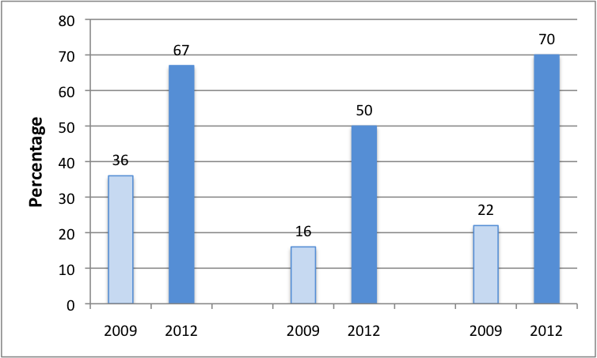
NAAT testing trend
Urine NAAT
Hetero Men
Rectal NAAT
MSM
NAAT testing
Women

Slide 15
Gonorrhoea testing:
Tests not recommended by CEG
Test | Yes Number (%, regional range) | Declined Number (%, regional range) | No Number (%, regional range) | NA Number (%, regional range)
Men
Urethral microscopy | 341 (10%, 0-23%) | 14 (0.4%, 0-2%) | 2082 (62%, 33-82%) | 911 (27%, 4-62%)
Women
Cervical microscopy | 303 (9%, 2-15%) | 7 (0.2%, 0-1%) | 2108 (64%, 37-93%) | 903 (27%, 1-54%)
Urethral microscopy | 130 (4%, 0-13%) | 3 (0.1%, 0-1%) | 2182 (66%, 44-99%) | 1006 (30%, 1-57%)
CEG = Clinical Effectiveness Group

Slide 16
Screening for Hepatitis B
Group/ Reason | Tested Number (%, regional range) | Not tested Number (%, regional range) | Declined Number (%, regional range) | Total Number
Heterosexual Male* | 155 (24%, 11-63%) (23%, 7-60%) | 2811 (74%, 31-83%) | 54 (2%, 0-6%) | 3020
MSM screened | 247 (75%, 52-100%) (82%, 54-100%) | 73 (22%, 0-48%) | 8 (2%, 0-22%) | 328
Test not applicable |  | 5 (7%, 0-68%)
Immune / Infected |  | 45 (62%, 0-100%)
Not applicable & immune / infected |  | 14 (19%, 0-67%)
Neither reason given |  | 9 (12%, 0-31%)
Female* | 561 (17%, 9-66%) (23%, 8-59%) | 2703 (81%, 76-92%) | 57 (2%, 0-8%) | 3321
* CEG does not recommend testing unless high risk group
Percentage in 2009

Slide 17
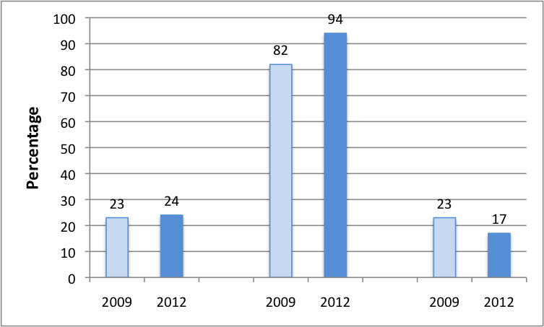
Screening for Hepatitis B
Hetero Men
MSM
Women

Slide 18
HIV testing
Group | Tested Number (%, regional range) | Not offered Number (%, regional range) | Declined Number (%, regional range) | Not applicable (%, regional range) | Total Number
Heterosexual Men | 2607 (86%, 76-96%) (83%, 70-96%) | 20 (0.7%, 0-4%) | 350 (12%, 4-15%) | 43 (1.4%, 0-3%) | 3020
MSM screened | 317 (97%, 91-100%) (94%, 90-100%) | - | 10 (3%, 0-22%) | 1 | 328
Reason for NA |  |  |  | HIV positive
Female | 2772 (84%, 74-93%) (81%, 66-98%) | 37 (1%, 0-3%) | 460 (14%, 7-24%) | 52 (2%, 0-4%) | 3321
Percentage in 2009

Slide 19
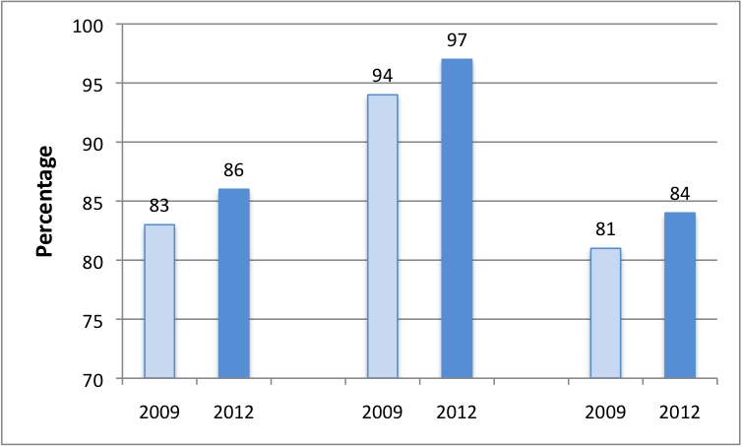
HIV testing
Hetero Men
MSM
Women

Slide 20
Acknowledgements: BASHH Regional Audit Chairs & Members
Chair Hugo McClean
Vice Chair Chris Carne
Hon Sec Ann Sullivan
Director of Development Anatole Menon-Johansson
BCCG Representative Phil Kell
BHIVA Representative Alison Rodger, Ed Wilkins
Scotland Daniel Clutterbuck
Wales Helen Baley, Sarah McAndrew, Carys Knapper
Northern Ireland Say Quah
Anglia Raouf Moussa
Cheshire & Mersey Ravindra Gokhale
Essex Gail Crowe
North Thames Ann Sullivan, Alan Smith
Northern Sarup Tayal
North-West Ashish Sukthankar
Oxford Gill Wildman
South East Thames Cindy Sethi
South-West Zoe Warwick
South-West Thames Steven Estreich
Trent Jyoti Dhar
Wessex Neelam Radja, Leela Sanmani
West Midlands Sashi Acharya
Yorkshire Amy Tobin-Mammen
Co-opted Members David Daniels, Nicola Low, Lindsay Emmett
Hilary Curtis for questionnaire design, collection, collation of data, user
support and production of regional & national aggregates

Slide 21
Web forms & audit

Slide 22
The key audit stages
No. | Criteria [AMRC, http://bit.ly/vUnKuy ]
Stage 1: Preparation and planning
1 | The topic for the audit is a priority
2 | The audit measures against standards
3 | The organisation enables the conduct of the audit
4 | The audit engages with clinical and non-clinical stakeholders
5 | Patients or their representatives are involved in the audit if appropriate
Stage 2: Measuring performance
6 | The audit method is described in a written protocol
7 | The target sample should be appropriate to generate meaningful results
8 | The data collection process is robust
9 | The data are analysed and the results reported in a way that maximises the impact of the audit
Stage 3: Implementing change
10 | An action plan is developed and implemented to take forward any recommendations made
Stage 4: Achieving and sustaining improvement
11 | The audit is a cyclical process that demonstrates that improvement has been achieved and sustained

Slide 23
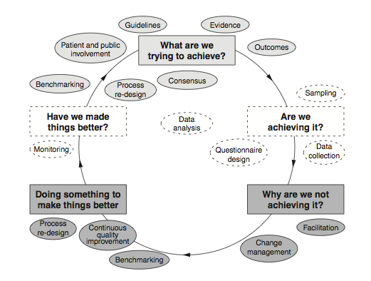
The clinical audit cycle
(NICE http://bit.ly/vO6joY , 2002)

Slide 24
Google™ web forms
Educational web site created
  http://bit.ly/sczCVz
Google account free to set up
Seven Web form question types available
Data written to central spreadsheet
Export possible in six formats
Automated analysis feature for real time reporting to auditors

Slide 25
South Thames Audit Group:
HIV partner testing - Background
The CQUIN* to ‘enhance partner notification (PN) of newly diagnosed to promote testing’ recommends that HIV is ‘discussed’ regarding at risk contacts and ‘HIV status is recorded’.
However, this CQUIN does not clarify if PN has been verified.
We therefore performed a regional audit of 17 GUM clinics to test if it is feasible to see and test partners within a month of diagnosis.
* Commission for QUaility & Innovation payment framework

Slide 26
South Thames Audit Group:
HIV partner testing - Methods
Clinics asked to audit PN for the last 20 newly diagnosed patients with HIV prior to May 2010
A web form was developed using Google™ forms (http://bit.ly/ge7SMn)
Auditors asked to answer 15 questions using a range of formats
Each submission, signed off by the auditors’ email address, contained one piece of pseudonymous data & represented one patient

Slide 27
Anonymised vs Pseudonymised information
Anonymised
  This is information which does not identify an individual directly, and which cannot reasonably be used to determine identity. Anonymisation requires the removal of name, address, full post code and any other detail or combination of details that might support identification.
Pseudonymised
  ……. it differs in that the original provider of the information may retain a means of identifying individuals. This will often be achieved by attaching codes or other unique references to information so that the data will only be identifiable to those who have access to the key or index. Pseudonymisation allows information about the same individual to be linked in a way that true anonymisation does not.
33837 / NHS Code of Practice: Confidentiality, November 2003, http://bit.ly/uUsvWW

Slide 28
South Thames Audit Group:
HIV partner testing – Results I
Web form written and distributed in 2 hours
Over 2/52, 209 patients audited from 14/17 clinics (71% response rate)
Upon submission, data was written to a time-stamped spreadsheet
Final analysis performed in 2 hours and presented to audit group 5/7 after audit closed

Slide 29
South Thames Audit Group:
HIV partner testing – Results II
Patient risk group
  103 (49.3%) endemic, 82 (39.2%) MSM, 18 (8.6%) not classifed, 6 (2.9%) low risk
Average time Dx to CD4 count = 12.3 days
Health advisors saw 164 (78.5%)
Partner seen and tested in one month
  110/183 (60.1%) regular partners
  16/52 (30.8%) casual partners
Follow up
  177/209 (84.7%) engaged in local care, 28/209 (13.3%) at another centre & 24/209(11.5%) lost of follow up

Slide 30
South Thames Audit Group:
HIV partner testing - Discussion
At regional audit group meeting (Nov 2010) it was agreed that:
  90% of regular partners should be seen & tested within one month of a new HIV diagnosis
  The health advisor teams should create an email contact sheet to facilitate communication
  Re audit should be done in one year
  1 Trust did not have access to Google

Slide 31
Security question raised at NAG
Audit list
Clinic A
Web form submission
Google web form dB
Pseudonymized information
Access through weblink
Data access = password protected
Audit list
Clinic B
NHS Firewall
Web form submission
Audit list
Clinic …
Web form submission

Slide 32
The Caldicott Principles
Justify the purpose.
Don’t use patient identifiable information unless it is absolutely necessary.
Use the minimum necessary patient identifiable information.
Access to patient identifiable information should be on a strict need to know basis.
Everyone should be aware of their responsibilities.
Understand and comply with the law.
33837 / NHS Code of Practice: Confidentiality, November 2003, http://bit.ly/uUsvWW

Slide 33
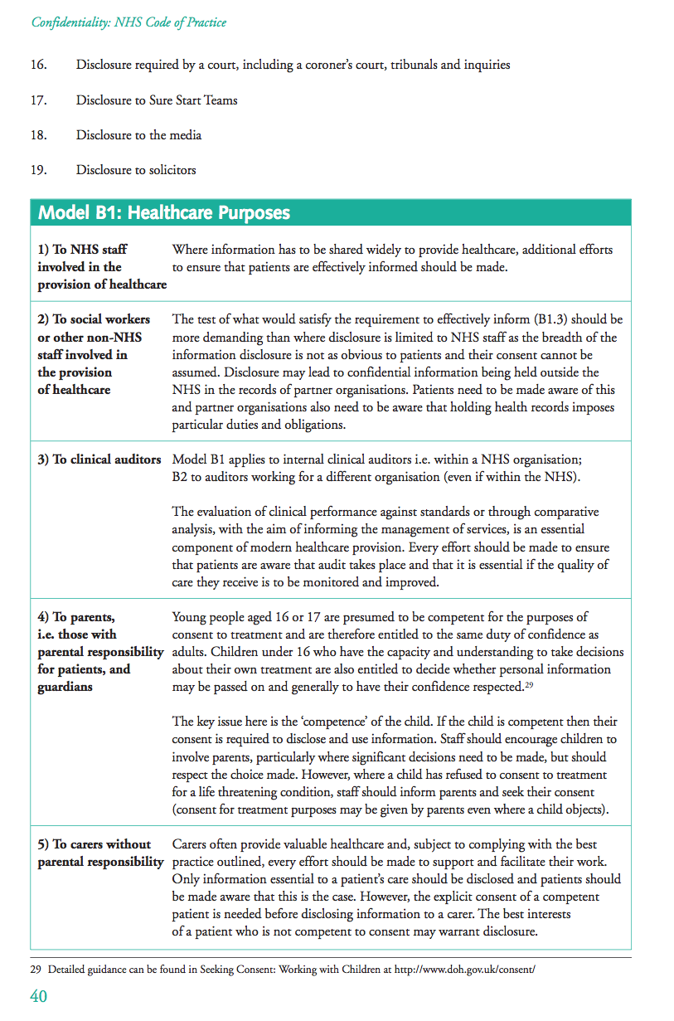
33837 / NHS Code of Practice: Confidentiality November 2003 http://bit.ly/uUsvWW

Slide 34
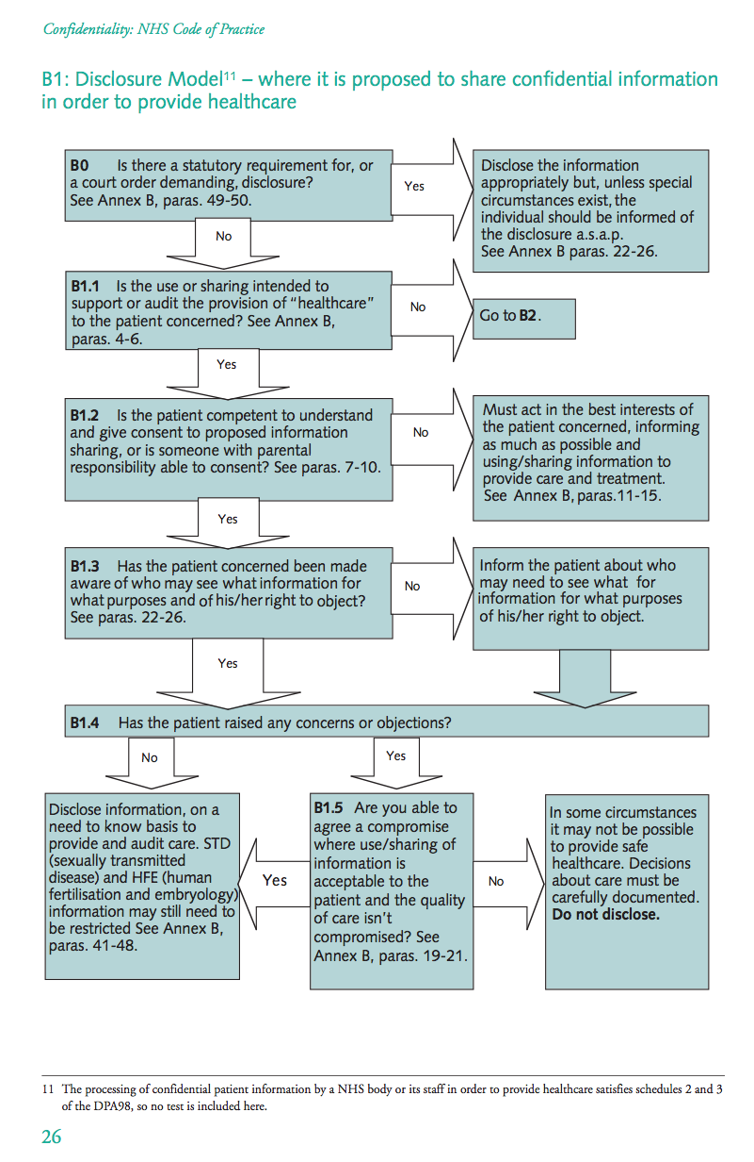
33837 / NHS Code of Practice: Confidentiality November 2003 http://bit.ly/uUsvWW

Slide 35
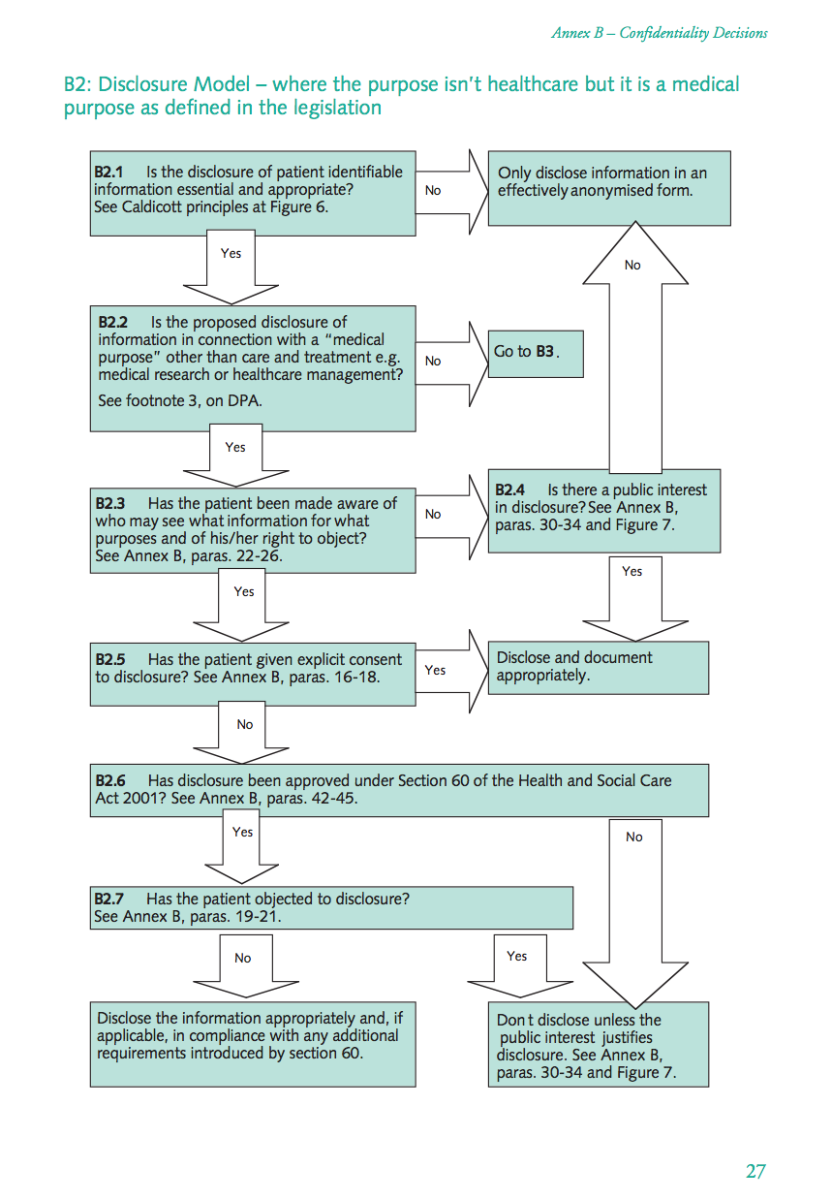
33837 / NHS Code of Practice: Confidentiality November 2003 http://bit.ly/uUsvWW

Slide 36
Summary
Audit is essential for quality improvement & it is clearly linked to revalidation
Google™ web forms are a robust data collection tool, facilitate analysis & reporting
Using a web form: audits can be run, analyzed and presented with three weeks
Pseudonymous data protects patient confidentiality but anonymous data is preferable

Slide 37
Acknowledgements
Cindy Sethi & South Thames audit group
Mary Poulton (Caldicott guardian – King’s College Hospital)
Alex Colias (Head IT security – Guy’s & St Thomas’ NHS Foundation Trust)
Frances Flinter (Caldicott guardian – Guy’s & St Thomas’ NHS Foundation Trust)

