Slide 1
2011 Audit against the Key Performance Indicators (KPIs) in the BASHH MedFASH STI Management Standards (STIMS)
Updated presentation 20 Sept 2011
Hugo McClean
On behalf of the BASHH National Audit Group

Slide 2
2011 STIMS Audit- presentation scheme
STIMS Key Performance Indicators (KPIs)
Methods
Results
Key messages
Areas for improvement
Use of STIMS Audit findings

Slide 3

2011 Audit against the BASHH MedFASH
STI Management Standards (STIMS)
Standards:
Standards for the management of sexually transmitted infections
Posted on BASHH and MedFASH websites Jan 2010
Aims: “to support the commissioning and provision of high quality care for STIs across all settings”

Slide 4
STIMS KPIs
Practice in 9 patient management and policy areas
Many required further definition to allow auditing
(Continuing role of BASHH Clinical Standards Unit, Dr Immy Ahmed)

Slide 5
STIMS KPIs
Patient management: data from case notes
KPI | Summary | Further definition needed
1.4.1 | 48 hour access (patient registers) | No
3.4.1 | Sexual history | Yes
3.4.1 | STI/HIV risk assessment | Yes
3.4.2 | HIV testing & uptake | No
4.4.1 | Test results within 7 working days | Yes
5.4.1 | Partner notification | Yes

Slide 6
STIMS KPIs
Clinic policies
KPI | Summary | Further definition needed
2.4.1 | Staff competency/updating | Yes
6.4.1 | Information governance | Yes
7.4.1 | Care pathways to Level 3 services | Yes
8.4.1 | Audit participation and planning | No
9.4.1 | Patient and Public Engagement plan | Yes

Slide 7
Methods- eligible services
Eligible services:
  All UK Nations
  Genitourinary medicine clinics
  Services providing STI management at either level 2 or 3 defined in the BASHH MedFASH STIMS Project definitions in STIMS Appendix B
    Faculty of Sexual & Reproductive Healthcare consultant-led services
    Primary Care practitioner-led services at level 2
    Commissioned by PCTs to be provided by the independent or third sectors
Not included:
  Pharmacy-based services
  National Chlamydial Screening Programme services
  Non PCT-commissioned independent or third sector services

Slide 8
Methods- principles
Clinics seeing smaller numbers of cases
Senior clinical staff asked to assist with data collection
Asked to seek help from managers for information governance questions
Informed of planned re-audit in 2014
Case note data returned at clinic level

Slide 9
Methods: data collection- 1
Audit interval:
  Clinic policies: as of 31 December 2010
  Cases seen 1 October to 31 December 2010
Data collection
  Launched 6 Jan 2011
  Closed 30 April 2011
  Complete data set presented
Participation:
  Level 2 services: PCT Sexual Health Leads via Andrea Duncan (DH Sexual Health & HIV Programme Manager)
  Level 3 services: BASHH NAG Regional Chairs network
  BASHH website
Comments in free text boxes for each question: BASHH website

Slide 10
Data collection- 2
Data collected by clinics in an Excel workbook
Data submitted using an online form

Slide 11
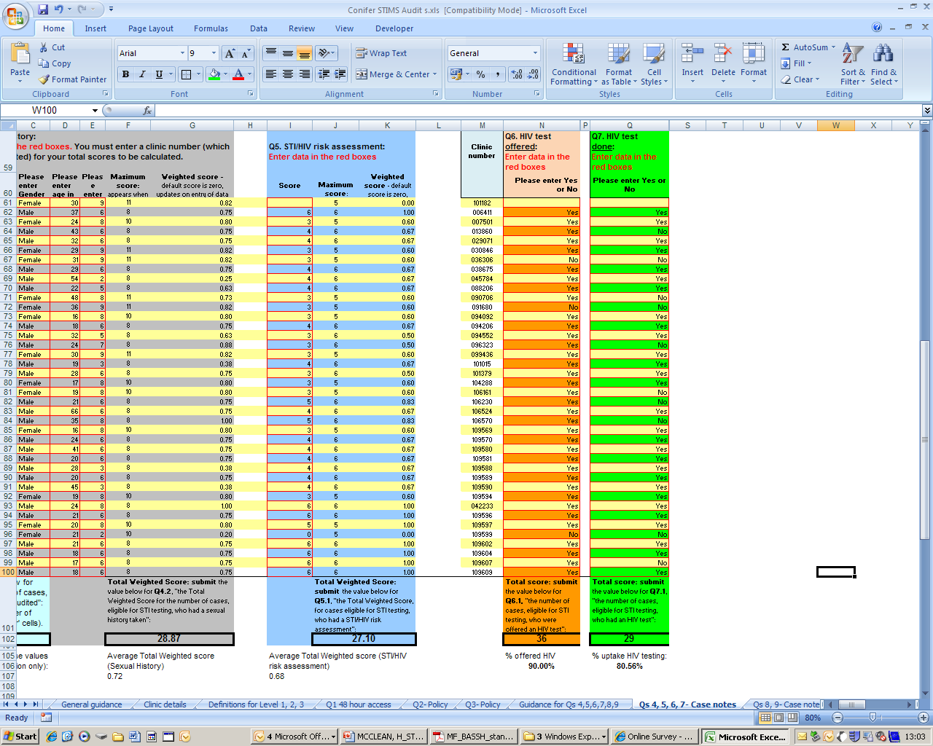
Data collection- 3
Clinic policy data
Case note data:
  Up to consecutive 40 cases*
  Clinic level performance computed: no individual patient data
Free text comments
*RCP Local Clinical Audit: handbook for physicians: http://old.rcplondon.ac.uk/clinical-standards/ceeu/Documents/Local-clinical-audit-handbook-for-physicians-August-2010.pdf

Slide 12
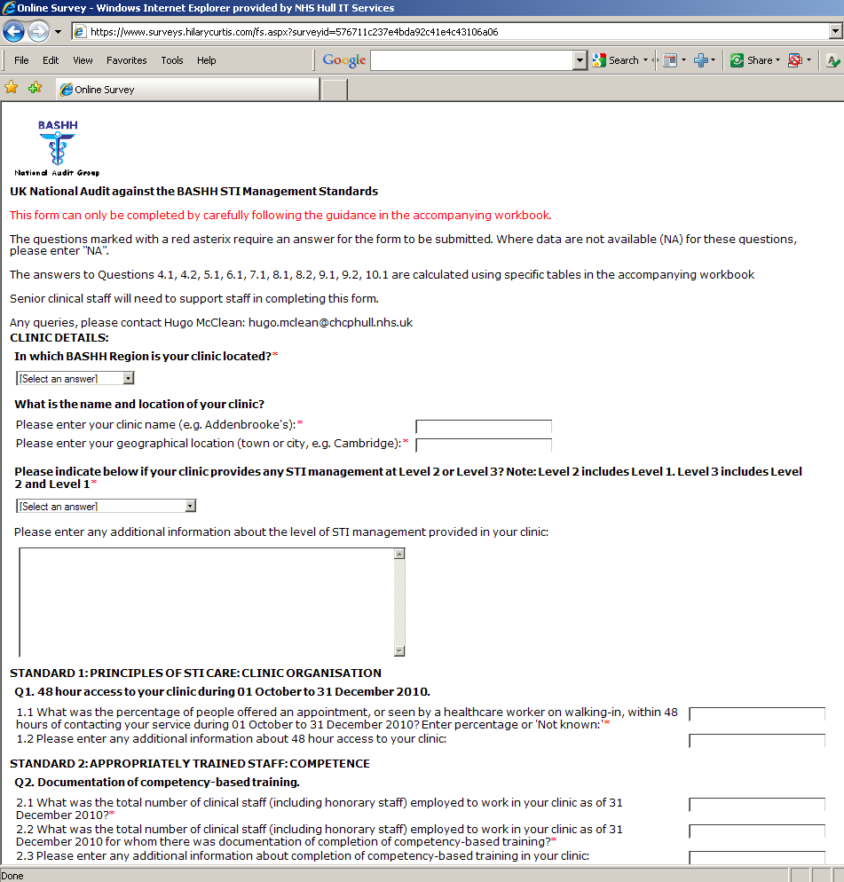
Data collection- 4
Data transcribed and submitted using an online form:

Slide 13
Results- clinic level data
Clinic level data
Percentage of clinics in each BASHH Region meeting KPI performance target
Overall national performance

Slide 14
Number (%) of clinics participating, by Region
BASHH Audit Group Region | Level 3 (%) | Level 2 (%) | Total (%)
North Thames | 27 (18%) | 4 (11%) | 31 (17%)
South Thames | 24 (16%) | 10 (27%) | 34 (18%)
Trent | 15 (10%) | 3 (8%) | 18 (10%)
South West | 12 (8%) | 3 (8%) | 15 (8%)
Yorkshire | 12 (8%) | 6 (16%) | 18 (10%)
Anglia | 10 (7%) | 6 (16%) | 16 (9%)
Wales | 10 (7%) | 3 (8%) | 13 (7%)
Northern | 8 (5%) | None | 8 (4%)
West Midlands | 8 (5%) | None | 8 (4%)
Oxford | 6 (4%) | 1 (3%) | 7 (4%)
Northern Ireland | 5 (3%) | None | 5 (3%)
Wessex | 5 (3%) | None | 5 (3%)
Cheshire and Merseyside | 4 (3%) | None | 4 (2%)
North West | 3 (2%) | 1 (3%) | 4 (2%)
National (%) | 149 (100%) | 37 (100%) | 186 (100%)

Slide 15
KPI 1. 48 hour access
Percentage of people offered an appointment, or seen by a healthcare worker on walking-in, within 48 hours of contacting an STI provider
Standard 98%

Slide 16
KPI 1. Percentage of clinics in each Region with ≥98%
48 hour access

Slide 17
KPI 2. Staff competency
Percentage of staff who have completed competency-based training
No nationally agreed standards for competency for some clinical staff groups
Percentage of staff with documentation of competency
Question: no justification of how competency was achieved, only whether it was documented
Standard 100%

Slide 18
KPI 2. Percentage of clinics in each Region with 100% staff with competency documented

Slide 19
KPI 2. Staff updating
Percentage of staff who have fulfilled update requirements
No nationally agreed standards for update requirements
Percentage of staff with documentation of updating
Question: no justification of how updating was achieved, only whether it was documented
Standard 100%

Slide 20
KPI 2. Percentage of clinics in each Region with 100% staff with updating documented

Slide 21
KPI 3. Sexual history
KPI: “Percentage of individuals with STI concerns who had a sexual history taken. Standard 100%”
Case definition: eligible for STI screening because of concern about STIs spontaneously expressed, or elicited during the visit to a service (either verbally or indicated on a triage or similar form)
Scoring system based on data elements from:
  BASHH 2006 National guidelines on undertaking consultations requiring sexual history taking*
    Competency (if age <16 years)
    Symptoms
    Reason for attendance
    Sexual contact details
    Previous STIs
    First day of last menses, or documentation about vaginal bleeding (women)
    Contraception (women)
    Cervical cytology (women age >=25 years)
  Score weighting based on gender and age
Standard: 75% documentation based on questions

Slide 22
KPI 3. Percentage of clinics in each Region with ≥75% sexual history documentation

Slide 23
KPI 3. STI/HIV risk assessment
KPI: Percentage of individuals with STI concerns who had a STI/HIV risk assessment made. Standard 100%
Case definition: eligible for STI screening because of concern about STIs spontaneously expressed, or elicited during the visit to a service
Scoring system based on data elements from:
  BASHH 2006 National guidelines on undertaking consultations requiring sexual history taking*
    Lifetime injecting drug use
    Sex abroad
    Risk factors for hepatitis B
    Medical treatment abroad
    HIV testing history
    Lifetime sexual contact with another man (men)
  Score weighting based on gender
Standard: 75% documentation based on questions

Slide 24
KPI 3. Percentage of clinics in each Region with ≥75% STI/HIV risk assessment documentation

Slide 25
KPI 3. HIV testing & uptake
Case definition: eligible for STI screening because of concern about STIs spontaneously expressed, or elicited during the visit to a service
Standards:
  Offer 100%
  Uptake, by those offered, 60%

Slide 26
KPI 3. Percentage of clinics in each Region with 100% HIV test offer

Slide 27
KPI 3. Percentage of clinics in each Region with ≥60% HIV test uptake (of those offered)

Slide 28
KPI 4. Test results within 7 days
Standard
  “Percentage of reports (or preliminary reports) that are received by clinicians within 7 working days of a specimen being taken”
Further definition:
  Chlamydial test results chosen
  'Received' = date report accessible to a relevant clinician, either paper report, or electronically.
  Paper reports- date stamped on the report
  Electronic reports- date report electronically posted by laboratory

Slide 29
KPI 4. Percentage of clinics in each Region with 100% positive chlamydia test results within 7 days

Slide 30
KPI 5. Partner notification
Standard
  “Rate of partner notification for chlamydia and gonorrhoea for each STI provider”
  Standard:
    At least 0.4 contacts per index cases in large conurbations, 0.6 elsewhere
    Within four weeks
Measured for chlamydial infection
Further definition:
  Contact event = seen for management
  Resolution: both verified by a healthcare worker AND reported by an index case
  Verified = contacting another agency if necessary
  Four weeks start = from date of first PN interview
See slide 52 for London and outside-London PN performance

Slide 31
KPI 5. Percentage of clinics in each Region with ≥0.4 chlamydial contacts verified by a healthcare worker
Null returns: Level 2, 49%; Level 3, 7%

Slide 32
KPI 5. Percentage of clinics in each Region with ≥0.6 chlamydial contacts verified by healthcare workers
Null returns: Level 2, 49%; Level 3, 7%

Slide 33
KPI 5. Percentage of clinics in each Region with ≥0.4 chlamydial contacts reported by index cases
Null returns: Level 2, 41%; Level 3, 5%

Slide 34
KPI 5. Percentage of clinics in each Region with ≥0.6 chlamydial contacts reported by index cases
Null returns: Level 2, 41%; Level 3, 5%

Slide 35
National PN performance: percentage of clinics with
≥0.4 & ≥0.6 performance levels
Service level | Verified/reported | Performance level: contacts seen/index cases
 |  | ≥0.4 | ≥0.6
 |  | % Clinics with this level of performance:
Level 3, n=164 | Verified | 63% | 38%
 | Reported | 70% | 52%
Level 2, n=37 | Verified | 41% | 35%
 | Reported | 43% | 41%

Slide 36
Level 3 PN performance: 2011 vs 2007
 | Performance level: contacts/index cases
 | ≥0.4 |  | ≥0.6
Audit | Verified | Reported | Verified | Reported
 | % Clinics with this level of performance:
2011 Standards Audit (contacts seen) | 63% | 70% | 38% | 52%
2007 BASHH Chlamydia Audit (contacts screened) | 55% | 52% | 31% | 25%

Slide 37
KPI 6. Information governance
BASHH Standards: “Provision of data by all providers of services managing STIs complies with national and local reporting requirements”
Please check with your service manager and/or senior clinical staff to help answer these questions!
Scoring system based on 22 information governance components
Standard 100%

Slide 38
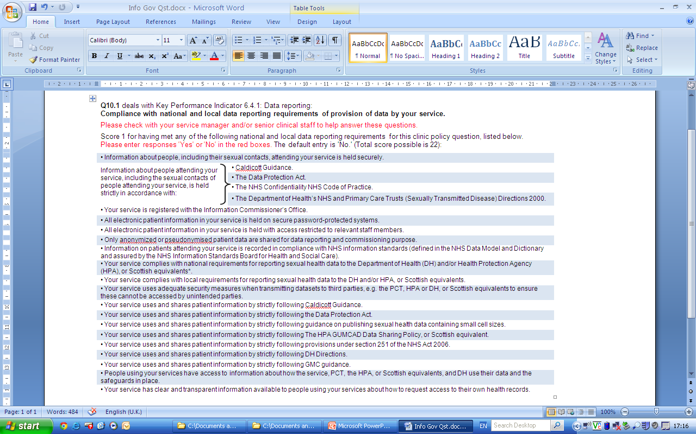
KPI 6. Information governance- questions
Notes:
Section 251 of the NHS Act 2006 http://www.ic.nhs.uk/services/medical-research-information-service/the-application-process/use-of-patient-identifiable-data-without-subjects-consent
Section 251 of the NHS Act 2006 replaces Section 60 of the Health and Social Care Act 2001. It provides relief from the common law duty of confidentiality which requires that patient identifiable data is only used with consent. Section 251 powers can only be used for medical purposes, where it can be shown that identifiable patient data is necessary and consent is not practicable.
If your study will use patient identifiable data from The NHS Information Centre, without the study subjects' consent, you will need to apply to the National Information Governance Board for Health and Social Care (NIGB) for approval. This could extend the application process.
The Health & Social Care Act 2008 establishes the National Information Governance Board for Health and Social Care (NIGB) as a statutory body with powers under the Secretary of State for health. They provide advice on the use of patient information and to oversee arrangements created under the NHS Act 2006. They assess applications for use of patient information, to make sure that it is in the interests of patients and wider public.
How to apply for S251 Support
Please make an application to the NIGB Ethics and Confidentiality Committee (ECC).
Information on Studies which have been given S251 NHS Act support will be placed on NIGB's publically available register of approved applications.
For more information on S251 NHS Act support please contact the NIGB Office.

Slide 39
KPI 6. Percentage of clinics in each Region with 100% information governance score (22/22)

Slide 40
KPI 7. Care pathways to Level 3 services
2 elements, documented evidence of explicit:
  Agreed care pathways linking all providers of services managing STIs in your area with Level 3 services
  Level 3 leadership role for your area

Slide 41
KPI 7. Percentage of clinics in each Region with care pathways to Level 3 services documented

Slide 42
KPI 7. Percentage of clinics in each Region with Level 3 leadership documented

Slide 43
KPI 8. Audit: annual participation & plan
2 elements, annual:
  Participation in a regional or national audit
  Completion of an audit plan

Slide 44
KPI 8. Percentage of clinics in each Region with evidence of annual participation in audit

Slide 45
KPI 8. Percentage of clinics in each Region with evidence of completion of annual audit plans

Slide 46
KPI 9. Patient and Public Engagement (PPE) plan
4 components:
  Documented PPE plan for 2010
    Engagement with service users about services used, and services they wished to attend
    Engagement with the public, including non-users of STI services, when
      Any redesign or major service development is planned
      Finding out why some groups don’t use services
  Implementation, any part of PPE plan
  Service user feedback arising from implementation
  Response to service user feedback

Slide 47
KPI 9: Percentage of clinics in each Region with a documented plan for PPE for 2010

Slide 48
KPI 9. Percentage of clinics in each Region with implementation of PPE plans

Slide 49
  KPI 9. Percentage of clinics in each Region with evidence of service user feedback arising from implementation

Slide 50
  KPI 9. Percentage of clinics in each Region with evidence of response to service user feedback

Slide 51
Weaknesses
Definitions
Validation of questions used for data collection
Under-representation of Level 2 services
Reporting bias
Representation of smaller services

Slide 52
Summary National Performance, ranked by Level 3 KPI performance

Slide 53
Key messages
BASHH KPIs required further definition to allow auditing
  →BASHH Clinical Standards Unit
KPIs are achievable by both Level 2 & Level 3 services
Variable performance against all KPIs across regions
Areas for improvement

Slide 54
Areas for improvement
Information governance
  Training
  Policies
Time to test results
  Laboratories/clinic systems
Documentation of staff competency
  Further national work in progress to describe competencies
PN at 0.6 level (verification)
  “Dedicated ” PN time
  ePN (Ann Sullivan)
Notes:
ePN (electronic Partner Notification)
There is evidence that structured data recording in electronic patient records (EPR) improves PN (See http://sti.bmj.com/content/87/2/152.abstract). However, use of EPR is variable and ePN allows patients, while in the clinic, to start the partner notification process, independent of legacy EPR systems, by entering one (or more) partner's mobile phone number into a secure database (N3 protected) via a secure Internet (HTTPS) web-service. ePN then (optionally) sends out pre-defined text messages to the numbers entered and automatically tracks and records whether the contacted parties attend a clinic for treatment, thereby providing auditable results against the published standards. It should also be noted that, the “patient” part is optional. Even without active patient involvement, the securely held data will allow clinics – regardless of their in-house systems or even if they are still paper-based – to associate, link and report on index/partner cases.

Slide 55
Making the best use of audit results- 1
Presenting/discussing in clinical meetings
  Interventions needed to improve practice
  Implementation
Relating change to individual and team practice
  Recording staff competency and updating
  Structures and processes to follow up and document partner notification outcomes
  Re-design of case note or EPR recording
  Improve uptake of HIV testing
  Improve access to test results
  Care pathways to connect all STI management providers to Level 3 services
  Planning ahead for audit work

Slide 56
Making the best use of audit results- 2
Planning change management
  Managers
  Commissioners
  Meetings: clinical, operational, clinical governance, staff meetings, meetings
Patients involvement in change management
Using the audit exercise for appraisal, revalidation and performance review

Slide 57
Change Champions
Collect examples from clinics where the STIMS Audit data was used
  To improve practice
  How this was achieved
  Share learning with other clinics, whose patients might also benefit

Slide 58
Acknowledgements
Funding: Sexual Health and HIV, Department of Health
Planning: BASHH National Audit Group
Participation:
  Level 2 services: Andrea Duncan Sexual Health and HIV Programme Manager, Department of Health
  Level 3 services: BASHH Regional Audit Chairs
  All clinics
  Service managers
Data collection and aggregation: Hilary Curtis

Slide 59
Acknowledgements: BASHH Regional Audit Chairs & Members
Chair Hugo McClean
Vice Chair Chris Carne
Hon Sec Ann Sullivan
Director of Development Anatole Menon-Johansson
BCCG Representative Phil Kell
BHIVA Representative Alison Rodger, Ed Wilkins
Scotland Daniel Clutterbuck
Wales Helen Baley, Sarah McAndrew, Carys Knapper
Northern Ireland Say Quah
Anglia Raouf Moussa
Cheshire & Mersey Ravindra Gokhale
Essex Gail Crowe
North Thames Ann Sullivan, Alan Smith
Northern Sarup Tayal
North-West Ashish Sukthankar
Oxford Gill Wildman
South East Thames Cindy Sethi
South-West Zoe Warwick
South-West Thames Steven Estreich
Trent Jyoti Dhar
Wessex Neelam Radja, Leela Sanmani
West Midlands Sashi Acharya
Yorkshire Amy Tobin-Mammen
Co-opted Members David Daniels, Nicola Low, Lindsay Emmett

