Slide 1
Management of syphilis
BASHH National Clinical Audit 2017

Slide 2
Background
Resurgence of syphilis:
England 2016: 5,920 cases, highest since 1949, up 97% from 2012
Northern Ireland 2015: 76 cases, up 17% from 2014
Scotland 2015: 316 cases, up 99% from 2014
Wales 2014: 115 cases, up 35% from 2012
Revised BASHH UK national guidelines on the management of syphilis published December 2015
Int J STD AIDS OnlineFirst doi:10.1177/0956462415624059
Notes:
90% in England

Slide 3
Key treatment outcomes (standards)
Recorded pre-treatment RPR/VDRL (97%)
Recorded full adherence to a recommended treatment (97%)
RPR/VDRL six months post-treatment (65%)

Slide 4
Key PN outcomes (standards)
Outcome of agreed action, or decision not to contact, documented for all contacts (97% of index cases)
Contact attendance per index case (0.6 reported, 0.4 verified)

Slide 5
Methods
Survey of clinic policy/practice
Case note review of:
Last 40 adults (≥16) booked during 2016 with early infectious syphilis (SHHAPT A1, A2, A3)
Or all such patients if fewer than 40
Data collection via online questionnaires Feb/March 2017

Slide 6
Survey of policy and practice
161 level 3 GUM services
Notes:
Comment in presenting: 161 services is reasonably typical for BASHH audit.
2016: 142 level 3 or level 2+3 services
2015: 156 level 3 or level 2+3, plus 15 level 2, 1 or “other”

Slide 7
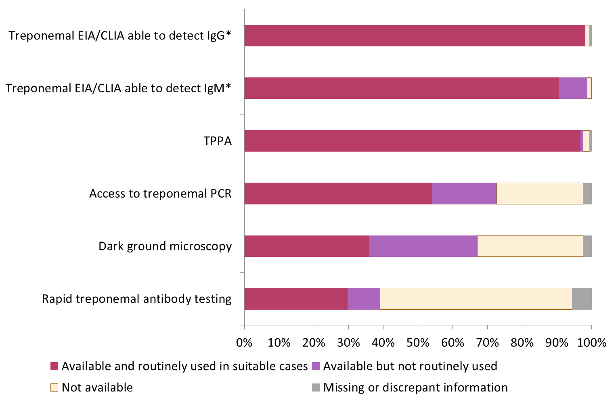
Availability of diagnostics
*Including combined IgG/IgM test.
Notes:
148 (91.9%) services have policy of confirming all positive screening tests for syphilis with a different test. 8 (5.0%) do not. 3 did not answer and for 2 services different respondents gave discrepant answers.
Data shown in graph is as follows:
Rapid treponemal antibody testing: Available and routinely used in suitable cases 30% Available but not routinely used 9% Not available 55% Missing or discrepant information 6%
Dark ground microscopy: Available and routinely used in suitable cases 36% Available but not routinely used 31% Not available 30% Missing or discrepant information 2%
Access to treponemal PCR: Available and routinely used in suitable cases 54% Available but not routinely used 19% Not available 25% Missing or discrepant information 2%
TPPA: Available and routinely used in suitable cases 97% Available but not routinely used 1% Not available 2% Missing or discrepant information 1%
Treponemal EIA/CLIA able to detect IgM*: Available and routinely used in suitable cases 91% Available but not routinely used 8% Not available 1% Missing or discrepant information 0%
Treponemal EIA/CLIA able to detect IgG*: Available and routinely used in suitable cases 98% Available but not routinely used 0% Not available 1% Missing or discrepant information 1%

Slide 8
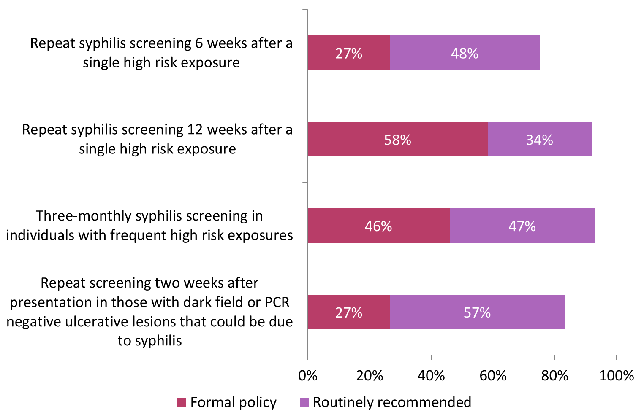
Clinic policy/practice on testing

Slide 9
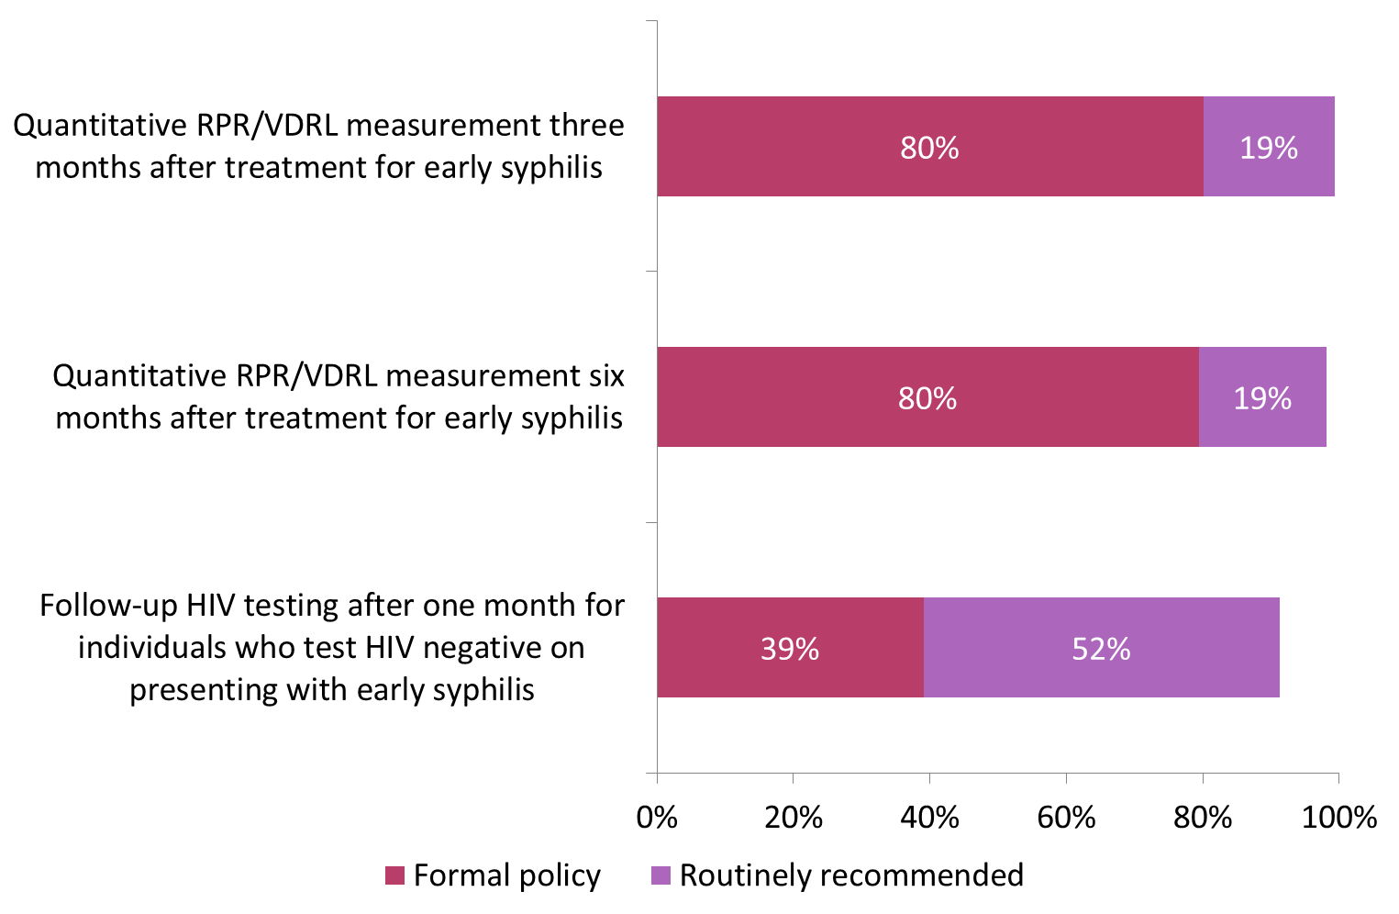
Clinic policy/practice on follow-up
Notes:
All services recommended RPR/VDRL at either 3 or 6 months, and 157 of 161 did so at both time points.

Slide 10
Usual/preferred treatment for early syphilis
100% of services:
IM benzathine penicillin

Slide 11
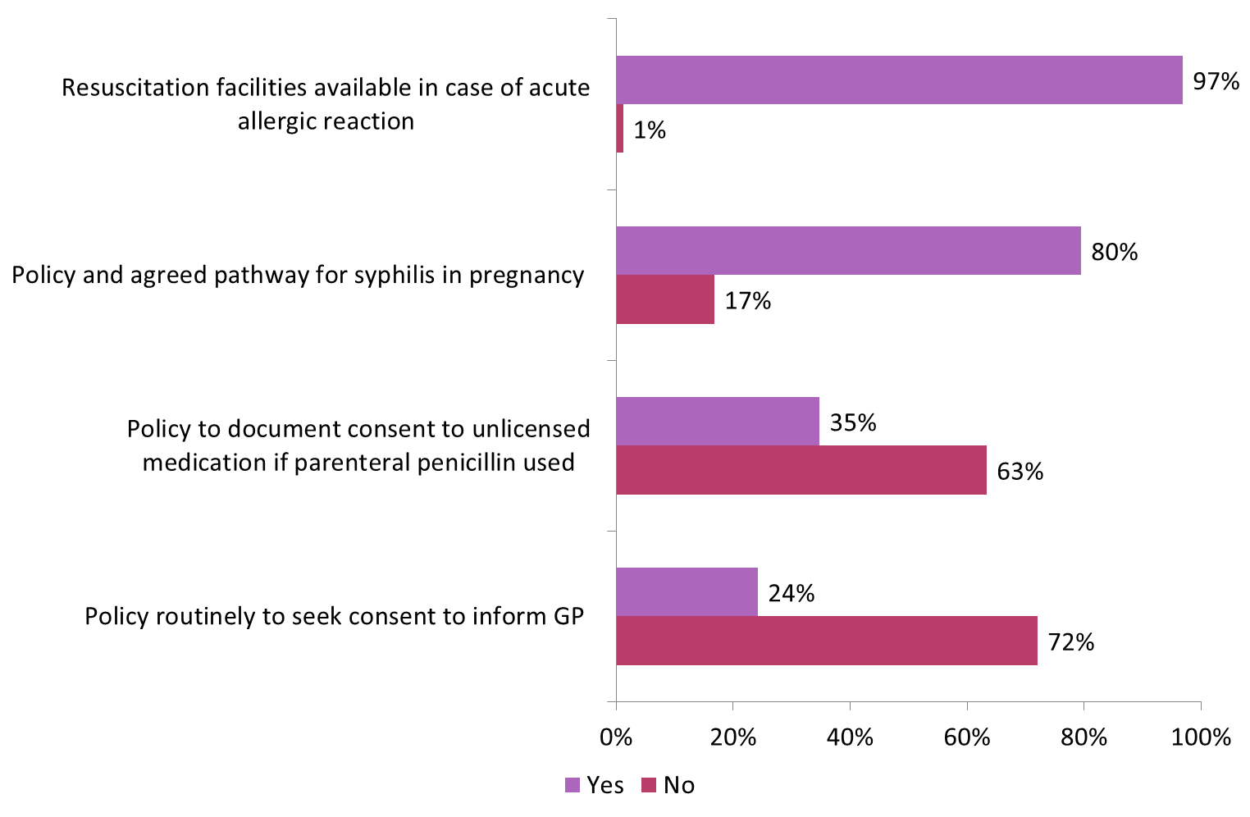
Aspects of clinical management
Notes:
Numbers do not add to 100% because of missing data and discrepant answers.

Slide 12
Written patient information
68.9% (111 services): printed FPA leaflet
31.7% (51): electronic FPA leaflet
13.7% (22): in-house leaflet
Other materials reported included BASHH leaflet and website
6.2% (10) reported no written information usually provided to syphilis patients.

Slide 13
Availability of partner notification
99.4% (160 services): patient referral
97.5% (156): provider referral
28.6% (46): electronic means of contact
Notes:
Discussed in NAG – unclear what respondents understood. Figure for provider referral is low - ?survey filled in by staff unfamiliar with the term? Possible confusion whether electronic means only purpose-designed eg ePN, or also includes ordinary email, text etc.

Slide 14
Case note review
3017 adults who presented during 2016 with early infectious syphilis

Slide 15
Characteristics of audited individuals
Gender | No (%) | Of which, gender of partner(s) | No (%)
Male | 2767 (91.7) | Male Male and female Female Trans* Not stated | 2305 (83.3) 150 (5.4) 280 (10.1) 4 (0.1) 28 (1.0)
Female | 199 (6.6) | Male Male and female Female Not stated | 186 (93.5) 1 (0.5) 8 (4.0) 4 (2.0)
Trans* | 7 (0.2) | Male | 7 (100.0)
Not stated | 44 (1.5) | Male Male and female Female Not stated | 33 (75.0) 4 (9.1) 3 (6.8) 4 (9.1)
*All trans audited individuals and partners had been assigned male at birth.

Slide 16
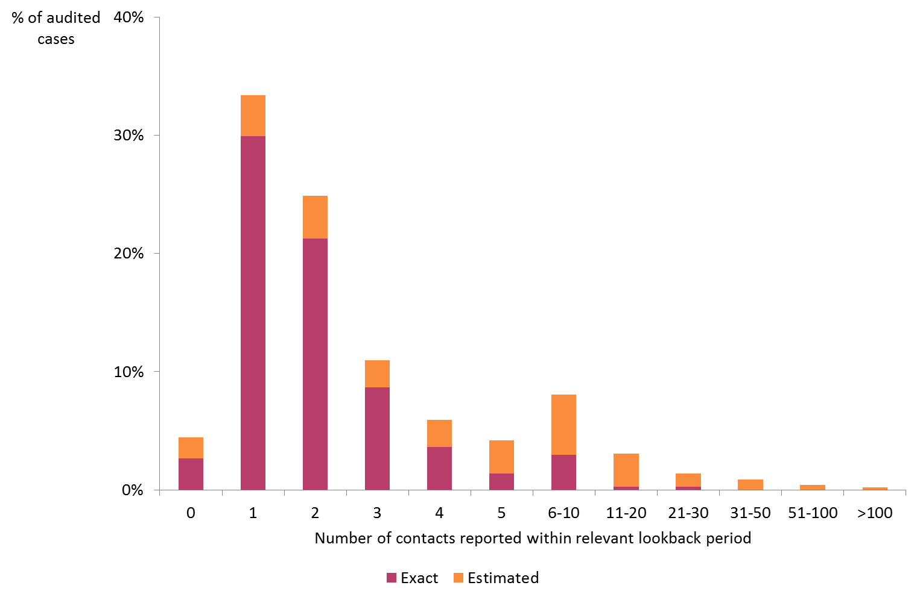
Numbers of partners reported
Notes:
Note horizontal axis, grouped categories for 6-10 upwards.
The question was: “How many contacts had the patient had during the relevant partner notification look back period? Enter a whole number, even if estimated.” Hence time period will have varied for different individuals.
Respondents were asked NOT to include the index case for audited individuals who attended as a partner of a syphilis index case

Slide 17
Clinical status
Syphilis stage | No (%)
Early asymptomatic/incubating | 276 (9.1)
Primary | 1045 (34.6)
Secondary | 774 (25.7)
Early latent | 887 (29.4)
Not answered | 35 (1.2)
Neurological or ophthalmic involvement was suspected in 63 cases.
This does not represent the prevalence of such involvement because clinics were invited to select individuals using SHHAPT codes A1, A2, A3, leading to exclusion of neurosyphilis cases coded A5, even if early.
Notes:
Not directly relevant to the audit, but:
Suggestion that need guidance on coding of early syphilis with neurological involvement – it should be possible to code A1/2/3 AND A5. Currently it seems that if this is done only the A5 code is retained in surveillance statistics.

Slide 18
Circumstances of diagnosis
Reason for attending | No (%)
Routine GUM screen | 713 (23.6)
Symptoms due to syphilis | 1174 (38.9)
Symptoms not due to syphilis | 300 (9.9)
As partner of syphilis index case | 244 (8.1)
As partner of non-syphilis index case | 62 (2.1)
Syphilis already diagnosed elsewhere | 232 (7.7)
Other | 292 (9.7)
Individuals reported as “other” included 162 (5.4% of all cases) diagnosed via routine monitoring of HIV infection, and 21 (0.7%) attending for PEP.

Slide 19
Outcome: pre-treatment RPR/VDRL
2860 (94.8%) had quantitative RPR/VDRL measurement on pre-treatment sample, taken on day of treatment for 1702 (56.4%)
80 (2.7%) not done
77 (2.6%) not answered
97% standard: not confirmed as met
Notes:
If individuals for whom question was not answered are excluded, then target was met (97.3%).
29 (36%) individuals for whom pre-treatment RPR/VDRL was reported not done were in major London clinics – discussion in NAG suggests this may be error in recording.

Slide 20
Outcome: full adherence to a recommended regimen
3017 cases
3003 (100%)
2554 (85.0%) IM benz. penicillin x1
429 (14.3%) other suitable regimen
Exclude 14 treated elsewhere
10 (0.3%) not treated
10 (0.3%) suitable regimen not reported
349 (11.6%) adhered
68 (2.3%) not documented/not answered
12 (0.4%) not fully adhered
96.7%
97% standard: not confirmed as met
Notes:
If individuals for whom treatment completion was not documented are excluded from denominator, then target was met (98.9%)

Slide 21
Outcome: contact action documented
2227 (73.8%) of index cases had agreed contact action(s), or decision not to contact, documented for all contacts
532 (17.6%) not documented for all contacts
258 (8.6%) not sure or not answered
97% standard: not met
Notes:
Suggestion in NAG that this may reflect not documenting when a decision has been made not to contact, because contact is deemed uncontactable

Slide 22
Outcome: contacts attending
Contacts per audited index case attending during 4 weeks following first PN interview:
0.45 verified by health care worker
0.49 reported by patient
0.94 in total
Standard 0.4 verified, 0.6 total: met
Notes:
To discourage/avoid double-counting, the question asked for:
Number of contacts verified by a health care worker as having attended
Number of additional contacts NOT verified by a health care worker but reported by patient as having attended

Slide 23
Outcome based on PNS coding
England data 2016:
0.61 contacts (PNS) per syphilis index case (A1/2/3)
12% of tested contacts had syphilis
This audit:
244 (8.1%) individuals with syphilis had attended as syphilis contacts
221 contacts expected from England data (3017*0.61*0.12 = 221)
This represents 0.67 contacts per index case, consistent with England data
Notes:
When presenting, stress that England-only analysis is because reporting system includes attendance as a contact – comparable data not available for eg Scotland
Suggestion to update with 2016 data but I don’t think PNS/T3/T4 info has been published.

Slide 24
HIV status
877 (29.1%) already known positive
75 (2.5%) tested positive at start of episode
2003 (66.3%) tested negative at start of episode
54 (1.8%) not tested at start of episode
8 (0.3%) not answered
Notes:
Following NAG discussion I’ve looked at the 54 not tested. They’re slightly less likely to be exclusively MSM than individuals who had a test – 61% v 70%. Also 20% of them had been referred in after diagnosis of syphilis elsewhere. I don’t think we can draw any meaningful conclusions.

Slide 25
Follow-up of HIV negatives/untested
1004 (50.1%) of 2003 who initially tested negative were re-tested 3-6 weeks later
13 (24.1%) of 54 not initially tested were tested at 3-6 weeks
383 (48.1% of 797) individuals with primary syphilis who were initially HIV negative or untested did not receive a follow-up test at 3-6 weeks.

Slide 26
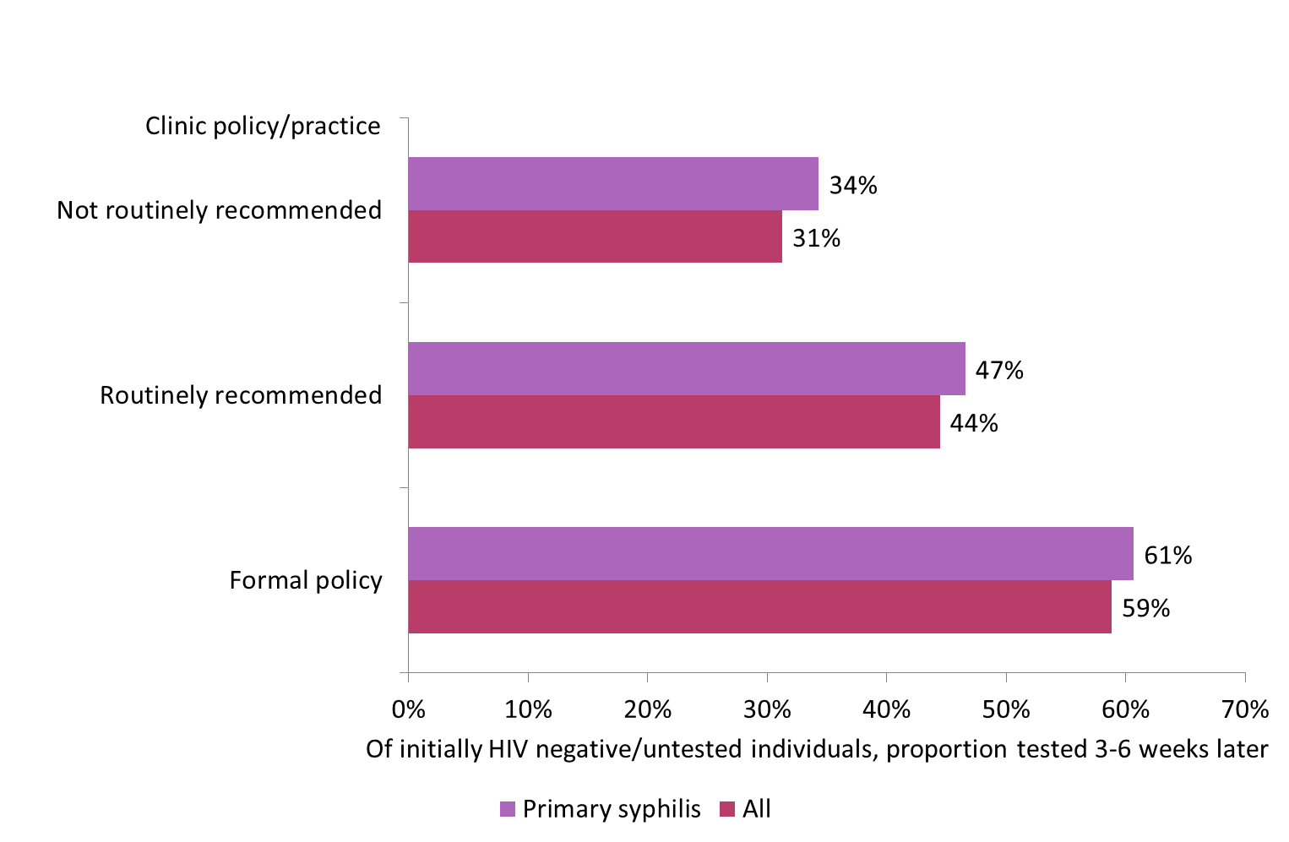
Follow-up HIV testing of audited cases according to clinic policy/practice as reported in survey

Slide 27
Summary of outcomes
Management of syphilis was generally good, although targets were narrowly missed:
94.8% audited individuals had pre-treatment quantitative RPR/VDRL
96.7% adhered fully to a recommended regimen
All services have a formal policy or routinely recommend quantitative RPR/VDRL at 3 and/or 6 months after treatment for early syphilis

Slide 28
Summary of outcomes, continued
PN outcomes were less encouraging:
73.8% of audited individuals had agreed contact action(s), or decision not to contact, documented for all contacts
0.94 contacts (0.45 HCW verified) were reported as attending per audited individual
But this is inconsistent with reasons for attendance as recorded at booking

Slide 29
Summary of outcomes, continued
50.1% of individuals initially testing negative for HIV were re-tested at 3-6 weeks, as were 24.1% of those not initially tested
Follow-up HIV testing rates were higher at clinics with policies supporting this

Slide 30
Recommendations
All services to ensure that contact action is completed for all patients
Caution is required with the contact attendance as reported by the patient
Consideration should be given to early follow-up HIV testing to diagnose seroconversion

Slide 31
Acknowledgements
Thanks to all participating clinical services
Planning group: L Anderson, H Curtis, E Hamlyn, A Hughes, H McClean, A Menon-Johansson, N Pal, S Scofield, A Sullivan, S Tayal.

