Slide 1
BASHH 2016 national audit: STI screening and risk assessment policy survey
Sumit Bhaduri
On behalf of the National Audit Group

Slide 2
Background
Current quality Standard –(Standards for management of STIs)-Offer of HIV tests – 97% - uptake 80%
Nil standard as regards HIV test refusal and further action (see Miller, Clarke , Patel et al)- 76% record underlying reasons. 63% offered less invasive option
Evidence to show that of MSM diagnosed with HIV in UK sexual health clinics with a prior clinic attendance, 23.7% were not tested for HIV (Clarke -poster EACS)

Slide 3
Background
BASHH guideline- Assessment of alcohol and recreational drug
Chemsex was associated with a threefold increase in the odds of having serodiscordant condomless sex and a 7.4-fold increase in the risk of sex with a risk of HIV transmission

Slide 4
Audit on Policy
STI/HIV screening and screening for management of possible problems associated with alcohol, recreational drugs and chemsex
Management of individuals who refuse HIV testing

Slide 5
Case note audit- STI screen/alcohol/recreational drugs/chemsex histoy
20 MSM attenders who are not known to be HIV positive, and
20 heterosexual attenders who are not known to be HIV positive and who have tested positive for chlamydia and/or gonorrhoea during the audited episode of care.

Slide 6
Case note Audit- patients not tested for HIV
5 MSM attenders who are not known to be HIV positive and who have not had an HIV test during the audited episode of care (they may have been previously tested), and
5 heterosexual attenders who are not known to be HIV positive and who have tested positive for chlamydia and/or gonorrhoea but have not had an HIV test during the audited episode of care (again, they may have been previously tested)

Slide 7
Participation
Survey: 142 services of which 88 (62%) level 3 (GUM) and 54 (38%) levels 3 & 2 (eg integrated)
Case note reviews | SH screening and risk assessment | Patients not tested for HIV
Total | 5493 (100%) | 1282 (100%)
MSM | 2790 (51%) | 602 (47%)
M heterosexual | 1296 (24%) | 275 (21%)
F heterosexual | 1408 (26%) | 405 (32%)

Slide 8
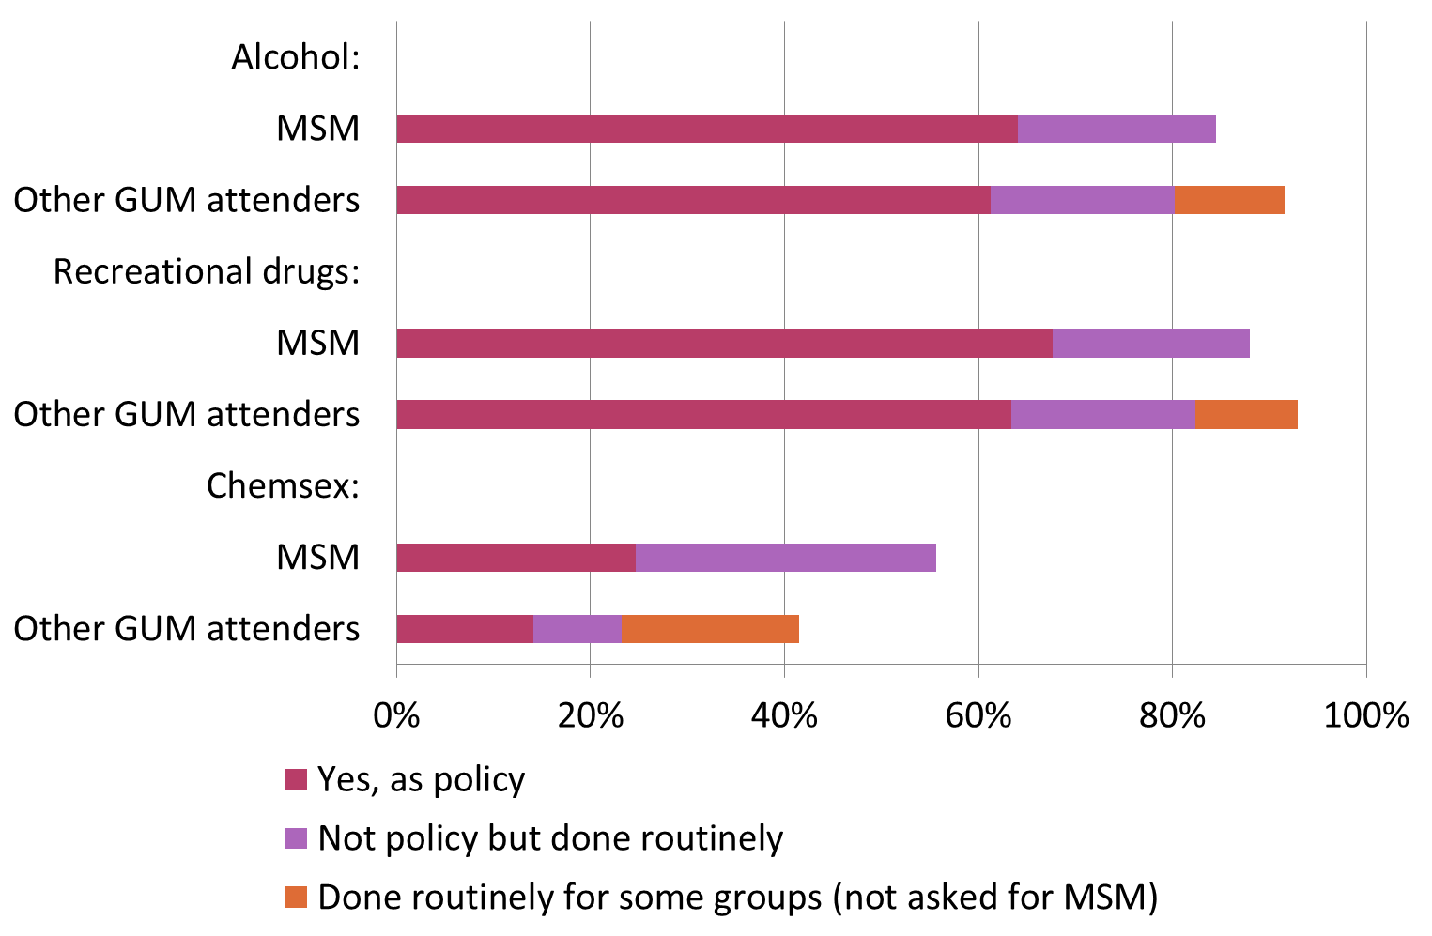
Policy to routinely take risk history
43%

Slide 9
Use of screening tools
 | number | %
ALCOHOL- FAST tool | 31 | 22
Other tool | 22 | 16
No standard tool | 88 | 62
Rec drugs- yes | 26 | 18
no | 115 | 81
Chem sex Yes | 13 | 9
no | 126 | 89

Slide 10
Agreed common pathway for patients disclosing substance abuse
  109 (76.8%) services have an agreed care pathway for alcohol
  100 (70.4%) have one for recreational drugs
  57 (40.1%) have one for chemsex

Slide 11
Case note review- sexual health screening and risk assessment
 | Offered full screen, including tests for chlamydia, gonorrhoea, syphilis and HIV | Reason recorded if not offered
Total | 5257 (95.7%) | 108 (56.5%)
MSM | 2687 (96.3%) | 60 (66.7%)
M heterosexual | 1256 (96.9%) | 19 (70.4%)
F heterosexual | 1314 (93.3%) | 29 (39.2%)

Slide 12
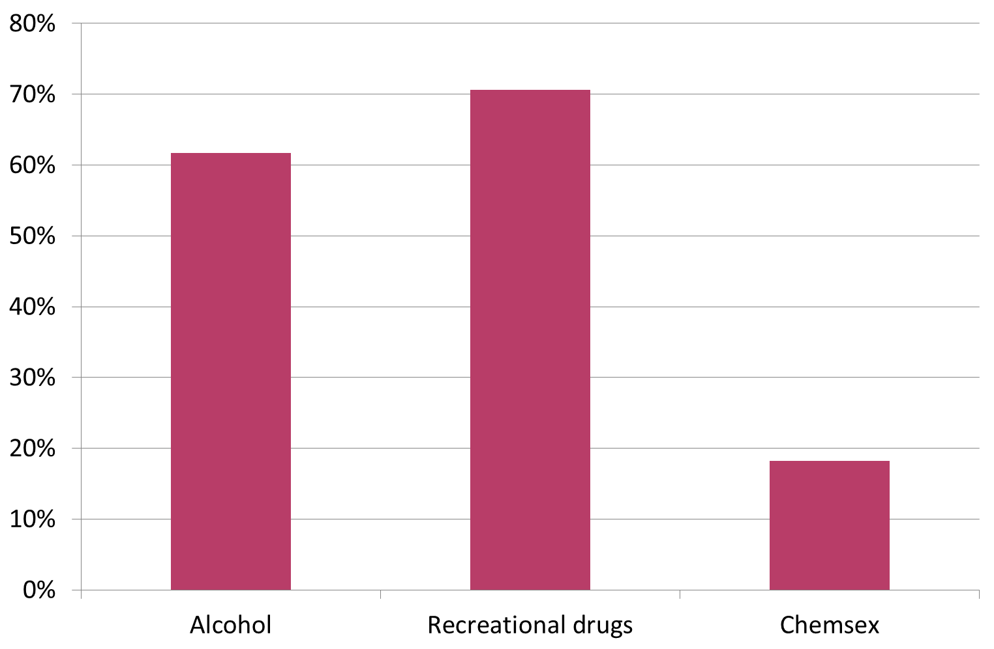
Risk history-seeking
Risk histories were sought from patients as follows:
  61.7% alcohol (54.4% history taken, 7.0% non-user, 0.2% declined)
  70.6% recreational drugs (36.1% history taken, 34.4% non-user, 0.2% declined)
  18.2% chemsex (8.1% history taken, 10.0% non-user, 0.1% declined)

Slide 13
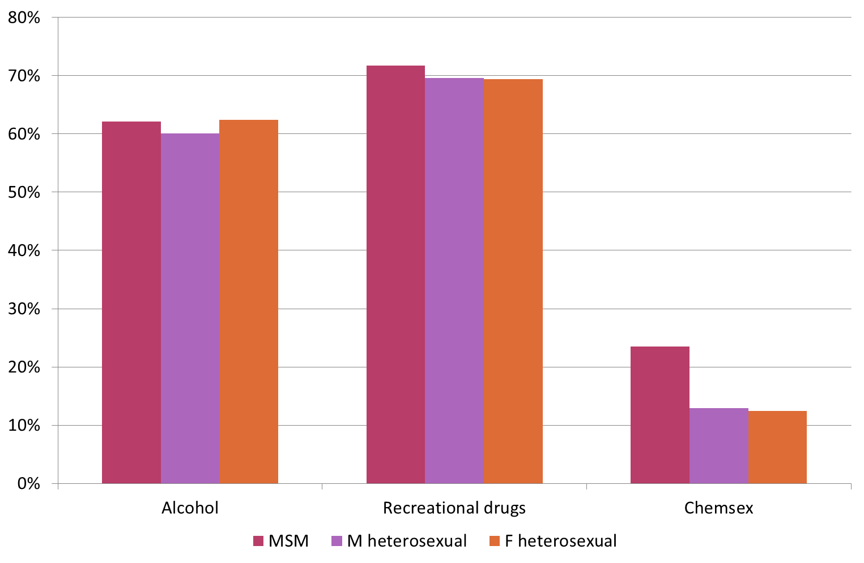
History-seeking by patient type

Slide 14
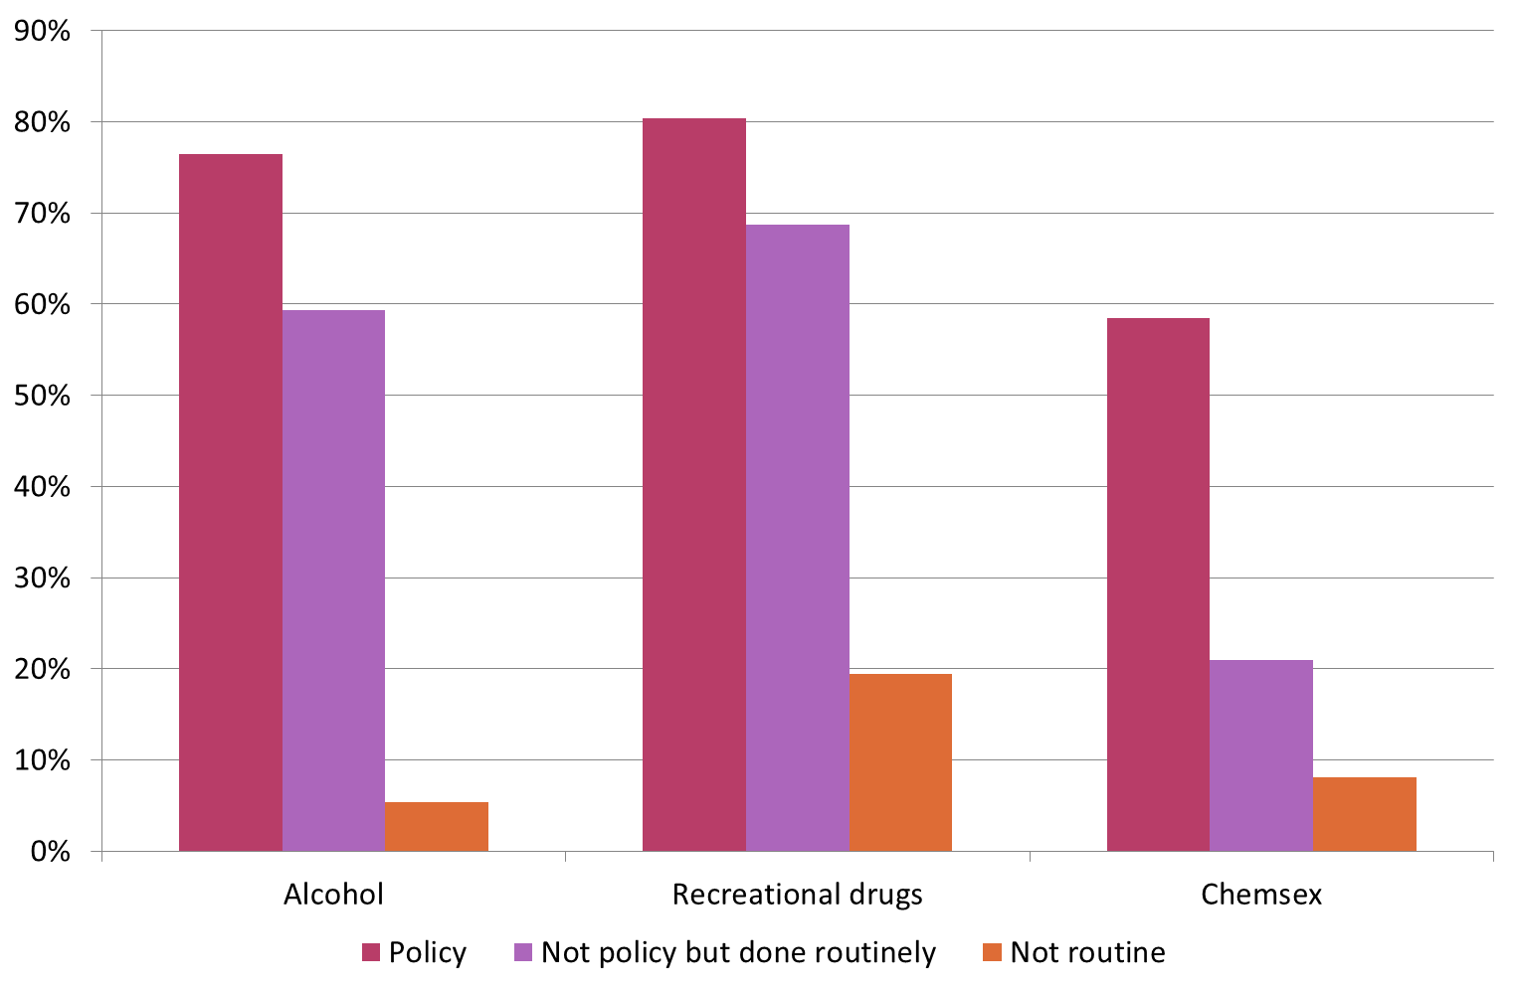
History-seeking by site policy
NB: data shown is for MSM only because the policy question was framed differently for other patient groups.

Slide 15
Policy on managing HIV test refusals
 | MSM | Heterosexuals
Written policy in place | 22 (15.5%) | 21 (14.8%)
Common agreed clinical practice | 101 (71%) | 92 (64.8%)
Neither | 19(13.4%) | 26 (18.3%)
No answer | 0 | 3 (2.1%)

Slide 16
Recording reasons for refusal of venepuncture
81% stated had policy
16.2% stated nil
90 (63.4%) sites have an alternative available at all times for attenders who refuse venepuncture:
  87 (61.3%) fingerprick, eg POCT
  12 (8.5%) oral fluid

Slide 17
Patients not tested for HIV during the current episode of care
5 MSM not tested for HIV and known not be positive
5 Heterosexuals testing positive chlamydia and gonorrhoea not tested for HIV

Slide 18
Whether HIV test offered
 | MSM | M heterosexual | F heterosexual | Total
Offered by clinician, declined by patient | 435 (72.3) | 229 (83.3%) | 316 (78.0%) | 980 (76.4%)
Not offered | 74 (12.3%) | 15 (5.5%) | 31 (7.7%) | 120 (9.4%)
Not recorded whether offered | 81 (13.5%) | 26 (9.5%) | 47 (11.6%) | 154 (12.0%)
Not answered | 12 (2.0%) | 5 (1.8%) | 11 (2.7%) | 28 (2.2%)

Slide 19
Whether previously tested for HIV
791 (61.7%) of all 1282 audited patients had previously been tested for HIV:
  482 (80.1%) of MSM (50.4% within last 3 months)
  117 (42.5%) of M heterosexuals
  192 (47.4%) of F heterosexuals

Slide 20
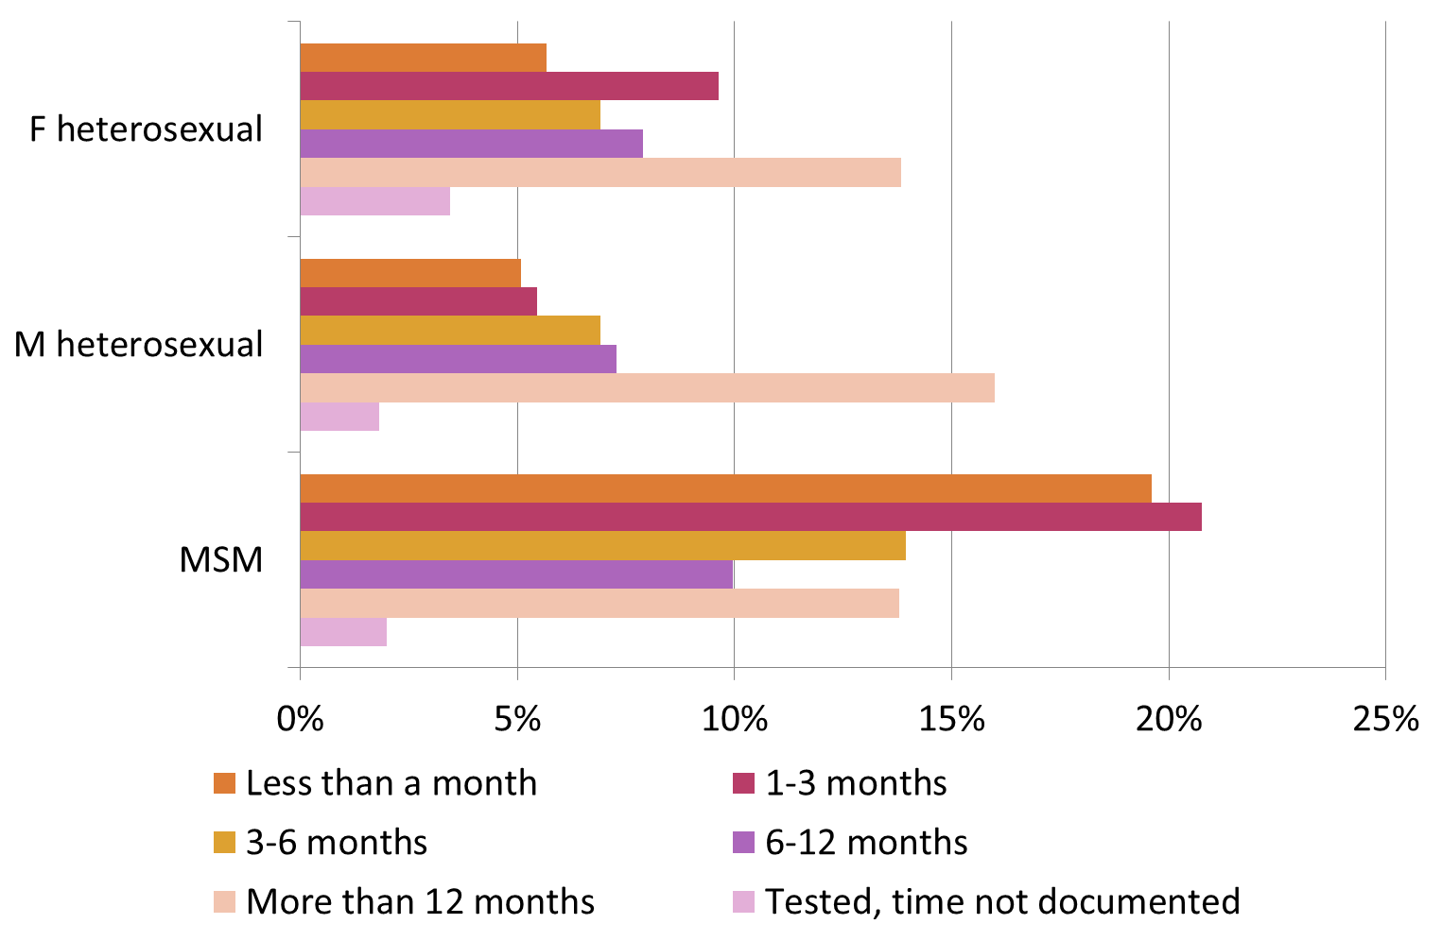
Time since most recent test
Notes:
54% of MSM had been tested within previous 6 months.

Slide 21
Documentation of reasons for not testing for HIV
774 (60.4%) of all patients had a reason for not testing documented in the record:
  422 (70.1%) of MSM
  144 (52.4%) of M heterosexuals
  208 (51.4%) of F heterosexuals

Slide 22
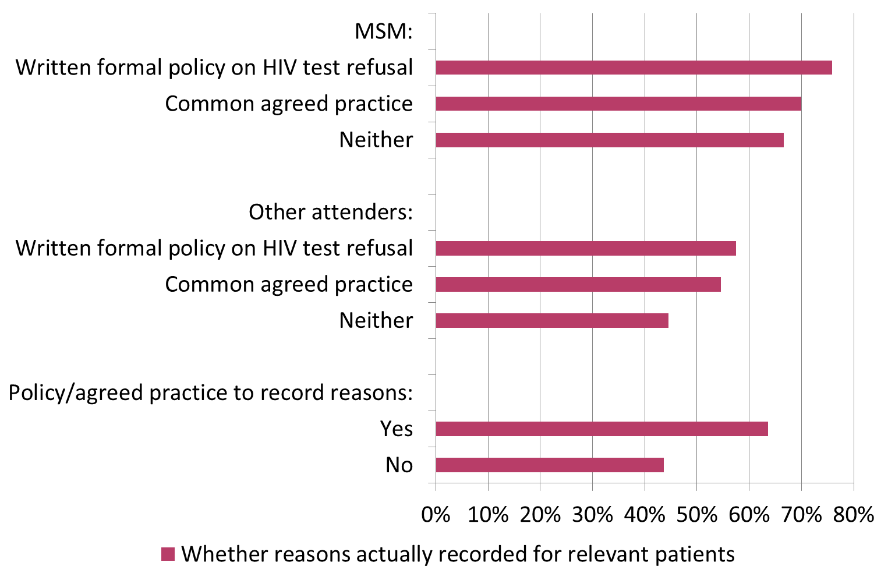
Recording of reasons by site policy

Slide 23
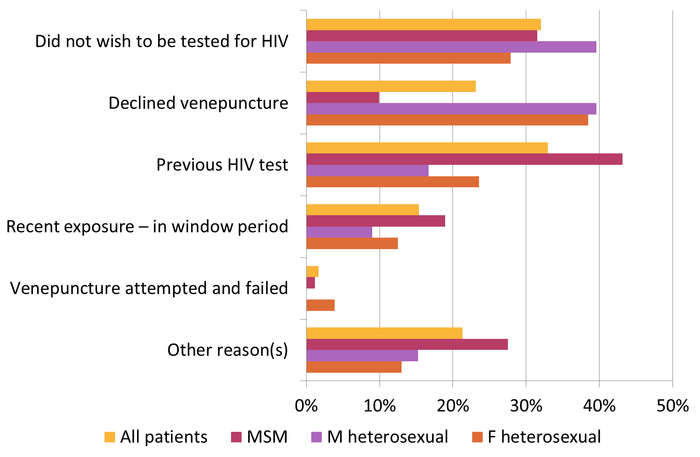
Reasons for not testing
NB: more than one reason could be selected.

Slide 24
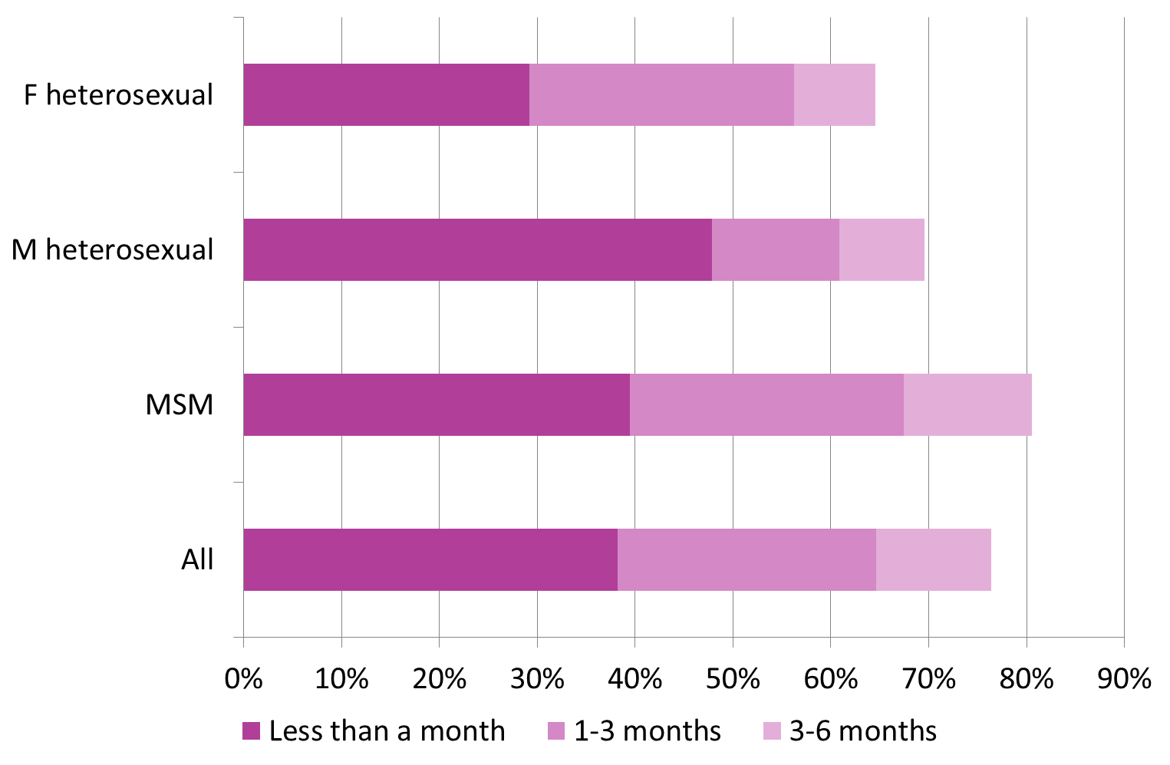
Time since previous test, among those not testing for this reason

Slide 25
Window period
Of 119 individuals not tested because of “recent exposure – in window period”, last exposure was:
  106 (89.1%) less than 4 weeks previously
  9 (7.6%) 4-8 weeks previously.
However, 21 (17.6%) had other earlier risk(s) of HIV not covered by a previous test (12/21- MSM). 5 of these 21 also had other reasons given (recent previous test or did not wish to be tested for HIV).
Notes:
The timing of the last exposure was not documented for 3 individuals for whom “recent exposure – in window period” was cited as a reason for testing, and for the remaining 1 this question was not answered.

Slide 26
Alternatives to venepuncture
26 (14.5%) of 179 individuals who declined venepuncture had been offered an alternative:
  24 fingerprick
  2 both fingerprick and oral fluid.
7 of these 26 individuals also had other reasons reported (recent previous test and/or did not wish to be tested for HIV).

Slide 27
Provision of information about other ways of accessing HIV testing
 | MSM | M heterosexual | F heterosexual | Total
Information about community/voluntary providers of testing | 6.3% | 1.8% | 0.5% | 3.5%
Information about home testing/sampling kits | 1.7% | 0.7% | 0.5% | 1.1%

Slide 28
Follow-up action planned or undertaken
 | MSM | M heterosexual | F heterosexual | Total
Offer of testing after future episode of risk | 19.4% | 8.4% | 11.1% | 14.4%
Re-call for testing at a later date | 12.3% | 6.2% | 7.9% | 9.6%
Record flagged to discuss at next attendance | 8.8% | 2.5% | 5.2% | 6.3%
HA/other clinician to call patient to discuss | 6.6% | 4.4% | 4.4% | 5.5%
Offer of annual testing | 3.8% | 1.5% | 1.2% | 2.5%
Other | 15.9% | 9.5% | 7.9% | 12.0%
None | 47.0% | 73.1% | 68.4% | 59.4%

Slide 29
Conclusions
Chemsex – no enquiry in 76.5% of MSM patients
Having policy in place correlated with more enquiries in all categories
Nil policy as regards HIV test refusal in clinics – 13.4% (MSM) and 18.3% (Heterosexuals).-Case note review showed better performance when policy in place
POCT available in 61.3% of clinics

Slide 30
Conclusions
21 (17.6%) not tested because “in window period” had earlier risks not covered by a previous test (2% of overall MSM sample)
No follow up for test refusal in 49% MSM, 67% heterosexual

Slide 31
Recommendations
Emphasis as regards adoption of universal alcohol risk assessment , recreational drug history and chemsex (MSM)
Agreed practice/guideline as regards actions on HIV test refusal - recording reasons for refusal
offer of POCT
active follow up

